Slide 1
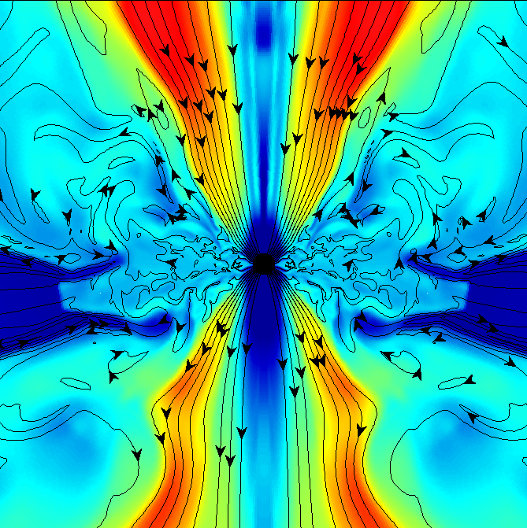
Close Binary Progenitors
Of Gamma Ray Bursts
And Hypernovae
Maxim Barkov
RIKEN ABBL, Japan
Serguei Komissarov
University of Leeds, UK

Slide 2
I. Gamma-Ray-Bursts
Discovery: Vela satellite (Klebesadel et al.1973);
Konus satellite (Mazets et al. 1974);
Cosmological origin:
1. Beppo-SAX satellite – X-ray afterglows (arc-minute resolution) ,
optical afterglows – redshift measurements – identification of host
galaxies (Kulkarni et al. 1996, Metzger et al. 1997, etc)‏
2. Compton observatory – isotropic distribution (Meegan et al. 1992);
Supernova association of long duration GRBs:
1. Association with star-forming galaxies/regions of galaxies;
2. A few solid identifications with supernovae, SN 1998bw, SN 2003dh
and others...
3. SN humps in light curves of optical afterglows.
4. High-velocity supernovae ( 30,000km/s) or hypernovae (10⁵²erg).

Slide 3

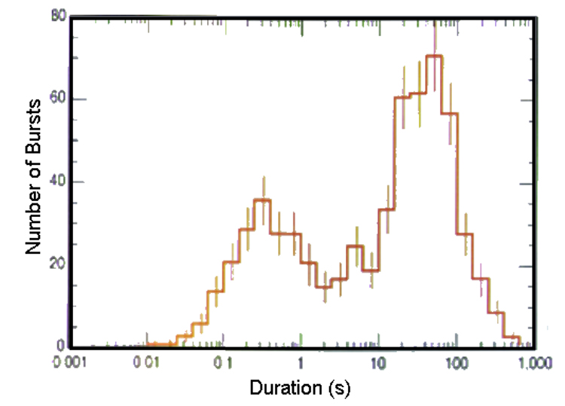
Spectral properties:
Non-thermal spectrum from 0.1MeV to GeV:
Bimodal distribution (two types of GRBs?):
long duration
GRBs
short duration
GRBs
very long
duration GRBs

Slide 4
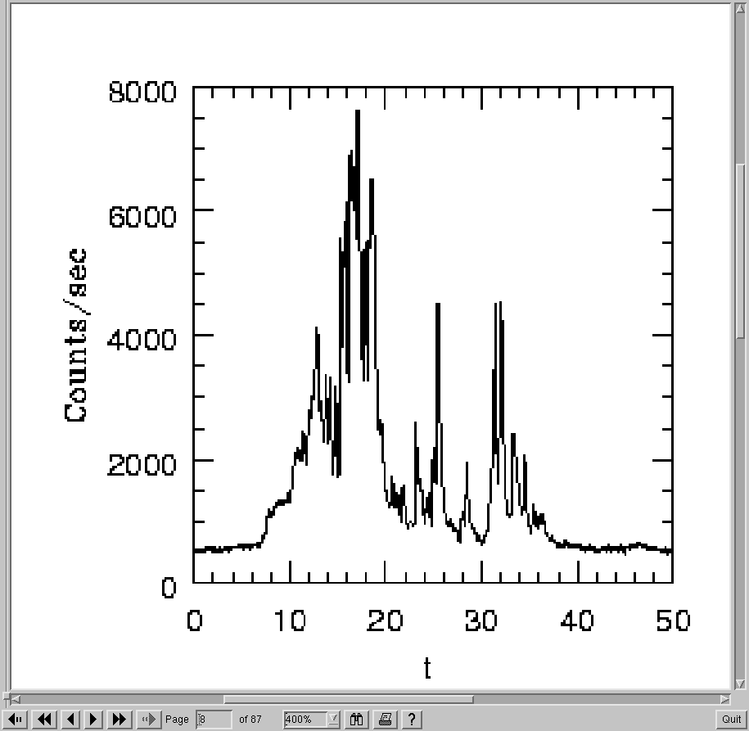


Variability:
smooth fast rise + decay;
several peaks;
numerous peaks with substructure
down to milliseconds
Total power:
assumption of
isotropic emission
Inferred high speed:
Too high opacity to unless Lorentz factor > 100

Slide 5
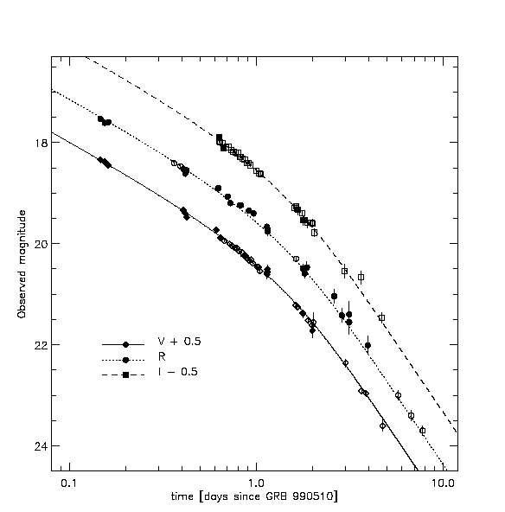

Inferred collimation:
afterglow light curve with achromatic break
beamed radiation
velocity
vector
v
(Piran, 2004)‏
decelerating and
expanding source
06/07/2014

Slide 6
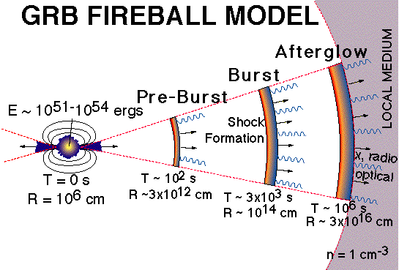
Relativistic jet/pancake model of GRBs and afterglows:
jet at birth
(we are here)
pancake later

Slide 7



Merge of compact stars – origin of short duration GRBs?
Blinnikov et al (1984);
Paczynsky (1986);
Goodman (1986);
Eichler et al.(1989);
Neutron star + Neutron star
Neutron star + Black hole
White dwarf + Black hole
Black hole + compact disk
Burst duration: 0.1s – 1.0s
Released binding energy:

Slide 8
Collapsars– origin of long duration GRBs?
Iron core collapses into a black hole:
“failed supernova”. Rotating envelope
forms hyper-accreting disk
Woosley (1993)‏
MacFadyen & Woosley (1999)‏
Collapsing envelope
Accretion disk
Accretion shock
The disk is fed
by collapsing
envelope.
Burst duration > a few seconds

Slide 9



Mechanisms for tapping the disk energy
Neutrino heating Magnetic braking
fireball
MHD wind
B
B
Eichler et al.(1989), Aloy et al.(2000)
MacFadyen & Woosley (1999)
Nagataki et al.(2006), Birkl et al (2007)
Zalamea & Beloborodov (2008,2010) ‏
Blandford & Payne (1982)‏
Proga et al. (2003)‏
Fujimoto et al.(2006)‏
Mizuno et al.(2004)

Slide 10
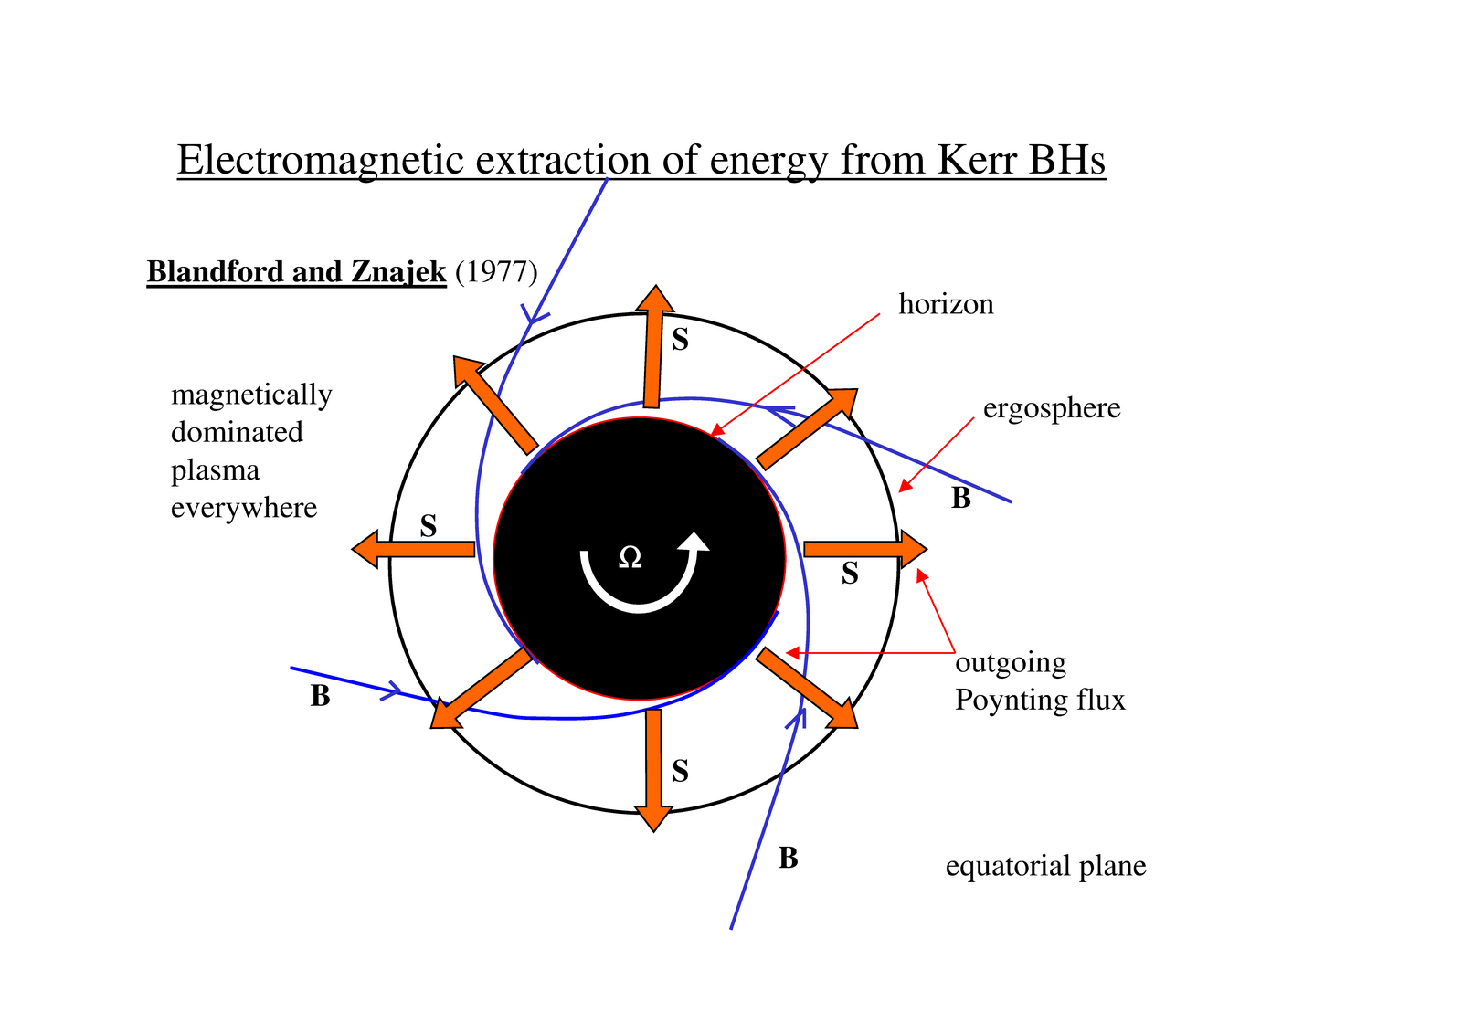

Slide 11
The possible scenario of GRB formation in close binary system with BH:

Slide 12
Numerical simulations: I
Setup
(Barkov & Komissarov 2008a,b)
(Komissarov & Barkov 2009)
black hole
M=3M_{sun}
a=0.9
Uniform magnetization
R=4500km
Ψ= 4x10²⁷-4x10²⁸Gcm⁻²
Rotation:
r_{c}=6.3x10³km
l₀ = 10¹⁷ cm² s⁻¹
2D axisymmetric
GRMHD;
Kerr-Schild metric;
Realistic EOS;
Neutrino cooling;
Starts at 1s from
collapse onset.
Lasts for < 1s
free fall
accretion
(Bethe 1990)
outer boundary,
R= 2.5x10⁴ km

Slide 13
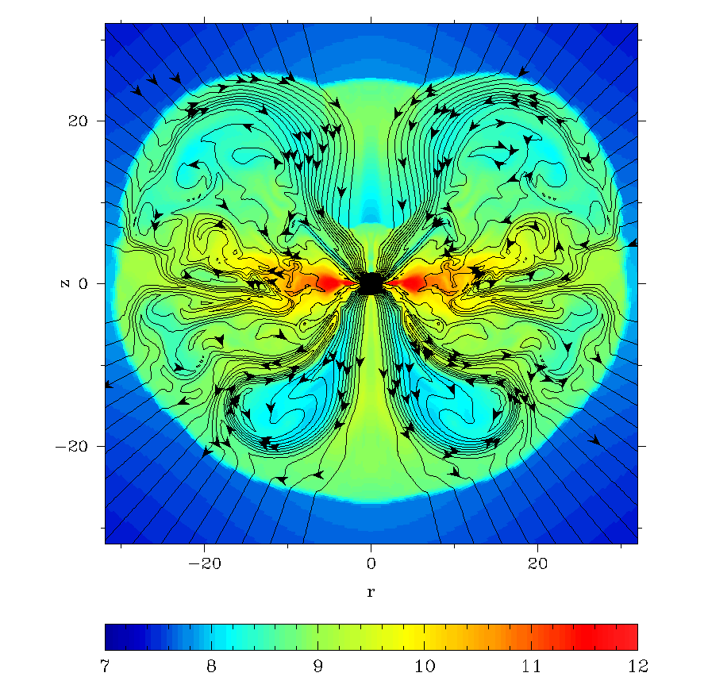
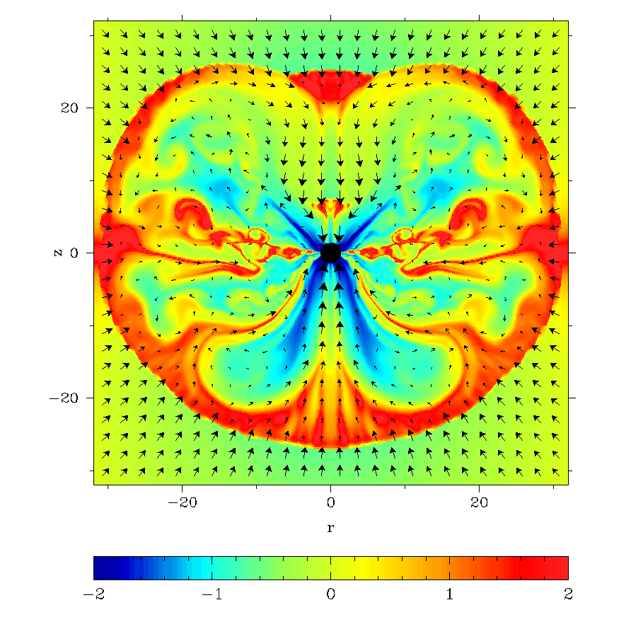
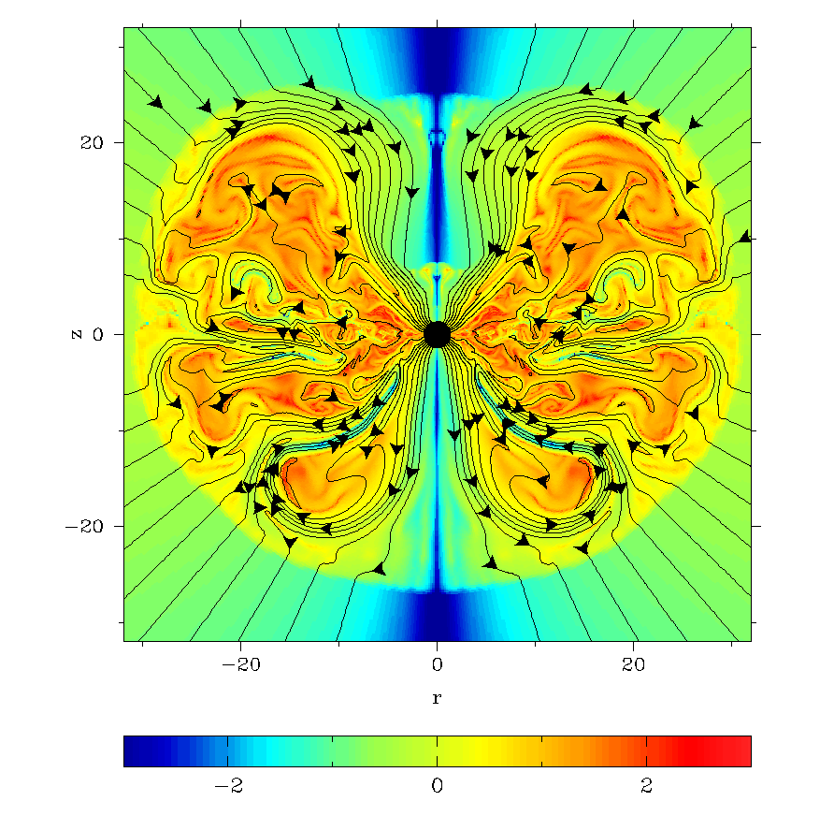
Model:A
C₁=9; B_{p}=3x10¹⁰ G
unit length=4.5km
t=0.24s
log₁₀ ρ (g/cm³)
log₁₀ P/P_{m}
log₁₀ B_{φ}/B_{p}
magnetic field lines, and velocity vectors

Slide 14
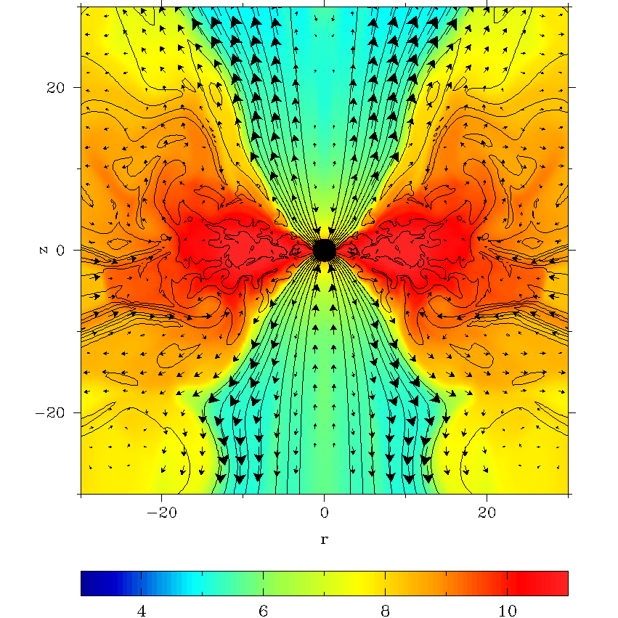
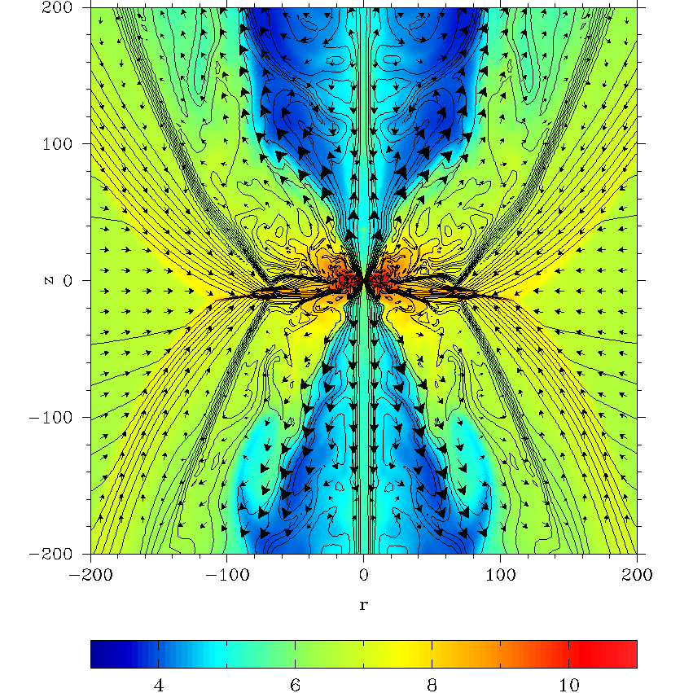
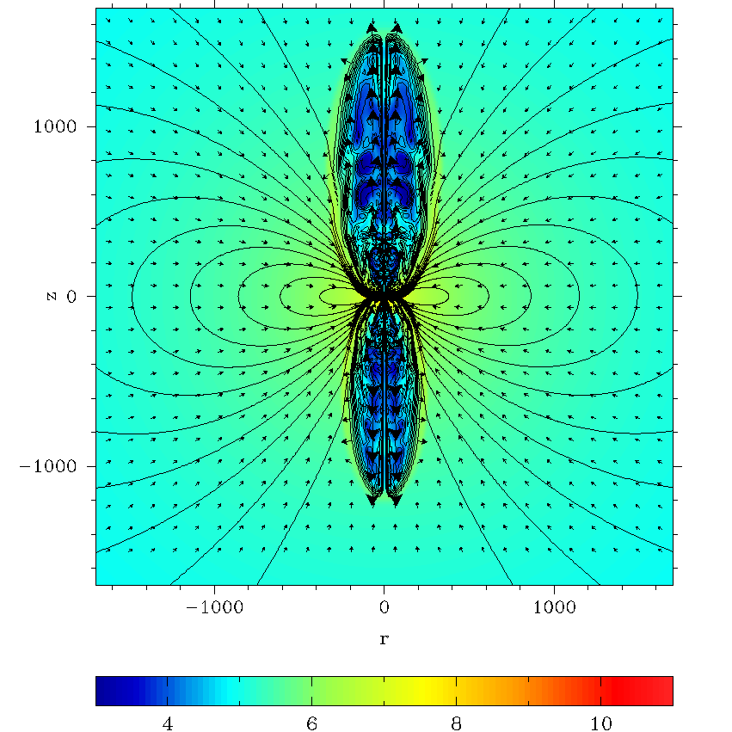
Model:A
C₁=9; B_{p}=3x10¹⁰ G
unit length=4.5km
t=0.31s
log₁₀ ρ (g/cm³)
magnetic field lines, and velocity vectors

Slide 15
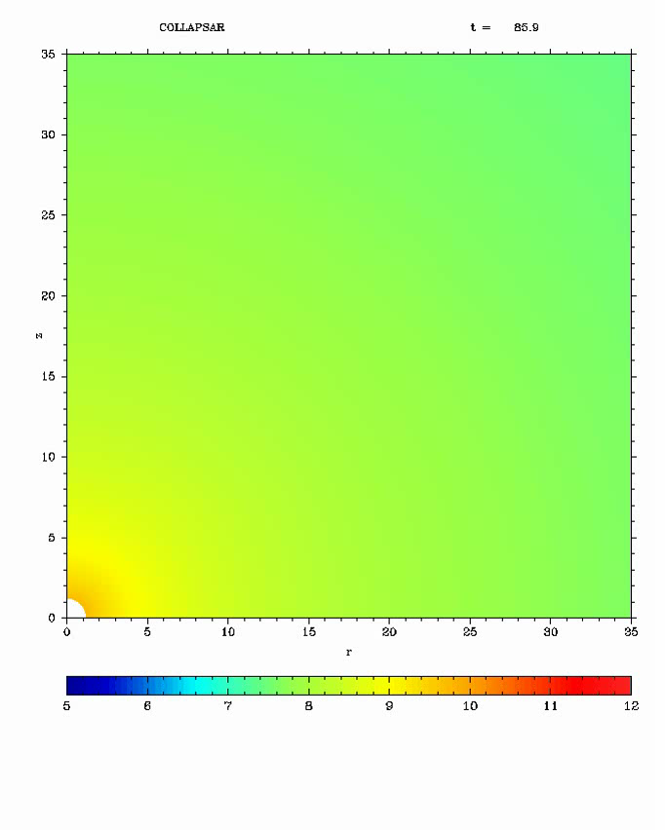
Model:A
C₁=9; B_{p}=3x10¹⁰ G
log₁₀ ρ (g/cm³)
magnetic field lines
06/07/2014

Slide 16
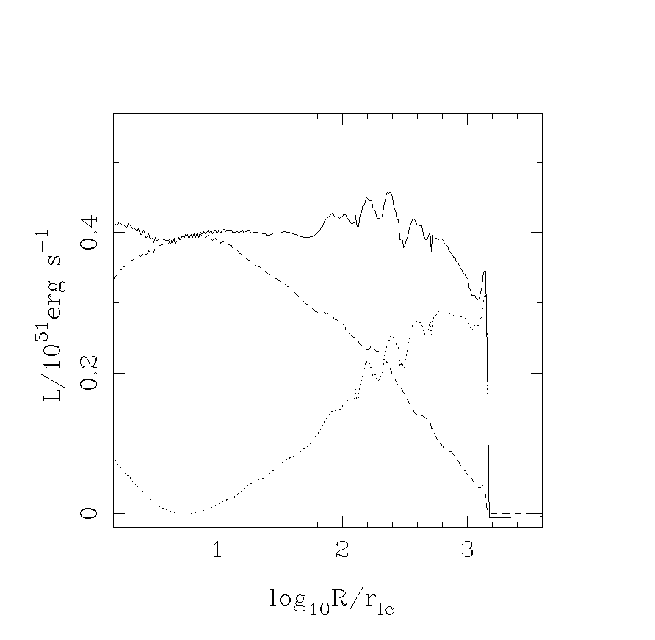
Jets are powered mainly by the black hole via
the Blandford-Znajek mechanism !!
Model: C
No explosion if a=0;
Jets originate from
the black hole;
~90% of total magnetic flux
is accumulated by the black hole;
Energy flux in the ouflow ~
energy flux through the horizon
(disk contribution < 10%);
Theoretical BZ power:

Slide 17
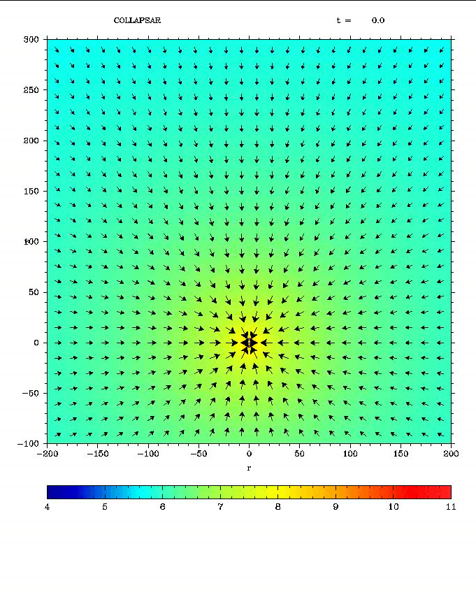
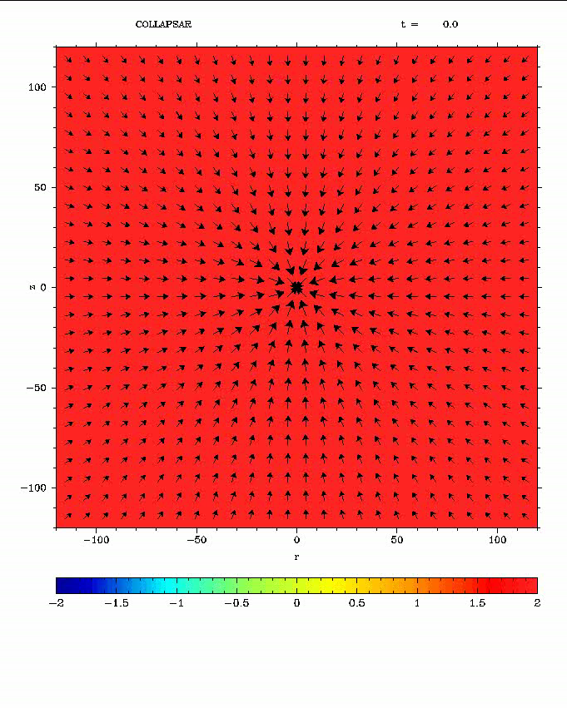

Slide 18
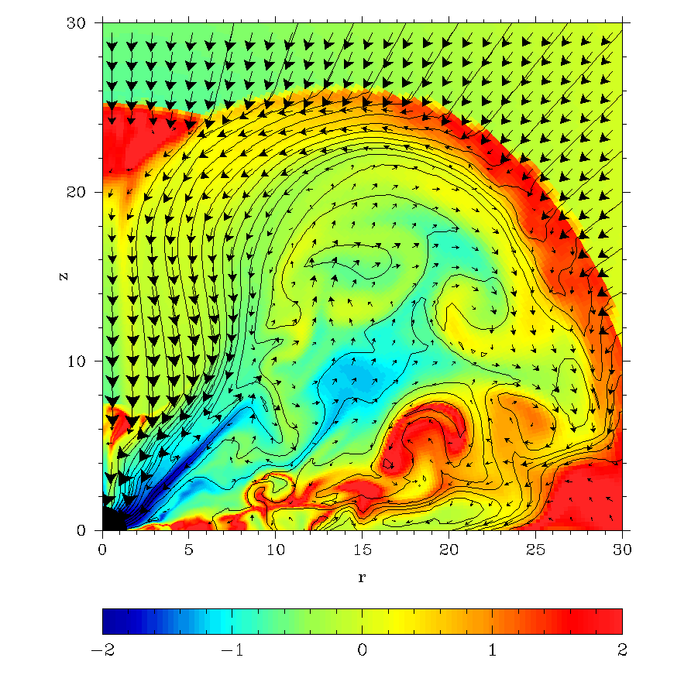

Magnetic Unloading
What is the condition for activation of the BZ-mechanism ?
1) MHD waves must be able to escape from the black hole ergosphere
to infinity for the BZ-mechanism to operate, otherwise accretion is expected.
or
2) The torque of magnetic lines from BH should be sufficient to stop accretion
(Barkov & Komissarov 2008b)
(Komissarov & Barkov 2009)

Slide 19
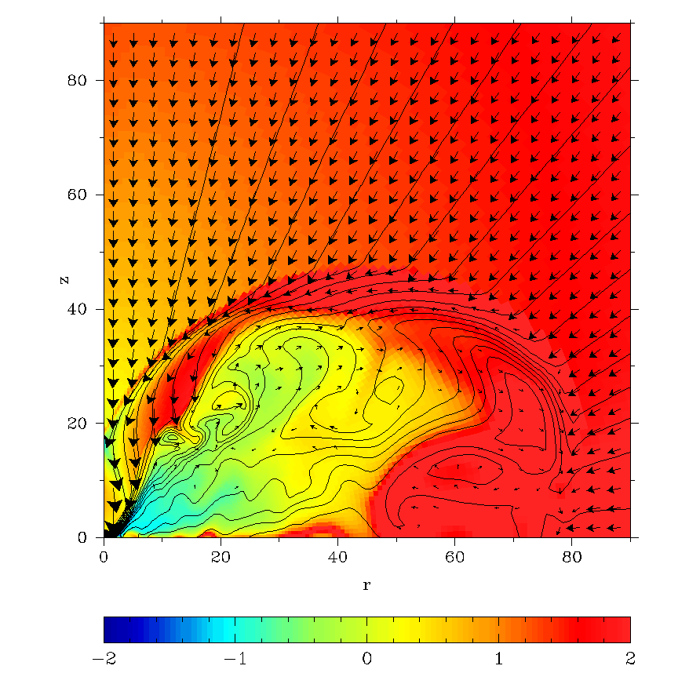
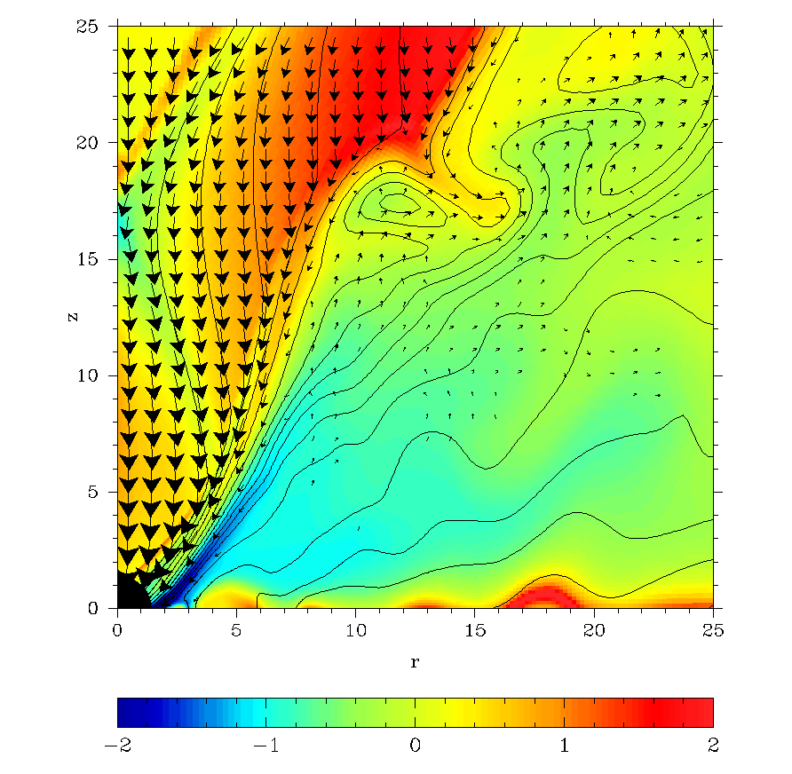
The disk accretion relaxes the explosion conditions. The MF lines’ shape reduces the local accretion rate.

Slide 20
Realistic initial conditions
Strong magnetic field suppresses the differential rotation in the star (Spruit et. al., 2006).
Magnetic dynamo can’t generate a large magnetic flux, a relict magnetic field is necessary. (see observational evidences in Bychkov et al. 2009)
In close binary systems we could expect fast solid body rotation.
The most promising candidate for long GRBs is Wolf-Rayet stars.

Slide 21
Simple model:
Barkov & Komissarov (2010)
If l(r)<l_{cr} then matter falling to BH directly
If l(r)>l_{cr} then matter goes to disk and after that to BH
Agreement with model Shibata&Shapiro (2002) on level 1%
BH

Slide 22
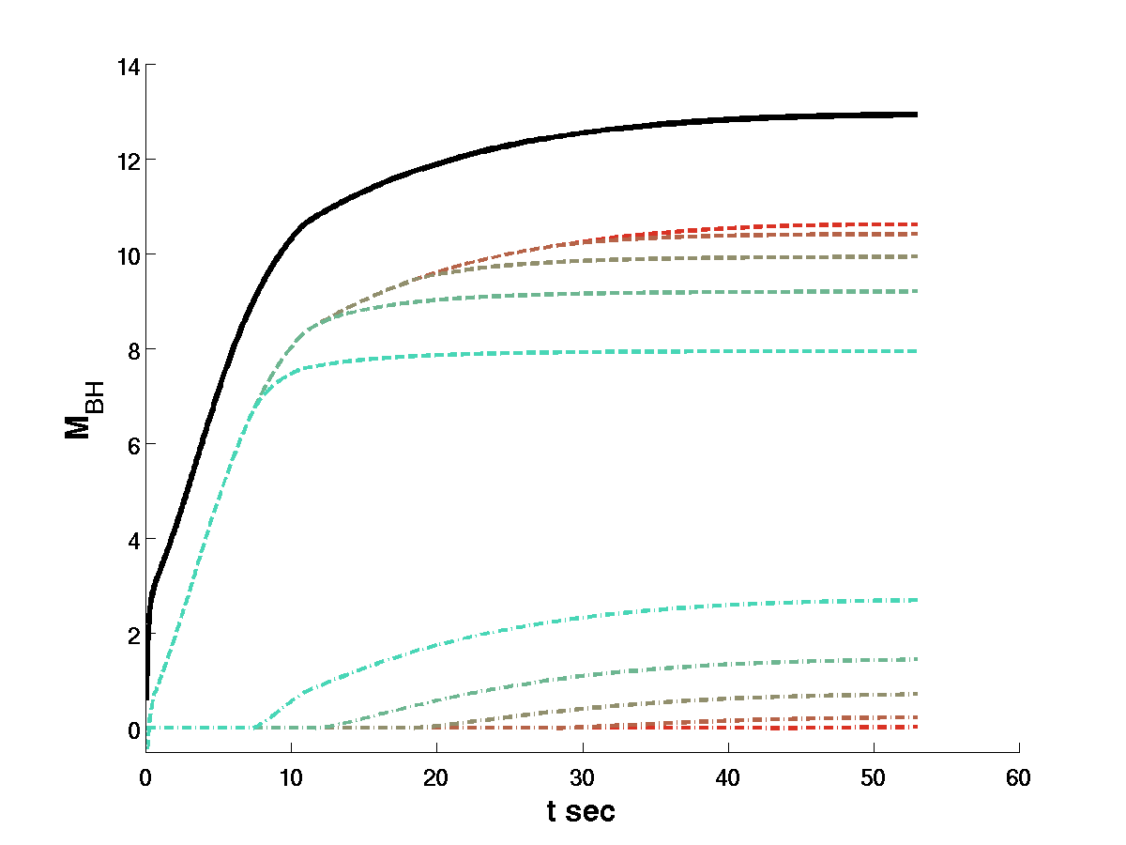
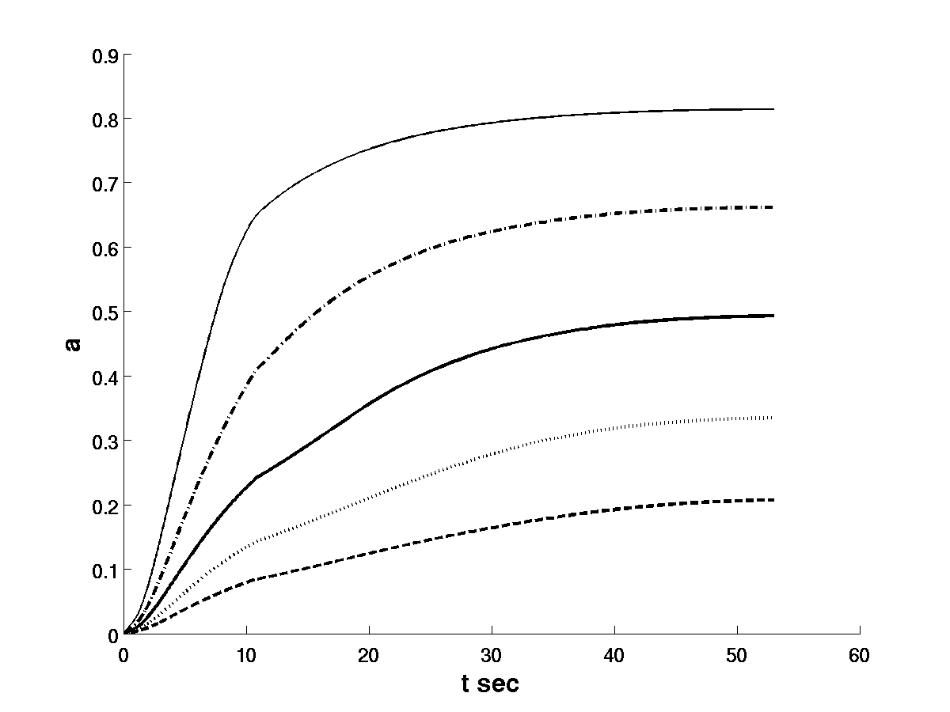
Realistic model
Heger at el (2004)
M=35 M_{sun}, M_{WR}=13 M_{sun}

Slide 23
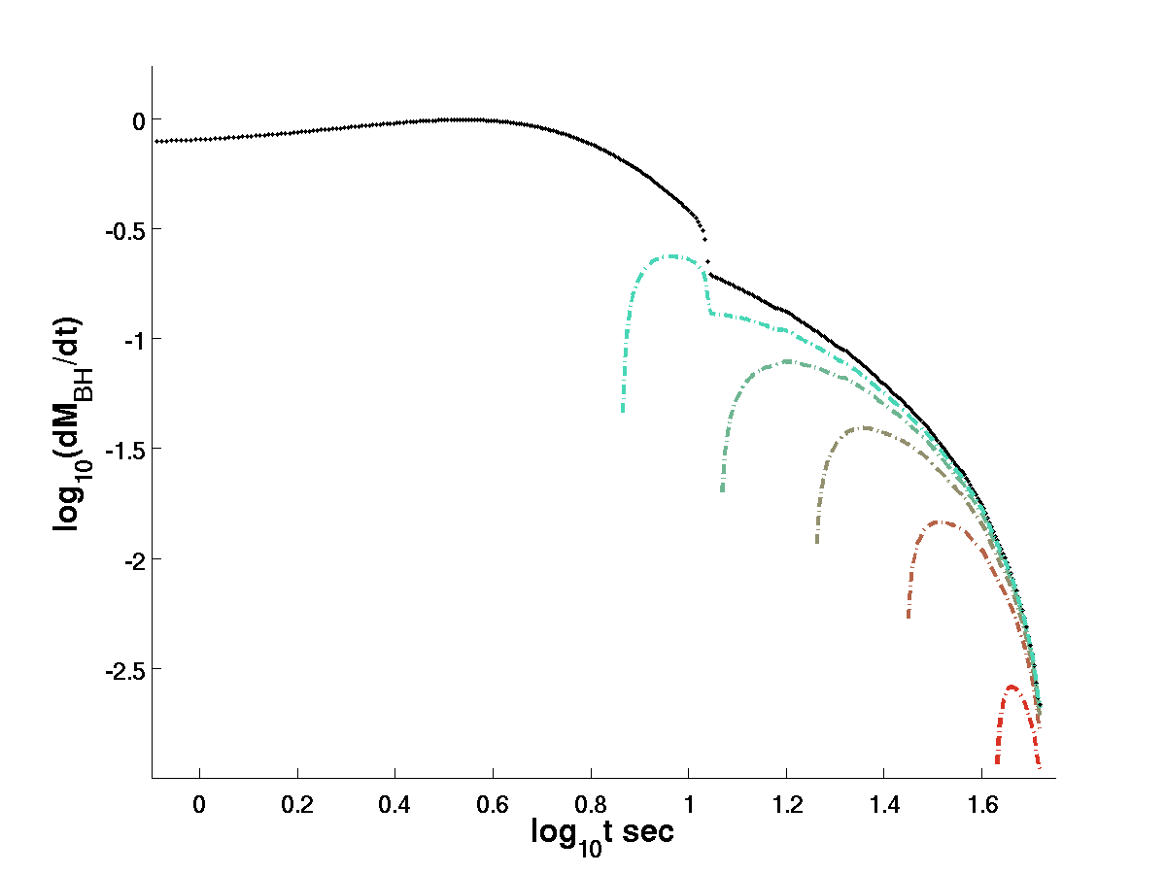
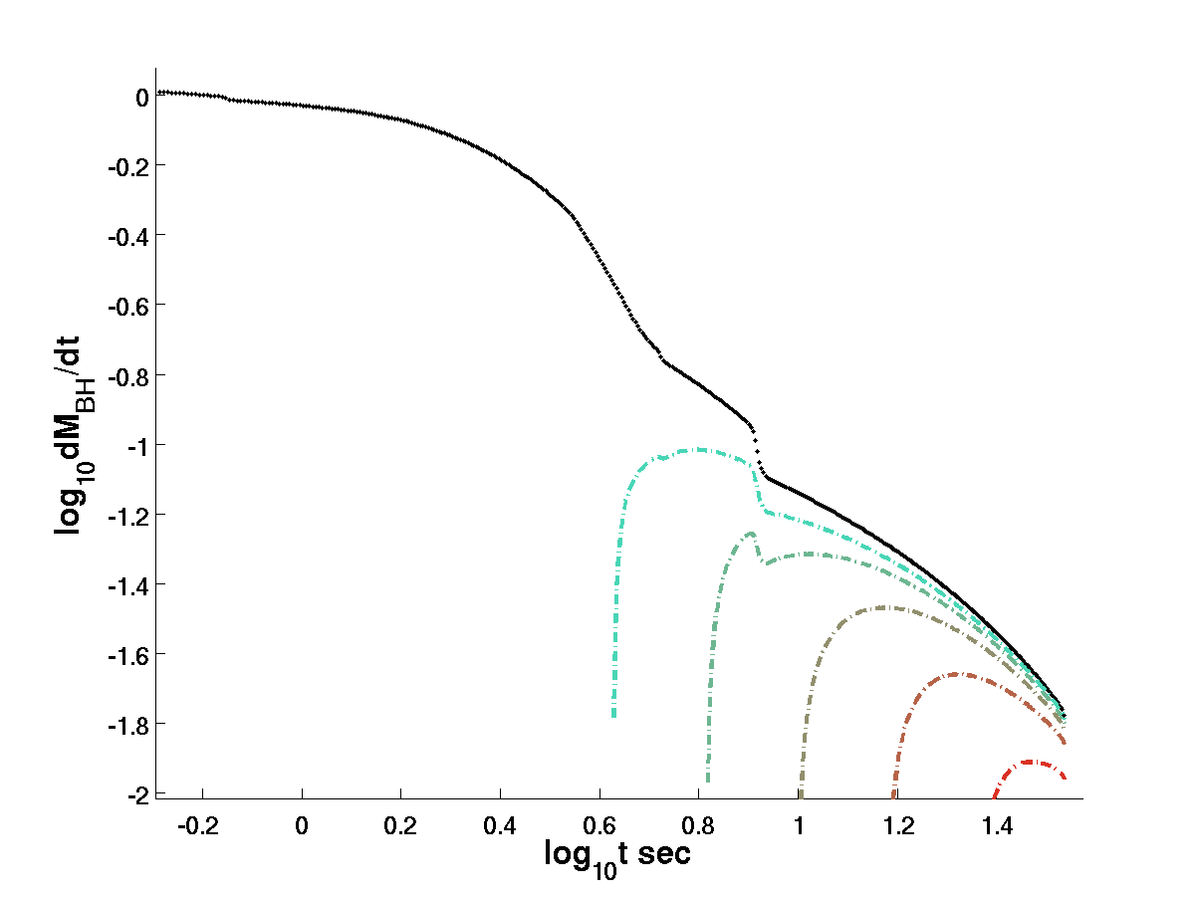
Realistic model
Realistic model
Heger at el (2004)
M=20 M_{sun}, M_{WR}=7 M_{sun}
M=35 M_{sun}, M_{WR}=13 M_{sun}
neutrino limit
BZ limit

Slide 24
Numerical simulations II: Collapsar model
Setup
GR MHD
2D
black hole
M=10 M_{sun}
a=0.45-0.6
v
Bethe’s
free fall model,
T=17 s, C₁=23
B
v
v
v
Dipolar
magnetic field
v
Initially solid
body rotation
B
Uniform magnetization
R=150000km
B₀= 1.4x10⁷-8x10⁷G
Barkov & Komissarov (2010)

Slide 25
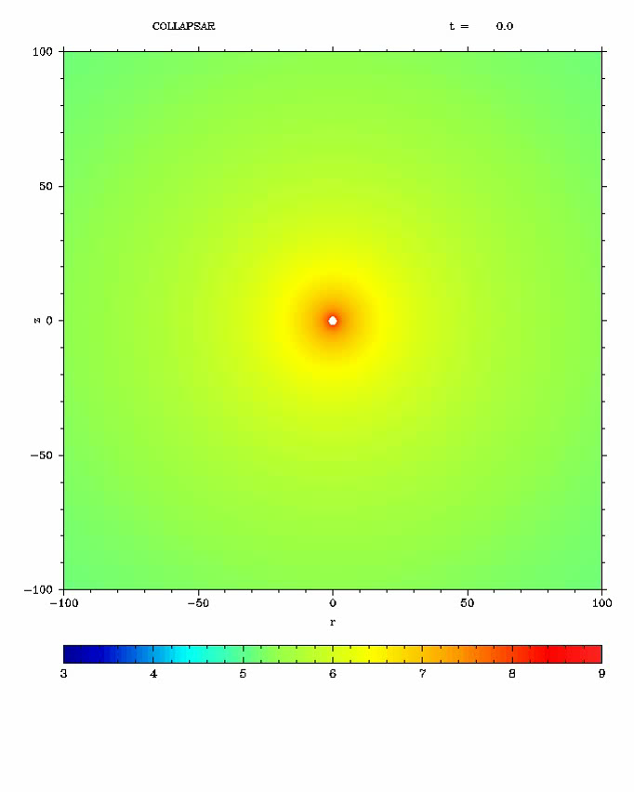
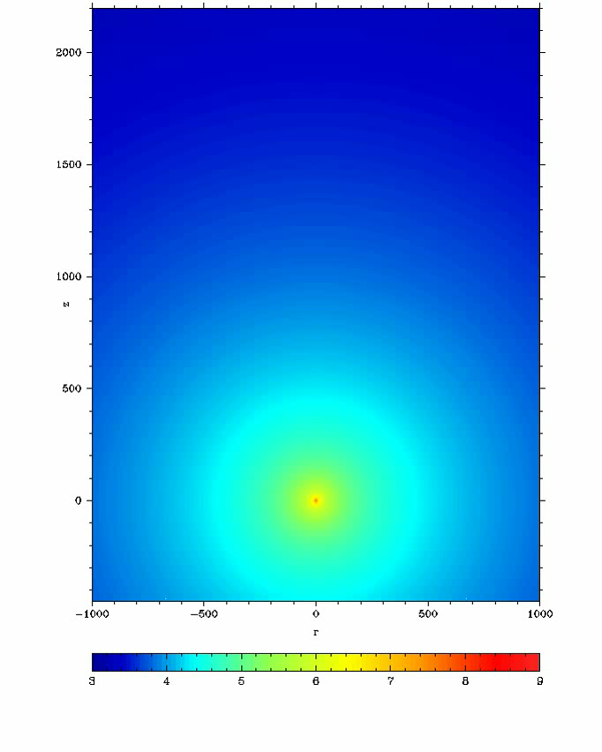
In some cases (30%) one side jets are formed.

Slide 26
2 Side jets
1 Side jet

Slide 27
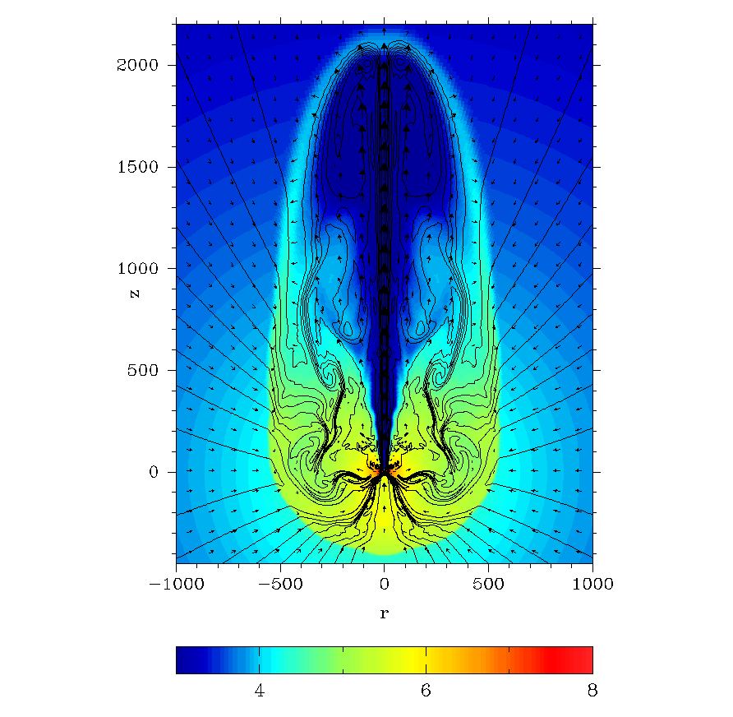
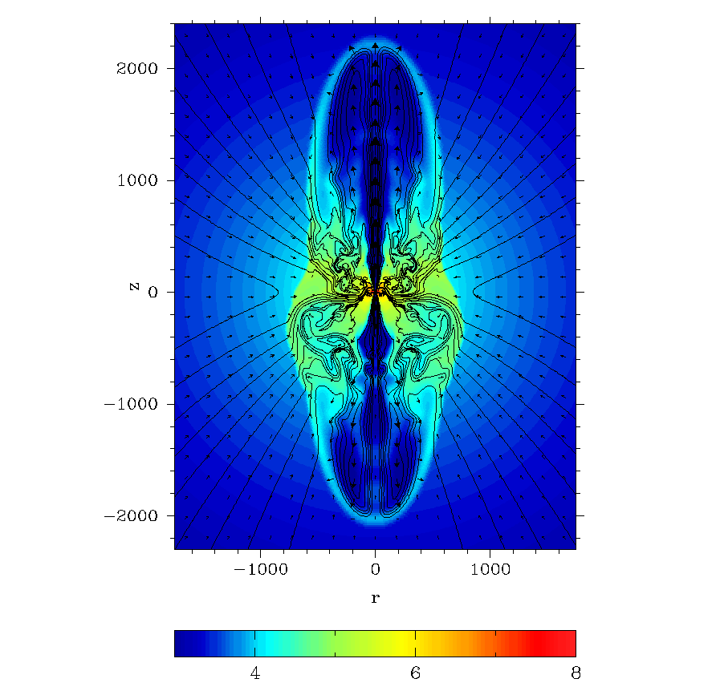
a=0.6 Ψ=3x10²⁸
a=0.45 Ψ=6x10²⁸
Model | a | Ψ₂₈ | B_{0,7} | L₅₁ | dM_{BH} /dt | η
A | 0.6 | 1 | 1.4 | - | - | -
B | 0.6 | 3 | 4.2 | 0.44 | 0.017 | 0.0144
C | 0.45 | 6 | 8.4 | 1.04 | 0.012 | 0.049

Slide 28
Common Envelop (CE):
Normal WRS
And
Black Hole
few
seconds
black hole spiralling
< 1000 seconds
disk formed
5000 seconds
MBH left behind
jets produced

Slide 29
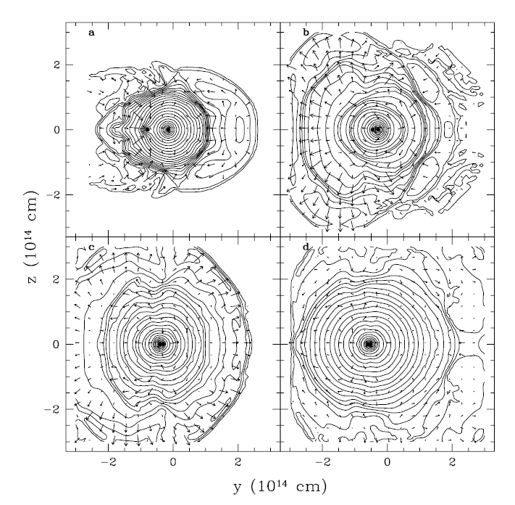
During CE stage a lot of angular momentum is transferred to the envelop of normal star.
Accretion of the stellar core can give the main gamma ray burst.
BZ could work effectively with low accretion rates.
Long accretion disk phase could be as long as 10⁴ s, i.e. a feasible explanation for X-Ray flashes.
see for review
(Taam & Sandquist 2000)
(Barkov & Komissarov 2010)

Slide 30
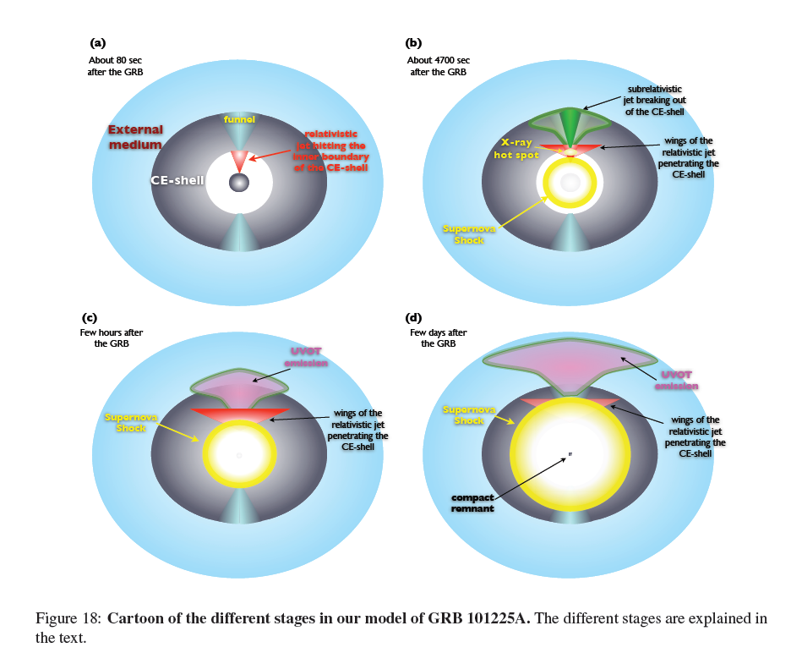
What about
observations?
Thöne et al, Nature 2011

Slide 31
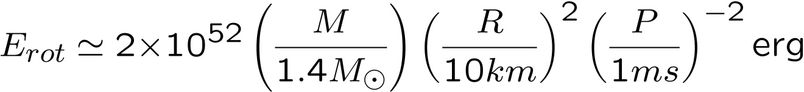
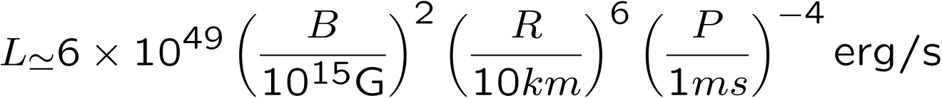
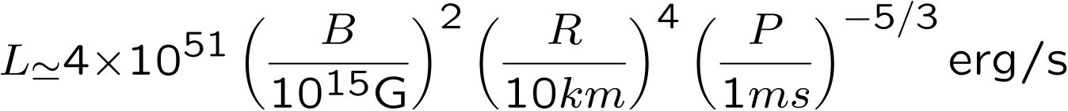
Fast Recycling of Neutron Star as Hypernova engine:
Usov(1992), Thompson(1994), Thompson(2005),
Bucciantini et al.(2006,2007,2008)‏,
Komissarov & Barkov (2007), Barkov & Komissarov (2011)
Rotational
energy:
Wind Power:
(i) ultra-relativistic
(ii) non-relativistic
Gamma-Ray-Repeaters and Anomalous X-ray pulsars - isolated neutron stars with dipolar(?) magnetic field of 10¹⁴- 10¹⁵ G (magnetars); (Woods & Thompson, 2004)

Slide 32
Possible scenario of GRB formation in close binary system with NS:

Slide 33
NS in Common Envelop:
Red Giant
And
Neutron Star
few
seconds
Neutron star spiralling
< 1000 seconds
NS recycled,
Field generated
NS + WR
5000 seconds
MBH left behind
jets produced, SNIIn

Slide 34


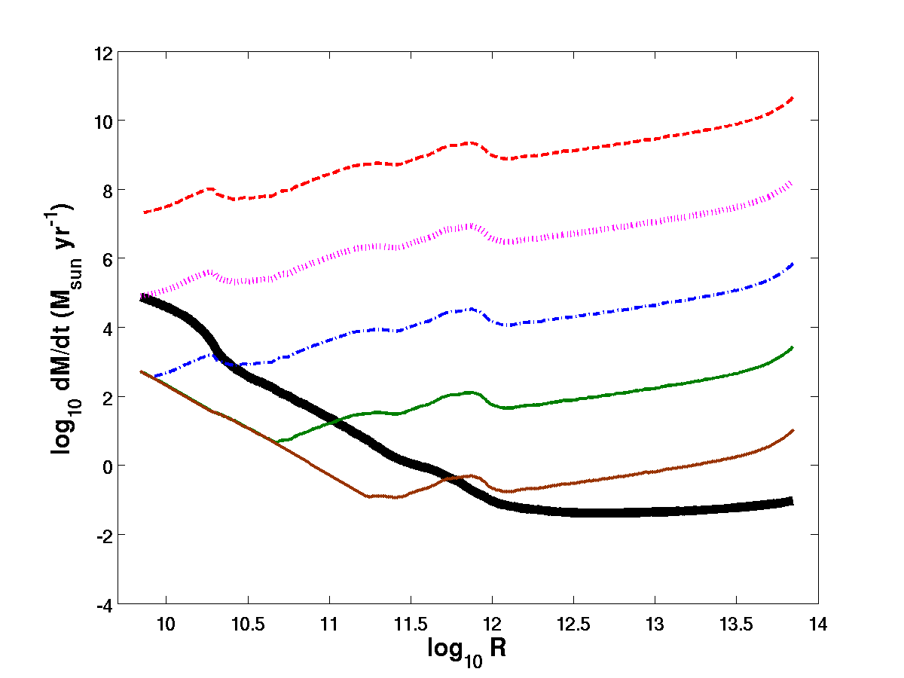





The accretion to NS: the sensitivity to parameters.
Barkov & Komissarov (2011)
Chevalier (1996)

Slide 35
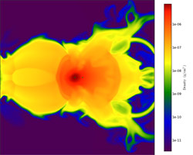


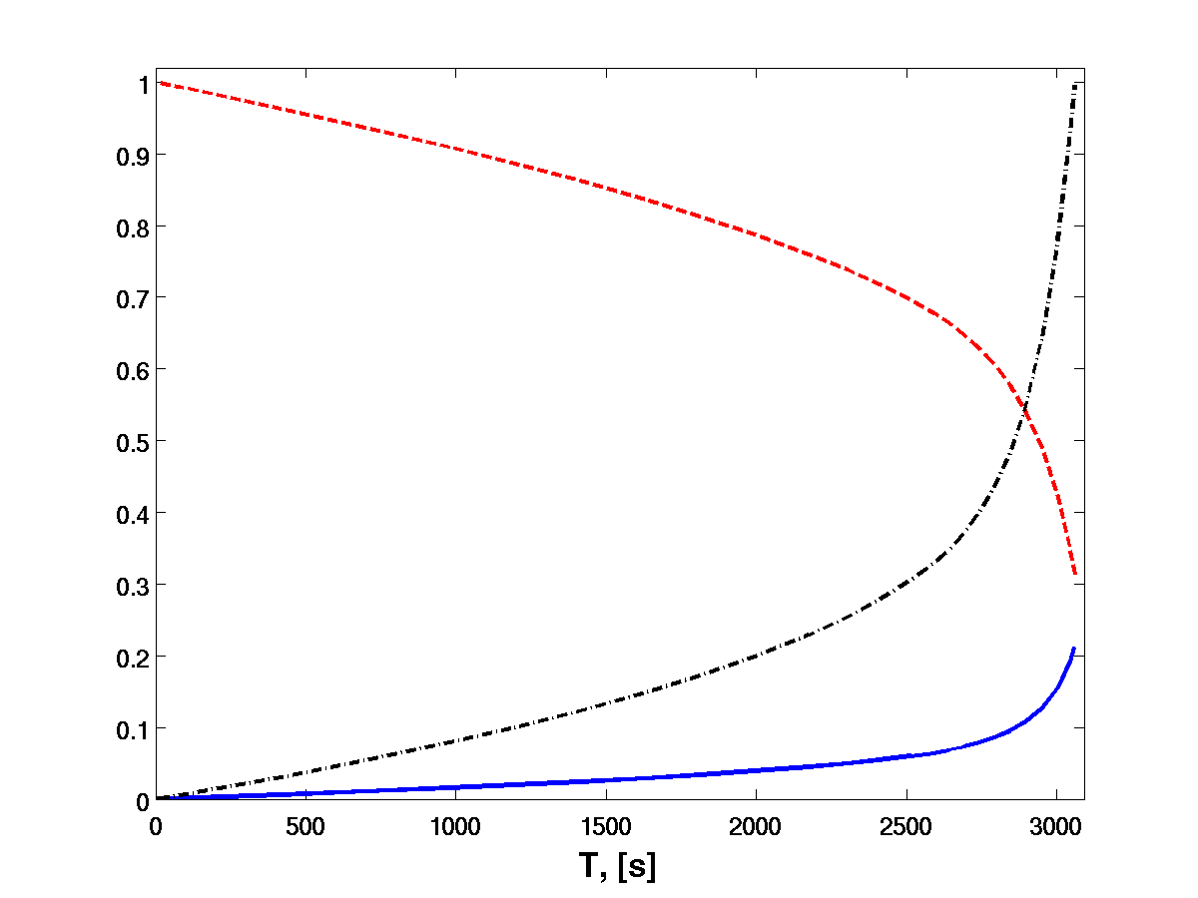
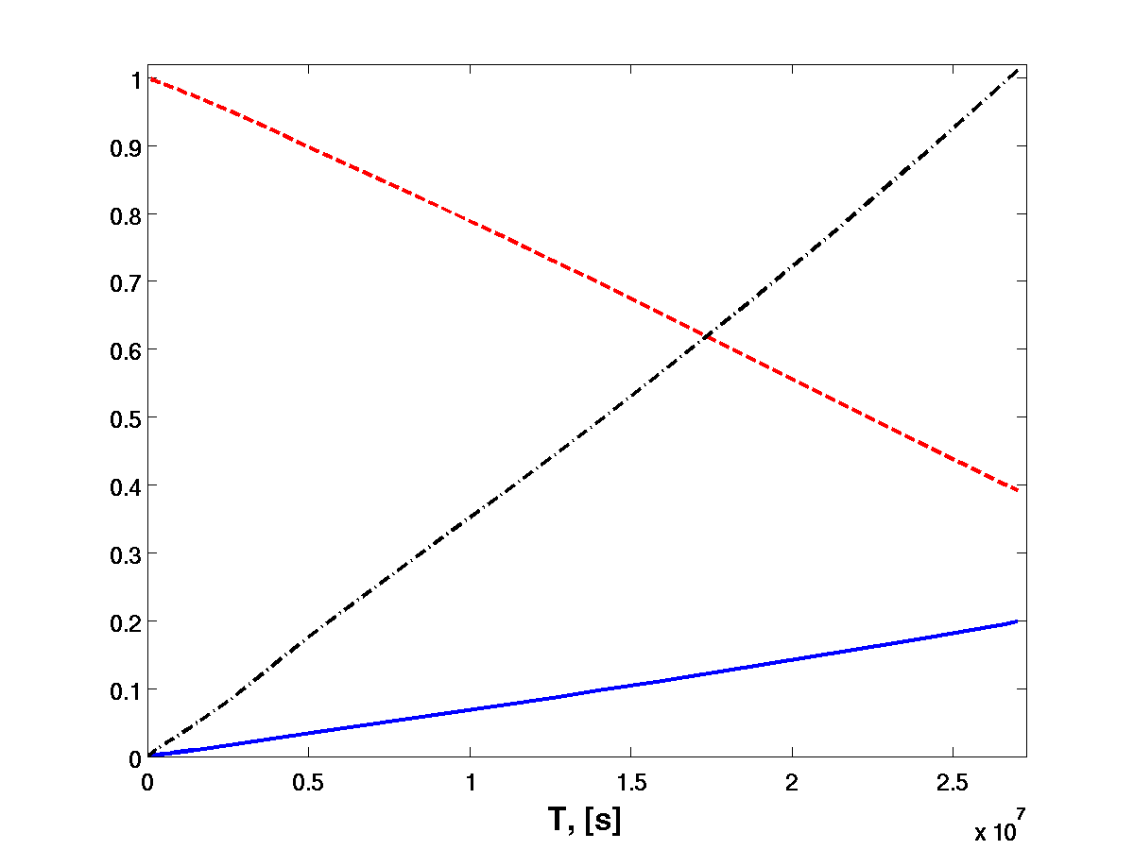
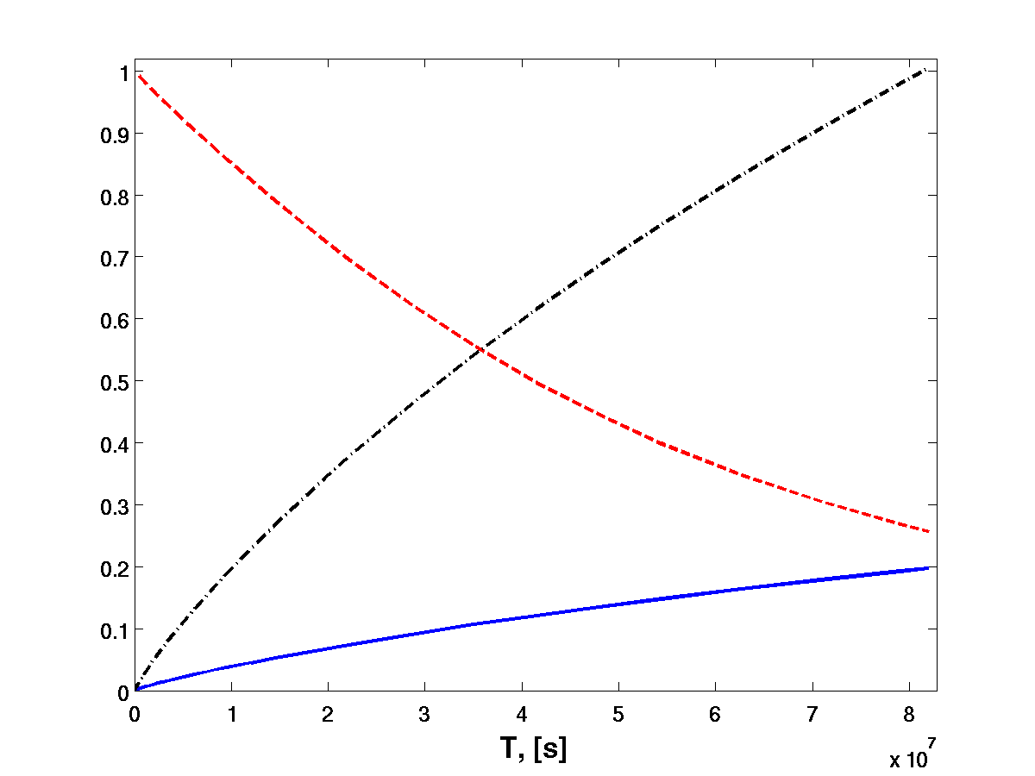
The NS penetration to the envelop of RG
De Marco et al (2011)
Chevalier (1996)

Slide 36
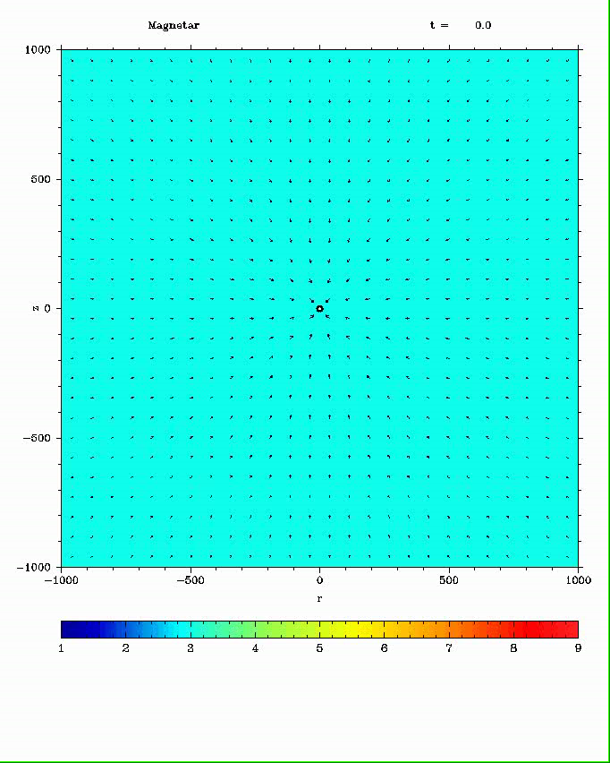
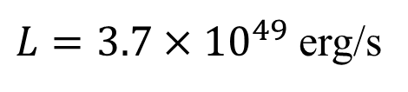
NS with dipole field:
P=4 ms
B=10¹⁵ G
$L=3.7×{10}^{49}$ erg/s
The intensive accretion to NS of matter with accretion rate of 10³ M_{sun}/yr can lead to the generation of strong magnetic field.

Slide 37
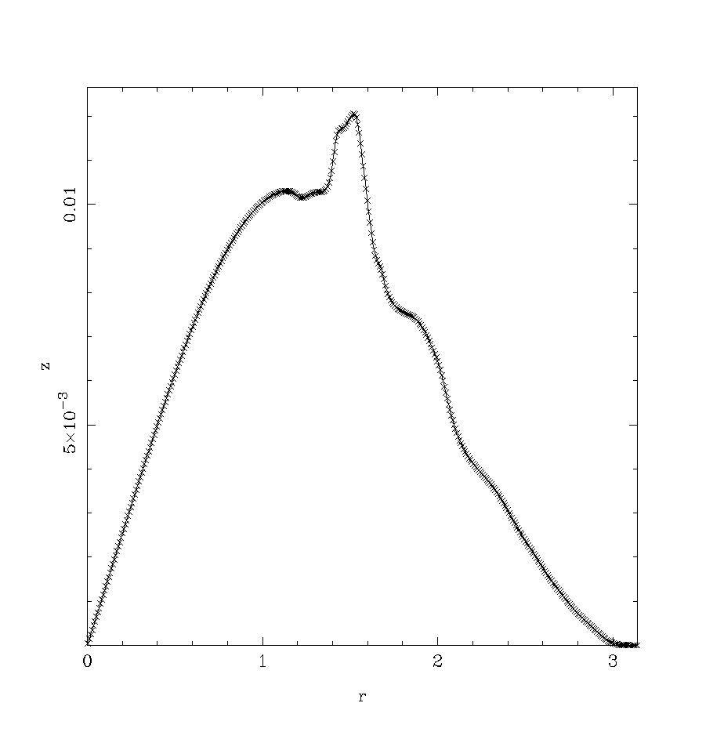
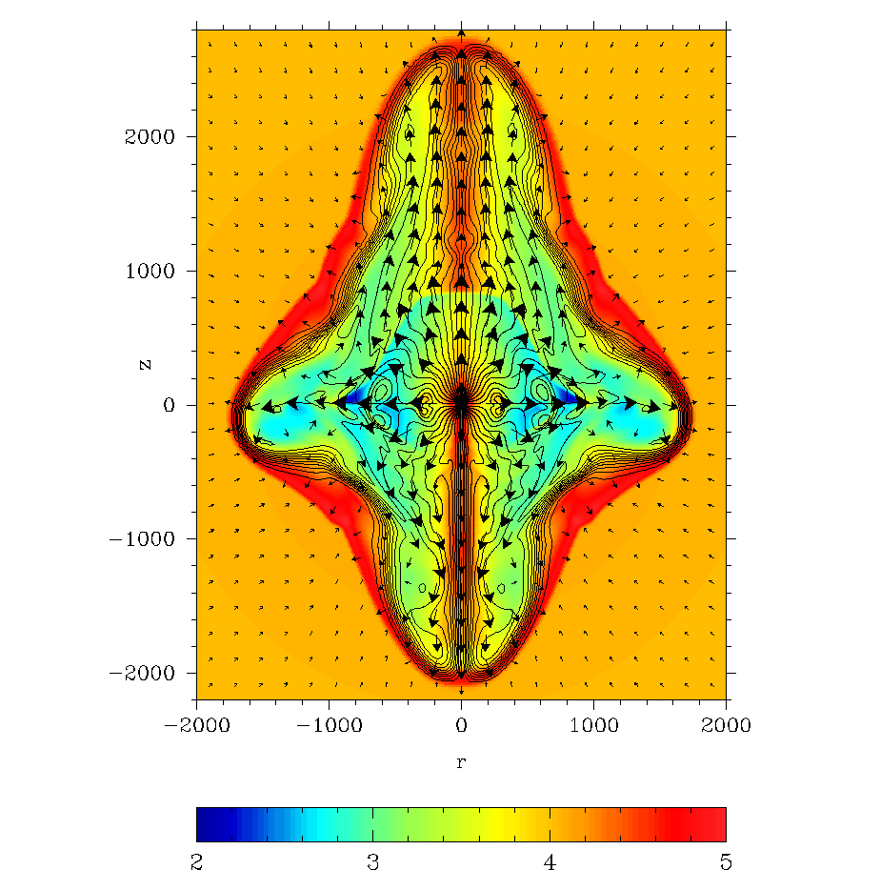

The complex topology of the NS magnetic field can lead to asymmetric explosion. Here is presented the explosion driven by NS with magnetosphere containing both dipole and quadruple harmonics (see also Lovelace et al. 2010)
Energy flux depends on polar angle

Slide 38




The NS activity after the explosion:
1 year after the beginning of the explosion we expect TeV and GeV photons with total luminosity of 10⁴⁰ erg/s
Such an emission can be detected at distances about 10 Mpc.

Slide 39
Conclusions
The Collapsar is a promising model for the central engine of GRBs.
Theoretical models are sketchy and numerical simulations are only now
beginning to explore them.
Our results suggest that:
+ Black holes of failed supernovae can drive very powerful GRB jets
via Blandford-Znajek mechanism if the progenitor star has strong
poloidal magnetic field;
+ Blandford-Znajek mechanism of GRB has much lower limit on accretion rate to BH then neutrino driven one (excellent for very long GRBs >100s);
+ One side jet can be formed (kick velocity order of V=200 km/s).
All Collapsar and NS based models need high angular momentum,
the common envelop stage could help.
Magnetar driven explosion on the common envelop stage can lead not only to
SN IIn with long plateau phase, but also to one year long TeV and GeV transient.
Such a transient can be detected with Cherenkov telescopes from distance ∼10 Mpc.

Slide 40
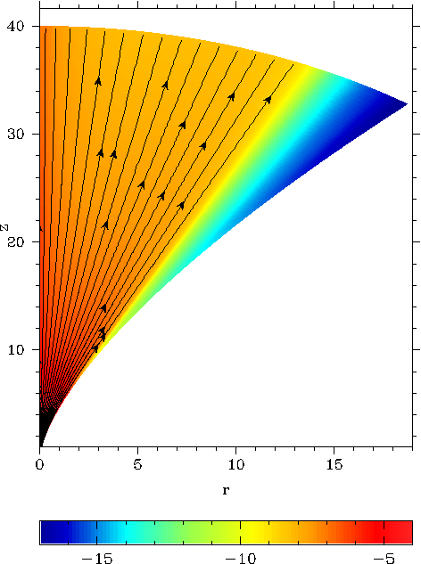
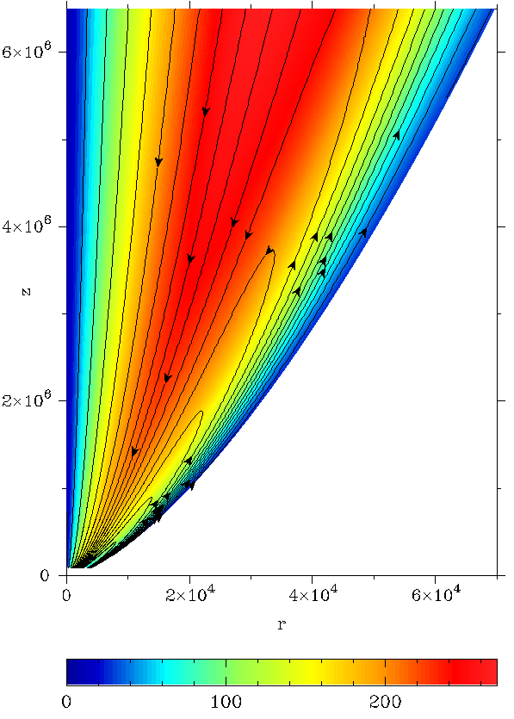
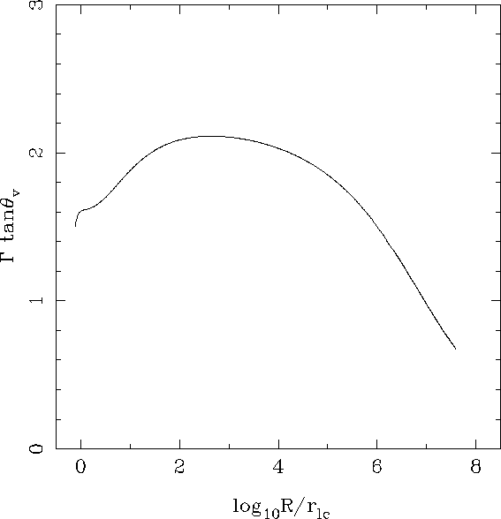
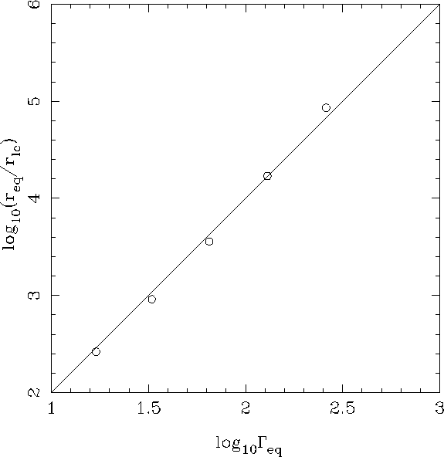
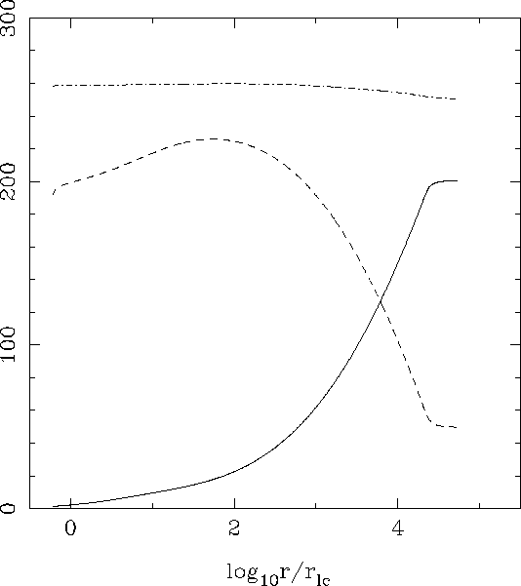
GRBs Jet magnetic acceleration:
We get MHD acceleration of relativistic jet up to Γ≈300
Conversion of magnetic energy to kinetic one more than 50%
Acceleration have place on long distance r_{eq}≈Γ²r_{lc}
The main part of the
jet is very narrow Γθ<2
(Komissarov et al 2009)
06/07/2014

Slide 41
I. Gamma-Ray-Bursts
Discovery: Vela satellite (Klebesadel et al.1973);
Konus satellite (Mazets et al. 1974);
Cosmological origin:
1. Beppo-SAX satellite – X-ray afterglows (arc-minute resolution) ,
optical afterglows – redshift measurements – identification of host
galaxies (Kulkarni et al. 1996, Metzger et al. 1997, etc)‏
2. Compton observatory – isotropic distribution (Meegan et al. 1992);
Supernova association of long duration GRBs:
1. Association with star-forming galaxies/regions of galaxies;
2. A few solid identifications with supernovae, SN 1998bw, SN 2003dh
and others...
3. SN humps in light curves of optical afterglows.
4. High-velocity supernovae ( 30,000km/s) or hypernovae (10⁵²erg).

Slide 42
Spectral properties:
Non-thermal spectrum from 0.1MeV to GeV:
Bimodal distribution (two types of GRBs?):
long duration
GRBs
short duration
GRBs
very long
duration GRBs

Slide 43
Variability:
smooth fast rise + decay;
several peaks;
numerous peaks with substructure
down to milliseconds
Total power:
assumption of
isotropic emission
Inferred high speed:
Too high opacity to unless Lorentz factor > 100

Slide 44
Merge of compact stars – origin of short duration GRBs?
Paczynsky (1986);
Goodman (1986);
Eichler et al.(1989);
Neutron star + Neutron star
Neutron star + Black hole
White dwarf + Black hole
Black hole + compact disk
Burst duration: 0.1s – 1.0s
Released binding energy:

Slide 45
Mechanisms for tapping the disk energy
Neutrino heating Magnetic braking
fireball
MHD wind
B
B
Eichler et al.(1989), Aloy et al.(2000)
MacFadyen & Woosley (1999)
Nagataki et al.(2006), Birkl et al (2007)
Zalamea & Beloborodov (2008,2010) (???)‏
Blandford & Payne (1982)‏
Proga et al. (2003)‏
Fujimoto et al.(2006)‏
Mizuno et al.(2004)

Slide 46
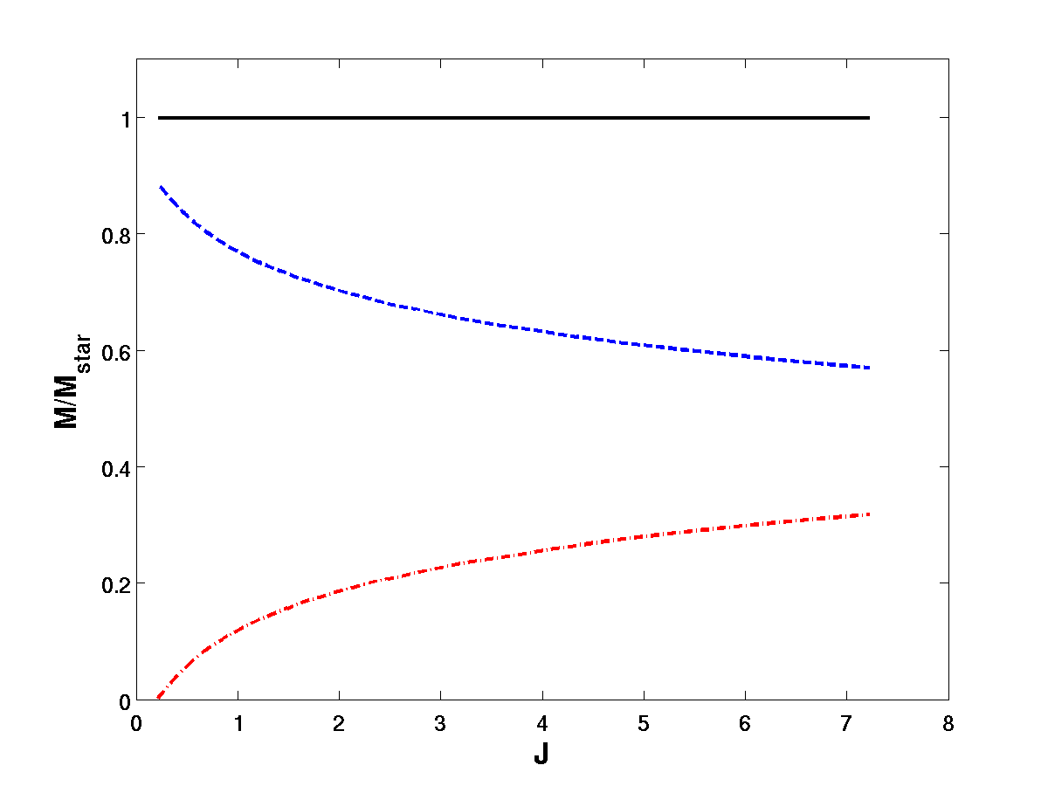
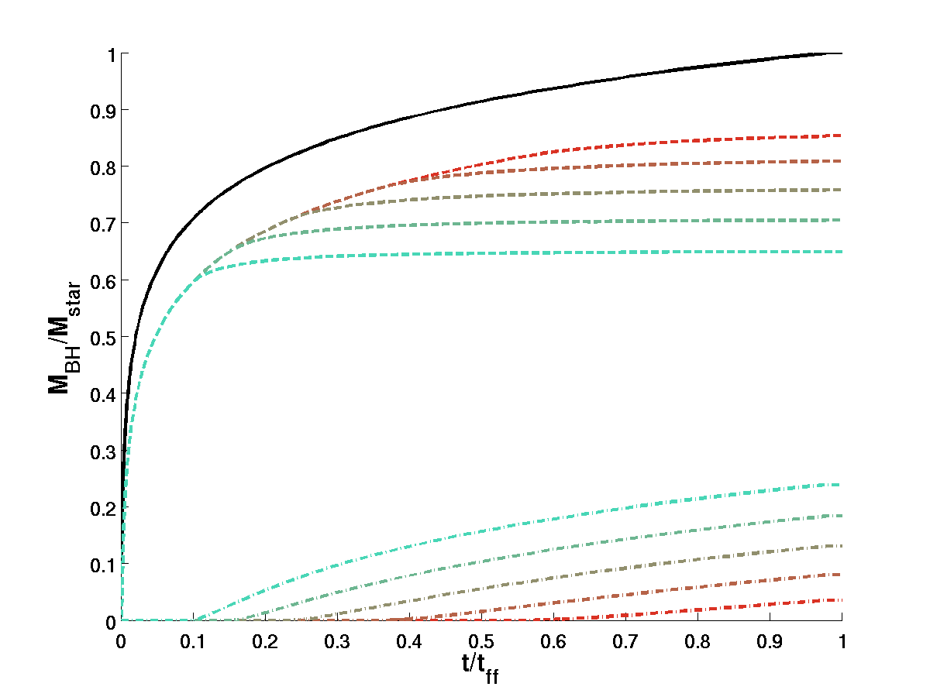
Power low density distribution model

Slide 47
Inferred collimation:
afterglow light curve with achromatic break
beamed radiation
velocity
vector
v
(Piran, 2004)‏
decelerating and
expanding source
06/07/2014

Slide 48
Plan of this talk
Gamma-Ray-Bursts – very brief review,
Models of Central Engines,
Numerical simulations I: Magnetic flux,
Magnetic Unloading,
Realistic initial conditions,
Numerical simulations II: Collapsar model,
Common Envelop and X-Ray flares,
Fast Recycling of Neutron Star as Hypernova engine,
Conclusions

Slide 49
Supernova connection of long duration GRBs:
1. Association with star-forming galaxies/regions of galaxies;
2. SN bumps in light curves of optical afterglows.
3. Few solid identifications with supernovae, SN 1998bw, SN 2003dh
and other suspects.
4. High-velocity supernovae ( 30,000km/s) or hypernova E_{s} ~ 10⁵²erg.

Slide 50




Summary:
Jets are formed when BH accumulates sufficient magnetic flux.
Jets power
Total energy of BH
Expected burst duration (?)‏
Jet advance speed
Expected jet break out time
Jet flow speed (method limitation)
Jets are powered by the Blandford-Znajek mechanism
Good news for the collapsar model of long duration GRBs !

Slide 51

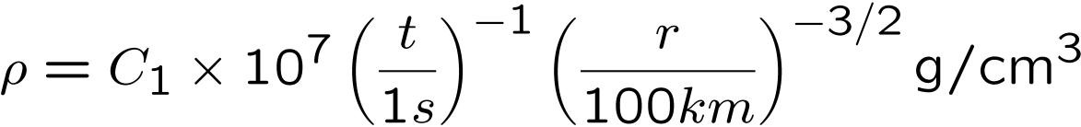
Free fall model of collapsing star (Bethe, 1990)‏
radial velocity:
mass density:
accretion rate:
Gravity: gravitational field of Black Hole only (Kerr metric);
no self-gravity;
Microphysics: neutrino cooling ;
realistic equation of state, (HELM, Timmes & Swesty, 2000);
dissociation of nuclei (Ardeljan et al., 2005);
Ideal Relativistic MHD - no physical resistivity (only numerical);

Slide 52
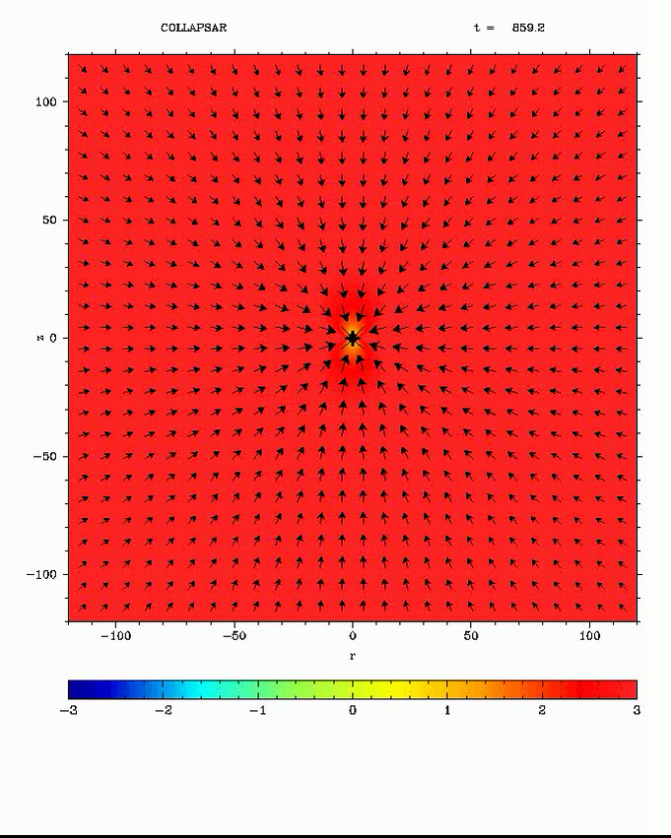
Model:C
C₁=3; B_{p}=10¹⁰ G
log₁₀ P/P_{m}
velocity vectors
06/07/2014

Slide 53

Preliminary results
1/50 of case a=0.9
06/07/2014

Slide 54




06/07/2014

Slide 55
V. Discussion
Magnetically-driven stellar explosions require combination of
fast rotation of stellar cores and (ii) strong magnetic fields.
Can this be achieved?
Evolutionary models of solitary massive stars show that even much
weaker magnetic fields (Taylor-Spruit dynamo) result in rotation being
too slow for the collapsar model (Heger et al. 2005)
Low metallicity may save the collapsar model with neutrino mechanism
(Woosley & Heger 2006) but magnetic mechanism needs much stronger
magnetic field.
Solitary magnetic stars (Ap and WD) are slow rotators (solid body rotation).
06/07/2014

Slide 56
The Magnetar model seems OK as the required magnetic field can be
generated after the collapse via α−Ω dynamo inside the proto-NS
(Thompson & Duncan 1995)
The Collapsar model with magnetic mechanism. Can the required
magnetic field be generated in the accretion disk?
This is much smaller than needed to activate the BZ-mechanism!
Possible ways out for the collapsar model with magnetic mechanism.
(i) strong relic magnetic field of progenitor, Ψ=10²⁷-10²⁸ Gcm⁻²;
(ii) fast rotation of helium in close binary or as the result of
spiral-in of compact star (NS or BH) during the common
envelope phase (e.g. Tutukov & Yungelson 1979 ). In both cases
the hydrogen envelope is dispersed leaving a bare helium core.
06/07/2014

Slide 57
Required magnetic flux , Ψ=10²⁷⁻²⁸ Gcm⁻², close to the highest
value observed in magnetic stars.
Accretion rate through the polar region can strongly decline
several seconds after the collapse (Woosley & MacFadyen 1999),
reducing the magnetic flux required for explosion (for solid rotation
factor 3-10, not so effective as we want);
Neutrino heating (excluded in the simulations) may also help to
reduce the required magnetic flux;
Magnetic field of massive stars is difficult to measure.
It can be higher than Ψ=2x10²⁷ Gcm⁻² ;
Strong relic magnetic field of massive stars may not have enough time
to diffuse to the stellar surface, t_{d} ~ 10⁹ yrs << t_{evol} ,
(Braithwaite Spruit, 2005)
06/07/2014

Slide 58


a=0.6 Ψ=3x10²⁸
a=0.45 Ψ=6x10²⁸
Model | a | Ψ₂₈ | B_{0,7} | L₅₁ | dM_{BH} /dt | η
A | 0.6 | 1 | 1.4 | - | - | -
B | 0.6 | 3 | 4.2 | 0.44 | 0.017 | 0.0144
C | 0.45 | 6 | 8.4 | 1.04 | 0.012 | 0.049
06/07/2014

Slide 59






Аккреция НЗ в оболчке

Slide 60





The accretion rate onto the NS in different models

