Slide 1
Compact binary progenitors of short-hard gamma-ray bursts
Koutarou Kyutoku RIKEN, iTHES
Collaborators include:
Kenta Hotokezaka (Hebrew U.), Kunihito Ioka (KEK),
Kenta Kiuchi, Masaru Shibata (Kyoto U.), Hirotada Okawa (Waseda U.),
Yuichiro Sekiguchi (Toho U.), Masaomi Tanaka (NAOJ),
Keisuke Taniguchi (Ryukyu U.), Tomohide Wada, Shinya Wanajo (RIKEN)

Slide 2


Shortness: $T_{90}$
Bimodality of $T_{90}$: separation at 2s (usual definition)
Bromberg+ (2013)
100
Number
10
$T_{90}$: the duration in which 90% energy is released
0.1
1
10
100
1000

Slide 3
Hardness: hardness ratio
Short bursts prefer large hardness ratios
Qin+ (2013)
Gray: BATSE
Red: Fermi
HR=S(100-350keV)/S(50-100keV)

Slide 4
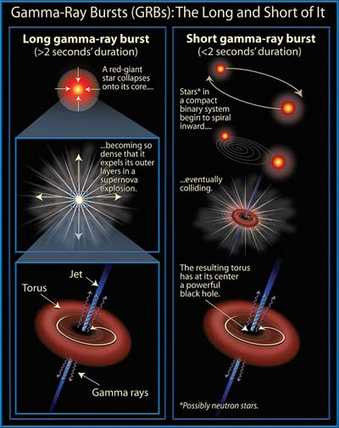
Binary merger scenario
Long-soft GRB: collapsar
confirmed by SN association
Short-hard: compact binary?
- black hole-neutron star?
- neutron star-neutron star?
rigorous confirmation will
need gravitational waves
(macronova/kilonova…)
http://www.daviddarling.info/images/gamma-ray_bursts.jpg

Slide 5

Redshift distribution
The SGRB distribution peaks at the smaller redshift
- delay time
to the merger
- low energy scale
No SGRB within
the AdLIGO range
(w/ $z$ determined)
Berger (2014)

Slide 6
Host galaxy type
~20% of SGRBs occur at/near early-type galaxies
example: GRB 050509B
Fong+ (2013)
Gehrels+ (2005)

Slide 7
Offset distribution
Kicked out from the host galaxy due to the SN kick
even this could be
biased toward
a small offset
(for the afterglow
to be detected)
Fong-Berger (2013)

Slide 8
Jet opening angle
Similar distributions for long and short GRBs
SGRB association
to GW events
will be a few %...
Fong+ (2014)

Slide 9
No supernova but macronova/kilonova
Macronova/kilonova: Li-Paczynski (1998)
radioactive heating due to r-process element decay
near-IR/optical flash around the week time scale
(but iron-group elements may also be relevant)
- 130603B Tanvir+ (2013), Berger+ (2013), Hotokezaka, KK+ (2013)
- 060614 (“long-short GRB”) Yang+ (2015)
- 080503 (“naked-eye GRB”) Kasen+ (2015)

Slide 10
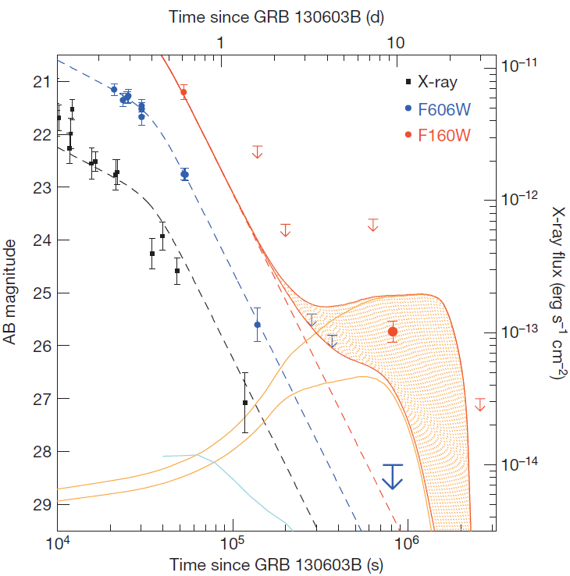
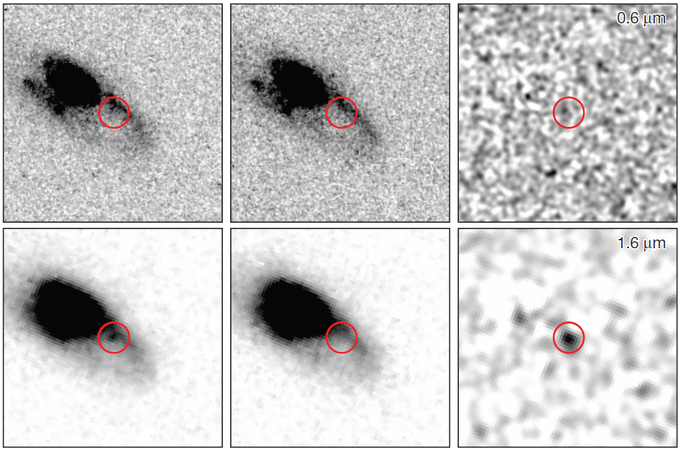



Near-infrared excess of GRB 130603B
Ejecta mass $M_{\text{ej}}=0.02\sim 0.1M_{⊙}$ may be required
9day
(event?)
30day
(background)
Excess
brightening
$$−$$
$$=$$
No optical excess
Excess in near-infrared
Tanvir+ (2013)
Tanvir+ (2013)

Slide 11

Another candidate GRB 060614
“long-short GRB” w/ $T_{90}=102\text{s}$ at $z=0.125$
near-IR excess at 13.6day
at the 6-sigma level
Gehrels+ (2006)
Yang+ (2015)

Slide 12
Long-term activity
Extended emission:
10~100s
Plateau emission:
1000-10000s
No “orphan”
- jet geometry?
- observed as LGRB?
Gompertz+ (2013)
050724
050911
060614
061006
061210
070714B
071227

Slide 13
Prompt-emission correlation
SGRBs satisfy their own Amati/Yonetoku relations
Amati
Yonetoku
Black: LGRB
Red: “secure” SGRB
Green: “misguided” SGRB
Tsutsui+ (2013)

Slide 14
What should be considered for SGRBs?
What is the outcome of compact binary mergers?
- BH-disk/torus, magnetar, or combinations?
How does the GRB jet propagate?
- confinement mechanism?
How is the long-term activity maintained?
(I do not include this topic in this talk)
Some others?

Slide 15
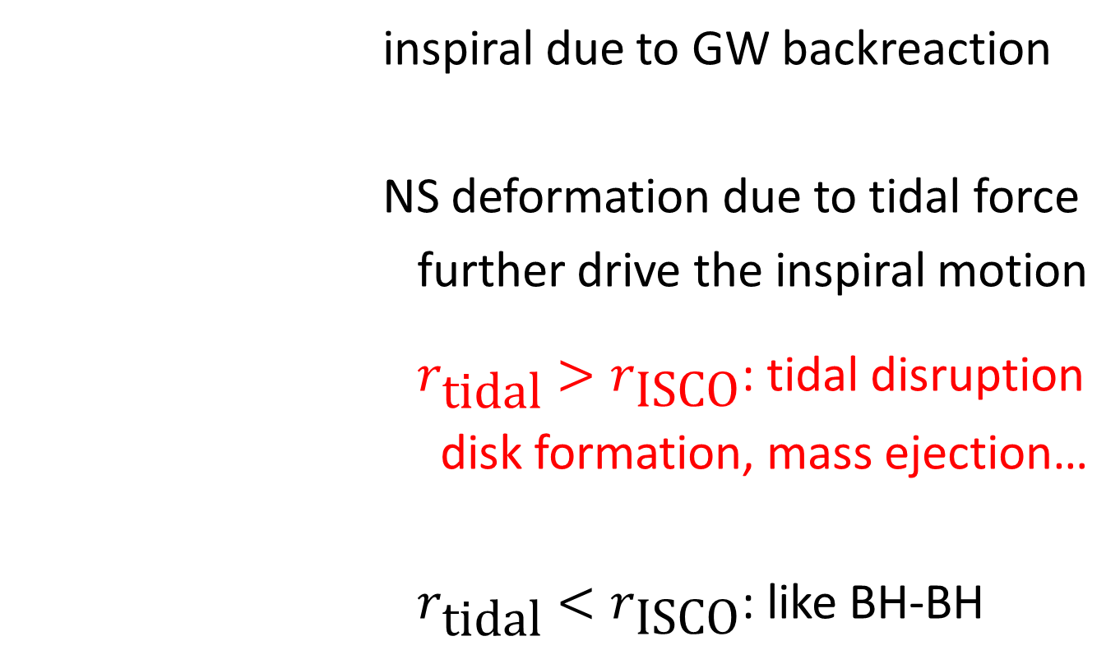
Merger dynamics of BH-NS
inspiral due to GW backreaction
NS deformation due to tidal force
further drive the inspiral motion
: tidal disruption
disk formation, mass ejection…
: like BH-BH

Slide 16
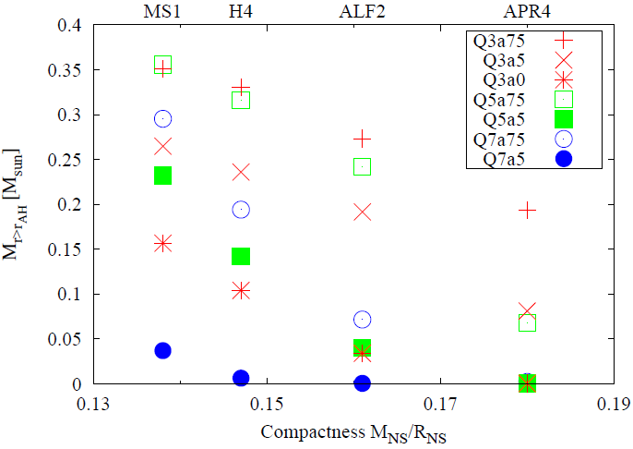

Mass remaining outside the BH
$M_{\text{disk}}>0.1M_{⊙}$ is possible for various parameters
- large NS radius
- small BH mass
- high BH spin
give a large value
variety due to
the BH variety
Kyutoku+ (2015)
large <- NS radius -> small

Slide 17
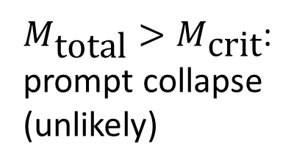
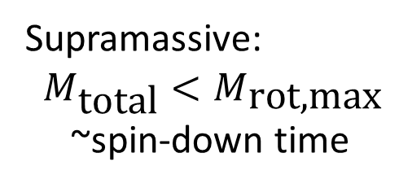


Merger dynamics of NS-NS
$$M_{\text{total}}<M_{\text{max}}$$
$$M_{\text{total}}<M_{\text{crit}}$$
Massive, hot NS
Stable NS
$M_{\text{total}}>M_{\text{crit}}$:
prompt collapse
(unlikely)
Hypermassive:
~100ms
Supramassive:
$M_{\text{total}}<M_{\text{rot}\text{,}\text{max}}$
~spin-down time
Small-mass disk
Large-mass disk
Small-mass disk?
[See e.g., Hotokezaka, KK+ (2013)]

Slide 18
Magnetic-field amplification
- Kelvin-Helmholtz instability at the contact surface
- winding and magnetorotational instability
during the hypermassive NS stage -> magnetar?
Note: saturate before the BH-disk/torus is formed!
Kiuchi, KK+ (2015)

Slide 19

Disk mass after the HMNS collapse
Again $M_{\text{disk}}>0.1M_{⊙}$ is a plausible outcome
variety comes from
the mass ratio?
percentage:
torus mass required
by observed SGRBs
assuming 5% efficiency
Symbol: NS equation of state
Giacomazzo+ (2013)
[see also Hotokezaka, KK+ (2013)]

Slide 20


Jet confinement by the NS-NS ejecta
Cocoon confinement: ejecta expanding w/ $v\sim 0.2c$
See also Aloy+ (2005), Murguia-Bertheir+ (2014), Duffel+ (2015)
Nagakura+ (2014)
$$ρ∝r^{−3.5}$$
$$M_{\text{ej}}=0.01M_{⊙}$$
$$L_{j}=2×{10}^{50}\text{erg}\text{/}\text{s}$$

Slide 21
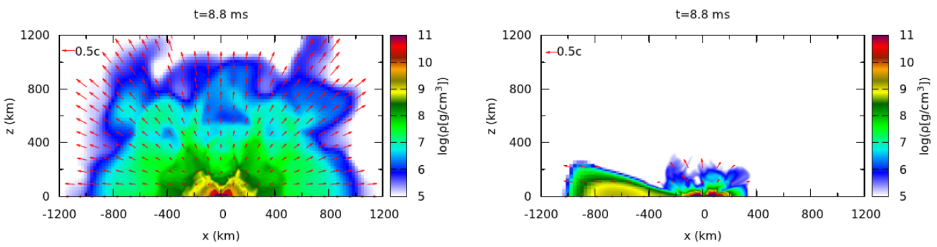
Ejecta profile comparison
Profile of dynamical ejecta on the meridional plane
NS-NS: hypermassive NS BH-NS: BH-disk
…but the reality depends on HMNS/disk winds
Hotokezaka, KK+ (2013)
Devoid of material
in the polar region

Slide 22
Thermally-driven wind in MHD
High-res. MHD BH-NS simulation on K-computer
-> turbulence-like state, efficient thermalization
Kiuchi, KK+ (2015)
Kiuchi, KK+ (2015)
10ms
20ms
30ms
40ms
50ms
60ms
Time from
the merger
Dynamical ejecta
Disk wind (dominant)

Slide 23
Ejecta morphology and BZ luminosity
A small opening-angle jet may be possible also for
a BH-NS merger remnant
Kiuchi, KK+ (2015)
Kiuchi, KK+ (2015)
Time from the merger (ms)

Slide 24
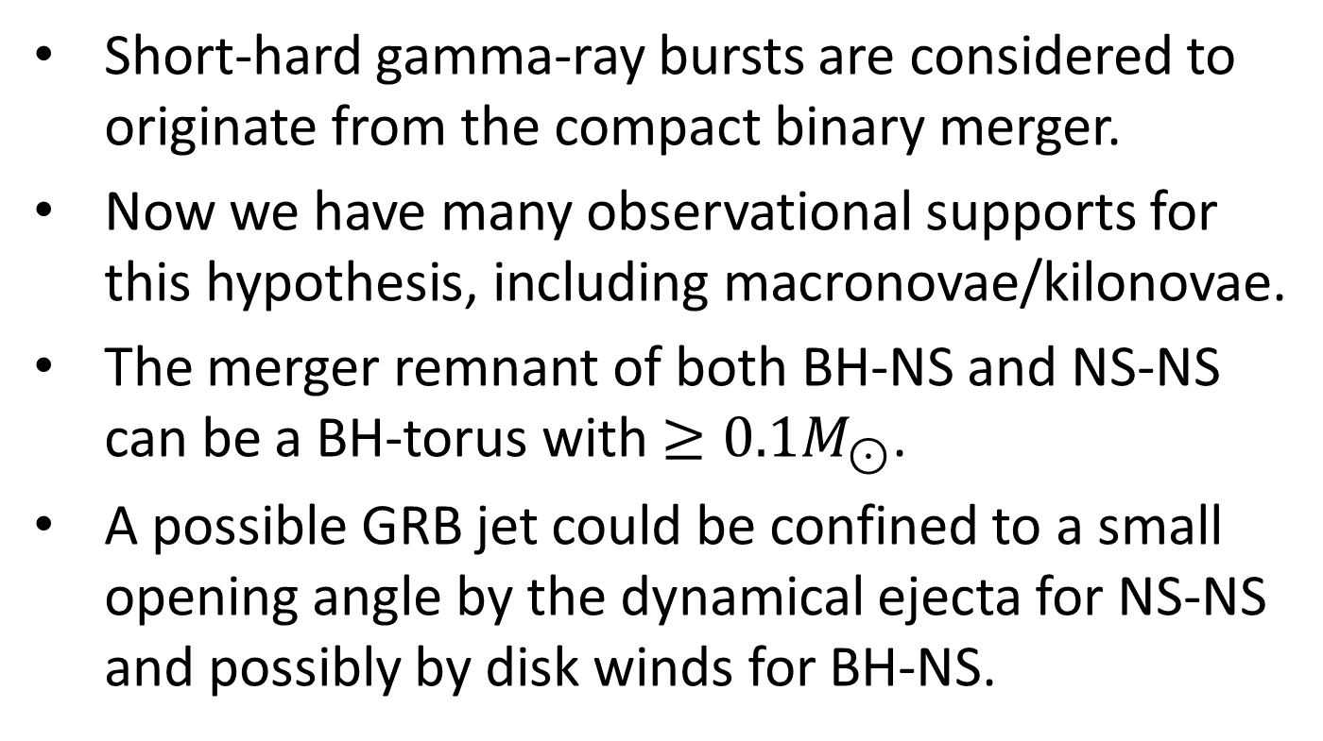
Summary
Short-hard gamma-ray bursts are considered to originate from the compact binary merger.
Now we have many observational supports for this hypothesis, including macronovae/kilonovae.
The merger remnant of both BH-NS and NS-NS can be a BH-torus with $≥0.1M_{⊙}$.
A possible GRB jet could be confined to a small opening angle by the dynamical ejecta for NS-NS and possibly by disk winds for BH-NS.

Slide 26
Appendix

Slide 27

Detector dependence of $T_{90}$
Qin+ (2013)

Slide 28
Time-reversal scenario
Massive NS wind responsible for late X-ray emission
-> collapse to BH-disk, jet launch, prompt emission
- jet launch possible?
(torus mass)
- orphan X-ray emission?
Siolfi-Siegel (2015)
Rezzolla-Kumar (2015)

Slide 29
Neutrino-driven wind
Not performed in 3D full general relativity
Just+ (2015)

