Slide 1




GRB correlations as cosmological tools?
Maria Dainotti
Marie Curie Fellow at Stanford University
in collaboration with
V. Petrosian, Stanford University, Stanford, California,
S. Nagataki, Riken, Tokyo, Japan and the Astrophysical Big Bang laboratory
K. Maeda, Kyoto University, Japan
S. Capozziello, University of Naples, Italy
R. Willingale, University of Leicester, UK
P. Obrien, University of Leicester, UK
X. Hernandez, UNAM, Mexico
S. Postnikov, Bloomington University, USA
M. Ostrowski, Jagiellonian University, Krakow, Poland

Slide 2
why GRBs as possible cosmological tools?
Because
They are the farthest astrophysical objects ever observed up to z=9.46 (Cucchiara et al. 2011)
Much more distant than SN Ia (z=1.7) and quasars (z=6)
Free from dust extinction
BUT
They don’t seem to be standard candles with their luminosities spanning over 8 order of magnitudes

Slide 3
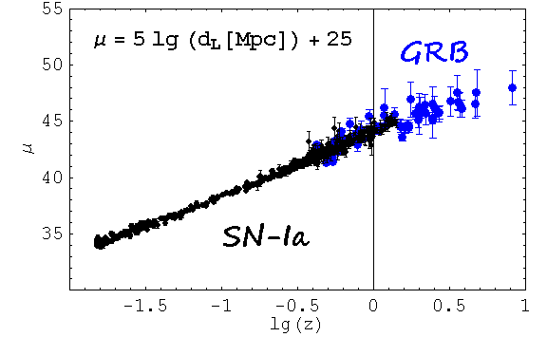
SN-Ia & GRBs, distance ladder
Huge step!
The aim is to find tight correlations so that they can be used as Standardizable candles and useful cosmological tools at high z.
There is a 1sigma discrepancy between SNe Ia and the Planck
Observations (Rigault et al. 2015), so the question is what will
be the Ho for high redshift Universe?

Slide 4
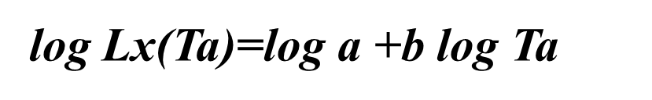
A possible reliable candidate is the
Dainotti et al. 2013, ApJ, 774, 157D
Firstly discovered in 2008 by Dainotti, Cardone, & Capozziello MNRAS, 391, L 79D (2008)
Later updated by Dainotti, Willingale, Cardone, Capozziello & Ostrowski ApJL, 722, L 215 (2010)
Lx(T*a) vs T*a distribution for the sample of 101 GRBs

Slide 5
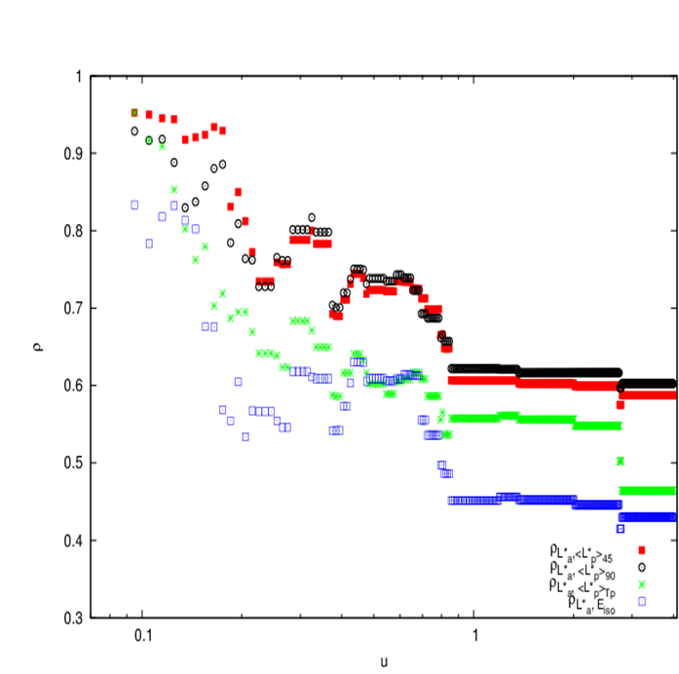
Also Prompt – afterglow correlations can be candidates
Dainotti et al., MNRAS, 418,2202, 2011
A search for possible physical relations between
the afterglow characteristic luminosity L*a ≡Lx(Ta)
and
the prompt emission quantities:
1.) the mean luminosity derived
as <L*p>45=Eiso/T*45
2.) <L*p>90=Eiso/T*90
3.) <L*p>Tp=Eiso/T*p
4.) the isotropic energy Eiso

Slide 6
The LX-Ta correlation as a distance estimator
Dainotti et al. 2011a ApJ, 730, 135, 2011
Distance modulus:
An update of the redshift estimator is still ongoing, with an updated sample of 176 GRBs, see similar approach but with the Yonetoku relation, Yonetoku et al. 2010, AIPC,1279,24Y.

Slide 7
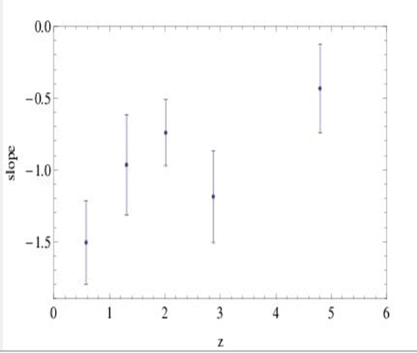
Is the LT correlation intrinsic to GRBs, or is it induced by redshift dependence and observational limitations?
Dainotti et al. 2013, ApJ, 774, 157D
ρ=-0.73 for all the distribution
The test in Dainotti et al. 2011, ApJ, 730, 135D checks that the slope of every redshift bin is consistent with every other.
The slope of each redshift bin are compatible in 2 sigma from the first to the last, while in 1 sigma among the contiguous ones.
black for z < 0.89,
magenta for 0.89 ≤ z ≤ 1.68,
blue for 1.68 < z ≤ 2.45
Green 2.45 < z ≤ 3.45
red for z ≥ 3.45.

Slide 8

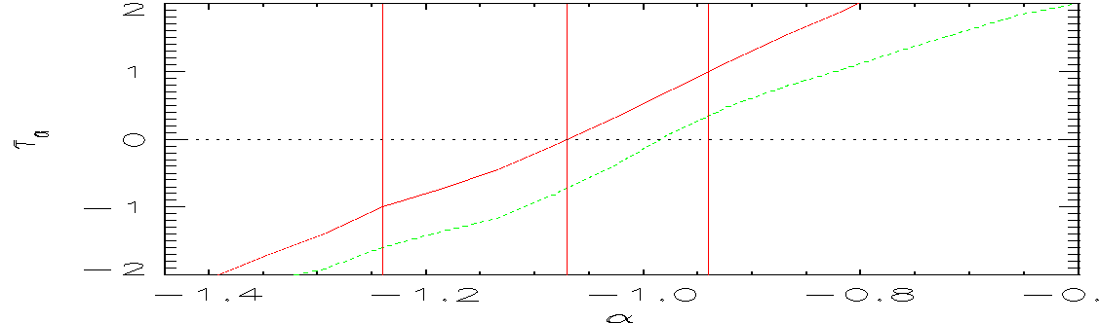
BUT, for a more Mathematical approach we apply:
The Efron & Petrosian method (EP) (ApJ, 399, 345,1992)
to obtain unbiased correlations corrected for instrumental threshold selection effect and redshift induced correlation (Lloyd,N., & Petrosian, V. ApJ, 1999)
If L*X and T*a are correlated with redshift
the luminosity vs. redshift evolution is g(z)
the plateau duration vs. redshift evolution is a f(z)
The observed correlation slope ,
b=-1.27 ± 0.15
vs
the intrinsic one
-1.07 ± 0.14
Dainotti et al. 2013, ApJ, 774, 157D

Slide 9
Conclusions – part II
The correlation La-Ta exists !!!
It can be useful as model discriminator :
energy injetion model from a spinning-down magnetar at the center of the fireball Dall’ Osso et al. (2010), Xu & Huang (2011), Rowlinson & Obrien (2011), Rowlinson et al. (2014). In this last paper the intrinsic correlation has been taken into account.
Accretion model onto the central engine as the long term powerhouse for the X-ray flux Cannizzo & Gerhels (2009), Cannizzo et al. 2010
Prior emission model for the X-ray plateau Yamazaki (2009)

Slide 10
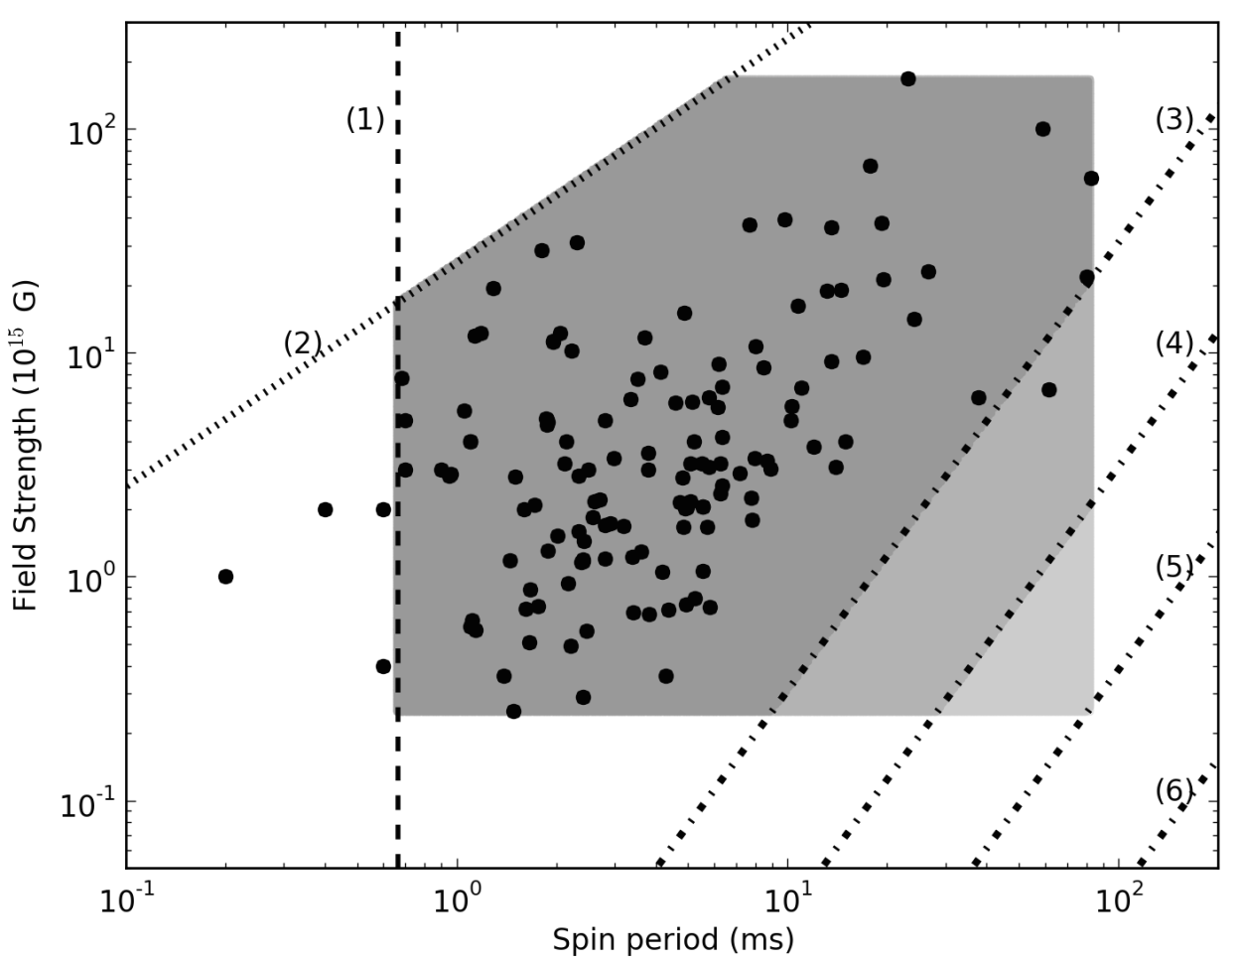


The magnetar central engine model explains this correlation
The spinning down millisecond magnetar analytically reproduces the LT intrinsic correlation
Rowlinson, Gompertz, Dainotti, et al. 2014, MNRAS,
Substituing Radius in the L0,49
Black points: Fitted magnetar parameters from GRB X-ray lightcurves (Lyons et al. 2010; Dall’Osso et al. 2011; Bernardini et al. 2012; Gompertz et al. 2013; Rowlinson et al. 2013; de Ugarte Postigo et al. 2013; Yi et al. 2014; Lu & Zhang 2014)
Notes:
Using the theoretical models, it is fairly trivial to prove that the intrinsic correlation falls out of the magnetar model. However, we can do one better. We have simulated a large number of newly born magnetars, including various observational selection effects (describe figure), and fitted the correlation to their plateau properties. Again, we were able to reproduce the observed steeper correlation slope. However, we also have the intercept, which is highly sensitive to the beaming angle of the jet and the efficiency of converting the rotational energy into the observed emission (i.e. the physics!). So perhaps we can use this and the observed data to place constraints on the magnetar model.

Slide 11
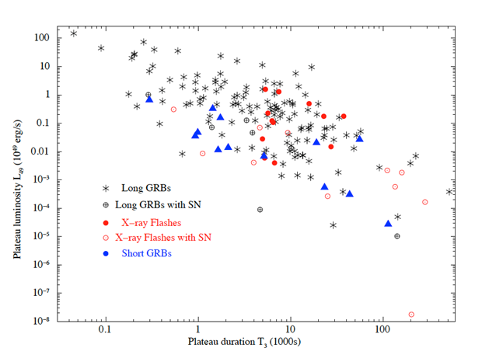
GRB-magnetars vs Galactic magnetars: X-ray plateaus
We derive B0 and P0 for all GRBs with Swift X-ray plateaus. How B0 and P0 compare with the Galactic population of magnetars?
Our Galactic magnetars may not come from GRBs
GRB-magnetar model in its present
form is safe if:
We allow two kind of magnetar progenitors, GRB-ones being different from Galactic magnetar ones (i.e. Metallicity differences?)
The No. of stable magnetars produced in the Milky Way via a GRB in the past Myr is about < 16

Slide 12
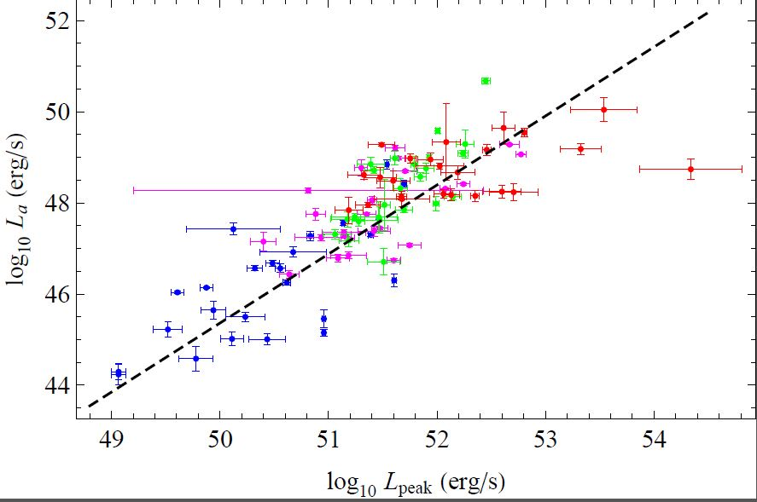
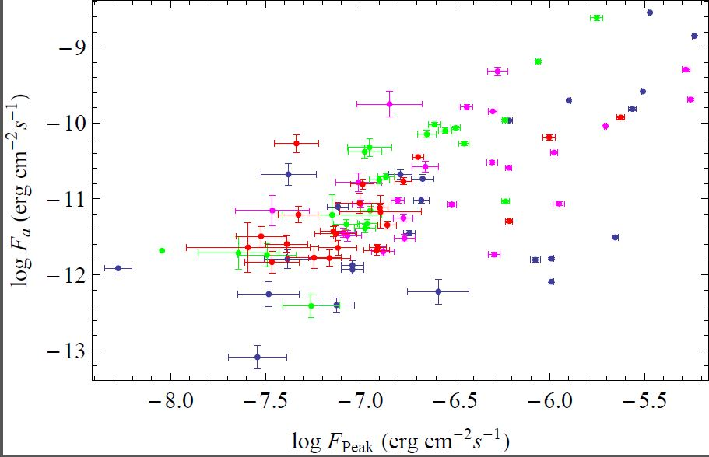
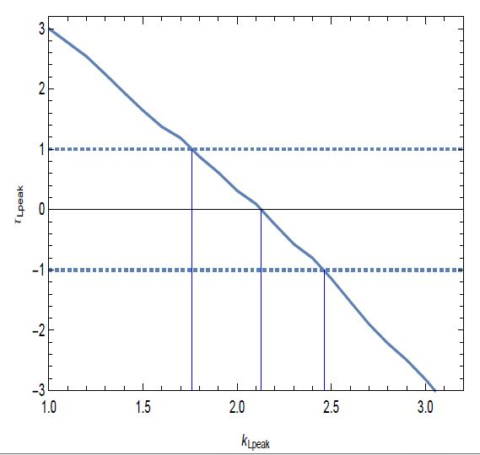
Also prompt-afterglow correlations are intrinsic !!!
Dainotti et al. MNRAS 2015b, 31, 4
Tau_Lprompt has been computed according to the EP method, we note that there is a strong evolution in the prompt, 2.13+(0.33,−0.37) consistent with other results in literature, Petrosian et al. 2015, ApJ.
Yonetoku et al. 2005, found a steeper evolution 2,60+/0.15 but still compatible with 1 sigma.

Slide 13
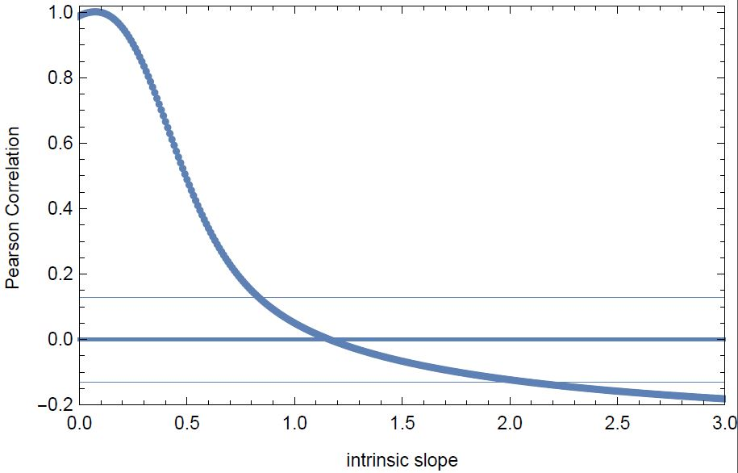

The partial correlation
Where r=Pearson correlation coefficient
And ‘ are the de-evolved quantities.
DL is the luminosity distance
Log L’’= log L’peak − α log L’afterglow
Where α is the intrinsic slope. The correlation becomes significant for α = 1.14+(0,83;−0,32), which is very close to the observed correlation 1.21(+0.14,
−0,13). The error bars quoted are at the 2 σ significance level.

Slide 14
Updating the GRB Hubble diagram with the luminosity-time correlation
Allows to increase both the GRBs sample (83 GRBs vs 69) in Schaefer et al. 2006 and reduce the uncertainty on the distance moduli μ(z) of the 14%
Cardone, V.F., Capozziello, S. and Dainotti, M.G 2009, MNRAS, 400, 775C
The use of the HD with the only Dainotti et al. correlation alone or in combination with other data shows results in agreement with previous ones in literature.
A larger sample of high-luminosity GRBs can provide valuable information in the search for the correct cosmological model (Cardone, V.F., Dainotti, M.G et al. 2010, MNRAS, 408, 1181)

Slide 15
How selection effects can influence correlation and cosmology and what is the circularity problem?
In Dainotti et al. 2013b MNRAS, 436, 82D it is shown how the change of the slope of the correlation can affect the cosmological parameters with a simulated data set of 101 GRBs with a central value of the correlation slope that differs on the intrinsic one by a 5σ factor.
The circularity problem derive from the fact that the parameters a and b depend on a given cosmology.
A way to overcome this problem is to change contemporaneously the fit parameters and the cosmology

Slide 16
Full sample : GRB+Sne +H(z)
Parameters for non flat/flat models are not distinguishable:
Overestimated of the 13% in ΩM, compared to the Ia SNe (ΩM , σM) = (0.27, 0.034), while H0, best-fitting value is compatible in 1σ compared to other probes.
This compatibility of H0 is due to the large intrinsic scatter associated with the simulated sample.

Slide 17
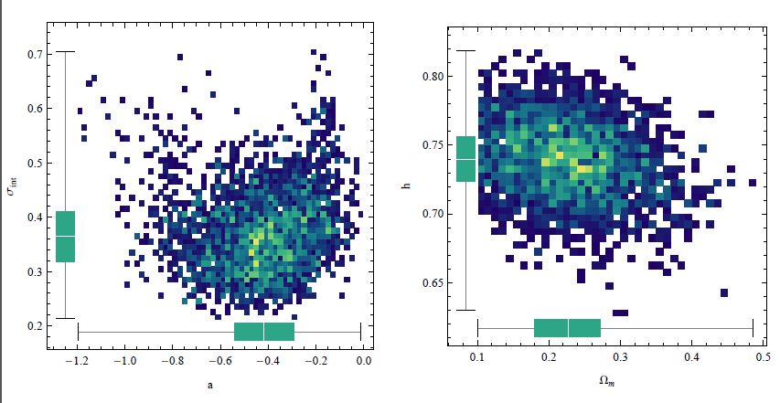
High luminous sample: GRBs only
Threshold value (log L∗X)th = 48.7, we are far well enough to the point in which the corrected luminosity function departs from the observed value Lx=47.
HighL sample differs of 5% in the value of H0 computed in Peterson et al. 2010, while the scatter in ΩM is underestimated by the 13%.

Slide 18
Distance ladder: from SNe to GRBs
Postnikov, Dainotti, Hernadez & Capozziello 2014,APJ, 783, 126P.

Slide 19
Long Sample and GRB-Sne associated sample.
Looking for a more homogeneous sample for a “Standard GRB set” both for cosmology and for a more precise redshift estimator
(Dainotti et al. ApJ submitted)
XRF and Short GRBs

Slide 20
The two dotted lines are the representation of 1 σ error around the best fitted slope. All the data points are within 1 σ. A+B category show ρ= -0.96 with P=1.4*10^-3
A strong spectroscopic evidence
B: Clear light curve bump as well as some spectroscopic evidence resembling a GRB-SN.
C: Clear bump consistent with other GRB-SNe at the spectroscopic redshift of the GRB.
D: Bump, but the inferred SN properties are not fully consistent with other GRB-SNe or the bump was not well sampled or there is no spectroscopic redshift of the GRB.
E: Bump, either of low significance or inconsistent with other GRB-SNe.

Slide 21
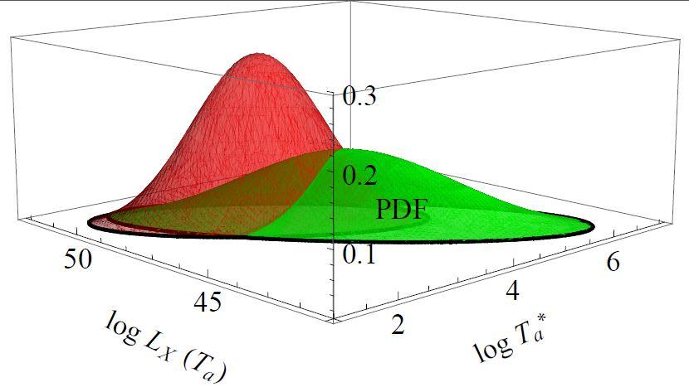
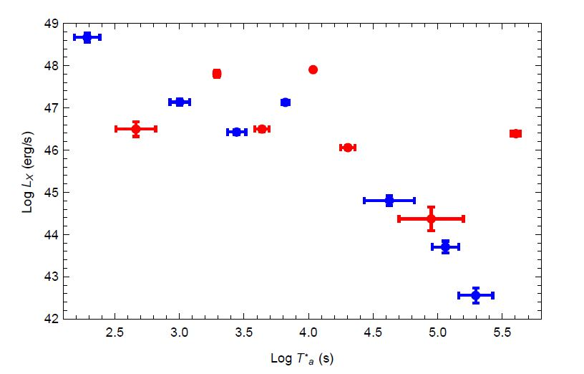
Are long-No-SNe and long-SNe two different populations ? Comparison at all z
Comparison at the same redshift
Red are the long GRBs, while green are the GRBs associated with Sne. If they are approximated by a binormal distribution they are compatible in 1 sigma.
Log LX∗T a distribution of the GRB-SNe sample (A+B) category
(red points) and the long GRB-NO-SNe (black points) at z <0.79.

Slide 22
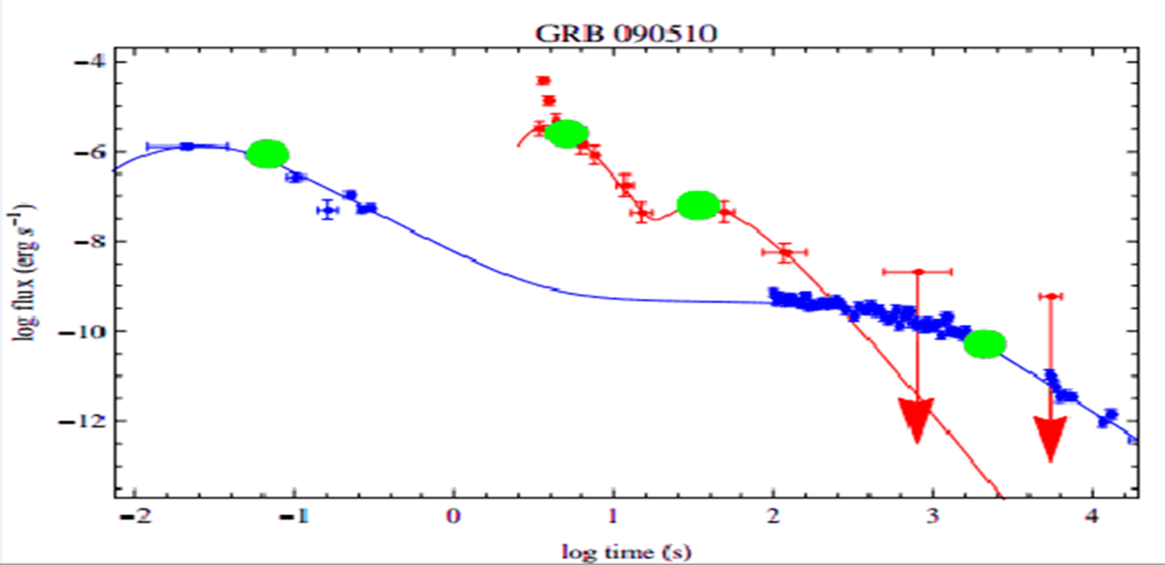
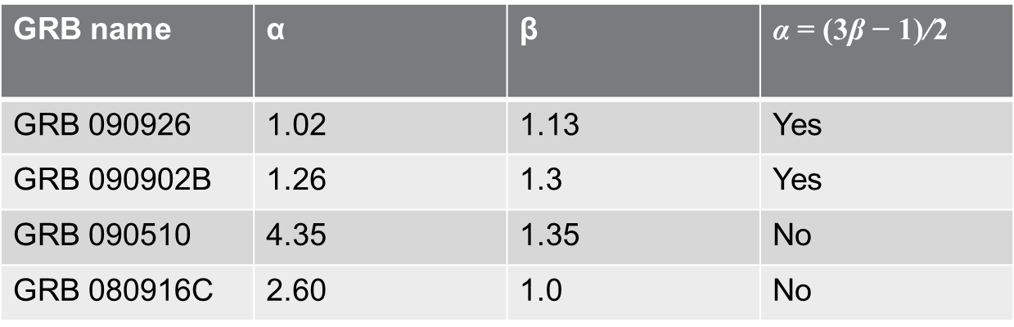
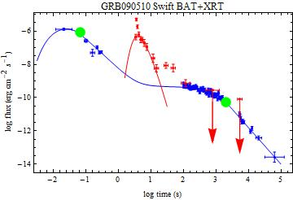
Does the Lx-Ta correlation exist for LAT GRBs?
First step: we can determine the existence of the plateaus ?
While GRB 090902B is compatible with the explanation of Kumar & Duran 2010,
GRB 080916C and GRB 090510 show that the closure relations are not fulfilled

Slide 23
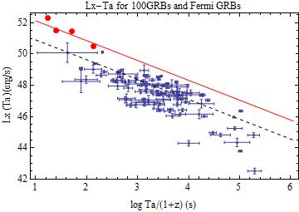
Does the Luminosity-Time relations hold also for high energy GRBs ?
This is still in preparation, still need to be updted with more cases in collaboration with N. Omodei and G. Vianello
Even as the paucity of the data restrains us from drawing any definite conclusion we note similar fitted slopes for L-T correlation,
but with different normalizations.
L-T correlation seems not to depend on particular energy range:
a physical scaling for GRB afterglows both in X-rays and in γ-rays.
Normalizations: log a=52.17 in X-rays and 53.40 in γ-rays

Slide 24
Conclusions III and Future perspectives:
This new subsample of GRBs could be as a test for cosmology together with type Ia SNe, because it is at small redshift range. However, also the long GRBs without Sne associated can be a good candidate for cosmological tools.
Investigation on why the GRB-Sne correlation is much tigher than the long normal Sne is still ongoing
We extended study of DE EoS up to redshift 9 using tight observational correlation in subclass of GRBs (Postnikov, S., Dainotti et al. 2014)
Resulting EoS band is consistent with cosmological constant (-1) and show small tendency for variations, although leaving it open for more data to come.
Current GRB events number and their luminosity distance estimation errors are consistent with what predicted by extrapolation from SNeIa and BAO. More (100 per Δz=1) and better quality (error/10) GRB data is needed to narrow DE EoS at higher redshifts (Dainotti et al. 2011 suggests it is within reach).
Future work is to repeat the method changing the a and b parameters of the correlation together with the cosmological setting and to change also the evolutions of both the variables luminosity and time.

