Slide 1
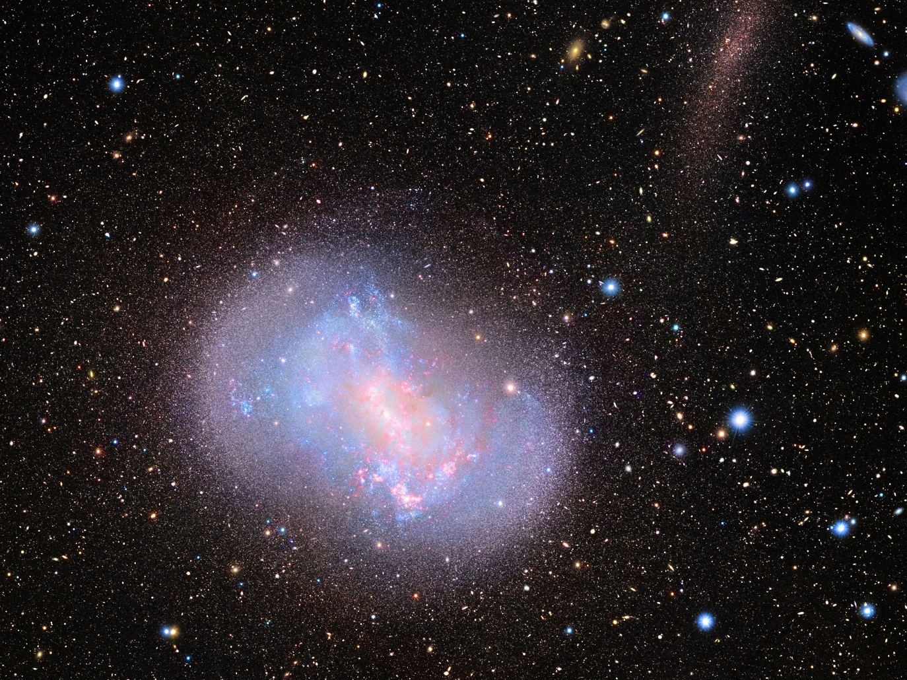
GRB Workshop @ RIKEN, Aug. 31 – Sept. 2, 2015
Solving Coalescence Time Scale Problem of GRB r-Process in Galactic Chemo-dynamical Evolution
Taka KAJINO
(COSNAP Collaboration Group)
National Astronomical Observatory of Japan
Department of Astronomy, The University of Tokyo

Slide 2

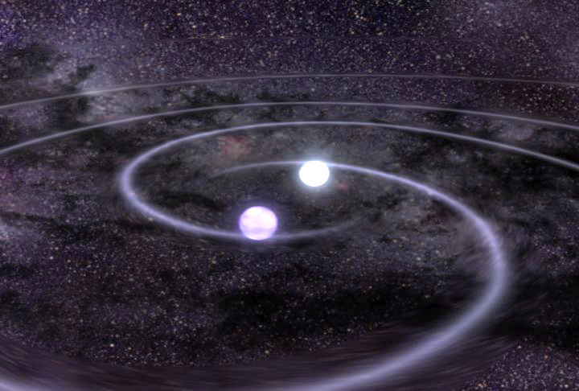
Astrophysical site for the r-process ?
Core-Collapse Supernovae
ν-driven Wind, 3D Hydro, Newtonian, 11.2 M
Takiwaki, Kotake, Suwa, ApJ 786 (2014), 83.
Binary Neutron-Star Mergers
SPH, Newtonian, ν-Leakage scheme
Korobkin et al., MNRAS 426 (2012), 1940.
Why high entropy S/k & low Y_{e} ?
1-10My !
Binary NS could merge too late ?
100My ≤ τ_{c} ≤ 10Ty
Universality !
Time Scale Problem ?
ν
Credit-NASA
ν
ν
ν
ν

Slide 3
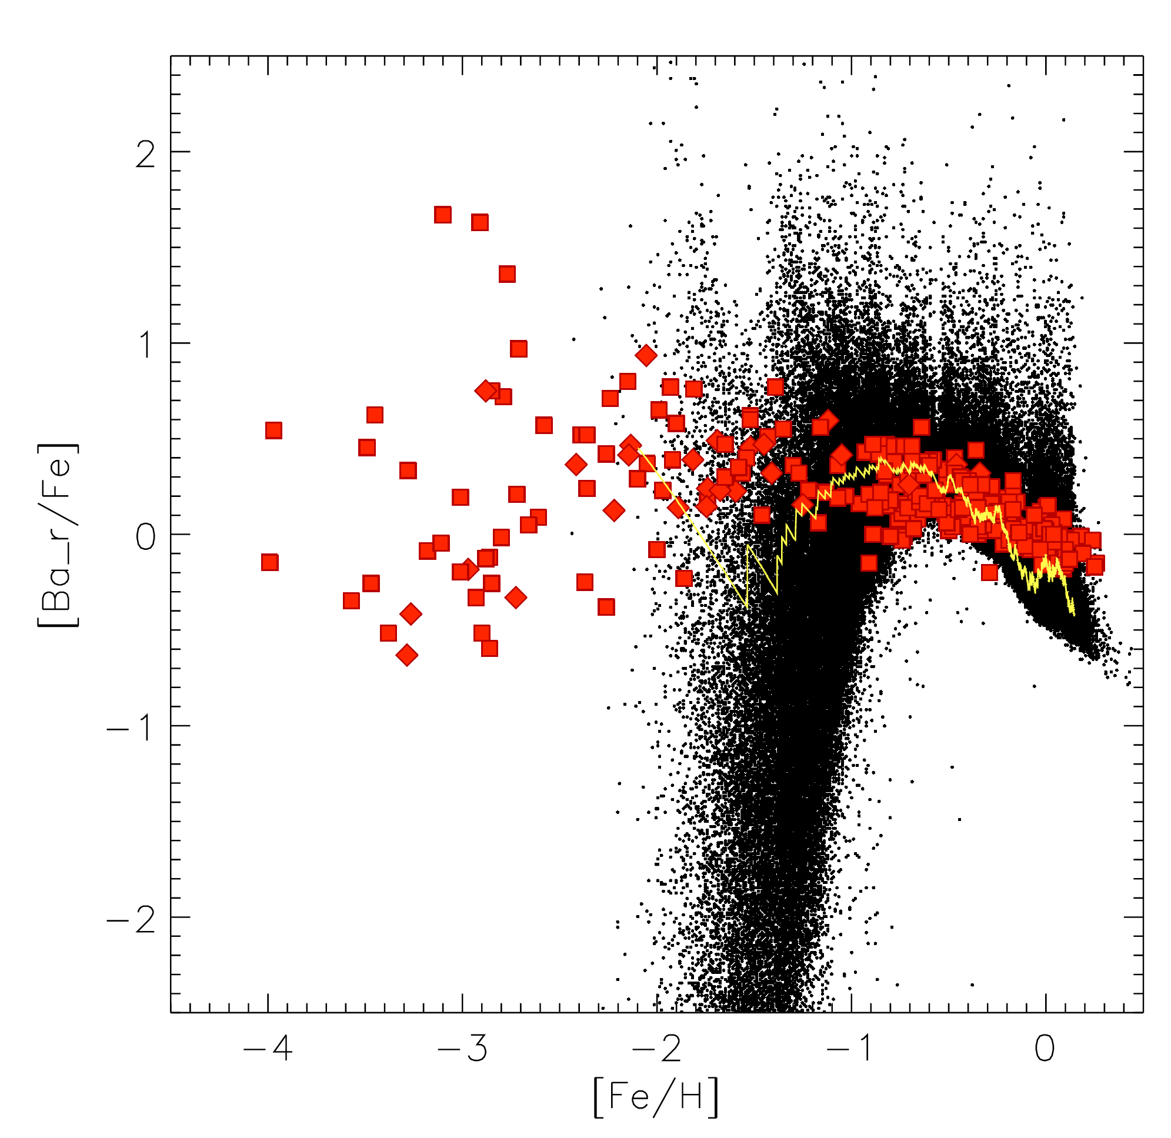

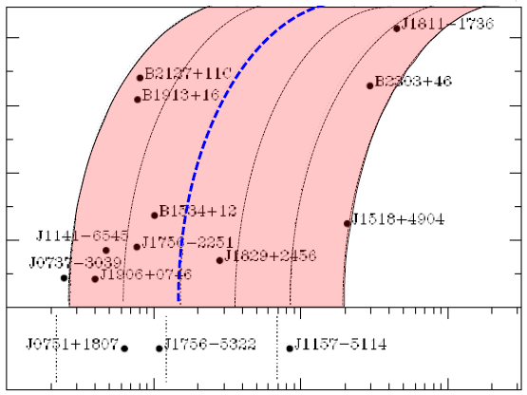
Argast, Samland, Thielemann, Qian,
A&A 416 (2004), 997.
Time Scale Problem ?
Coalescence time τ_{c} is too long !
τ_{c} = 100 My Neutron Star Mergers
(Theory)
τ_{c}
Extremely
Metal-Poor Stars
x
Lorimer, Living Rev. Rel. 11(2008), 8
100 My
1 Gy
10 Gy
100 Gy
1 Ty
10 Ty
0.8
0.6
0.4
0.2
0.0
[Ba_r/Fe]
Orbital eccentricity
Universality
Sun
(obs.)
－4 －3 －2 －1 0
[Fe/H]
1My 10My 100My ・・・ 10Gy
10 100 1000
Orbital period (hours)
100My 10Gy 10Ty
Life of Massive (20M ) stars
Wanderman and Piran(2014), arXiv:1405.5878; τ_{C} = 4Gy

Slide 4
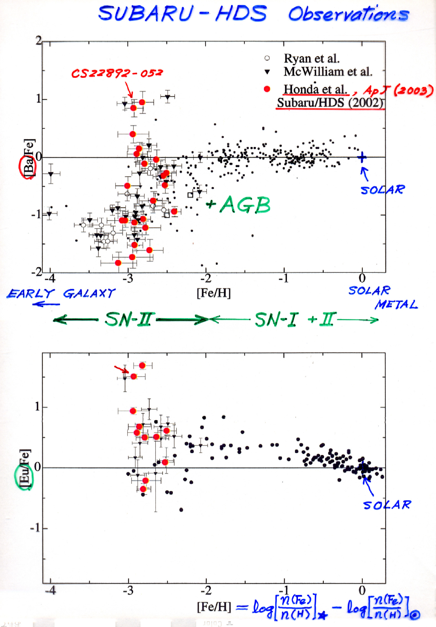
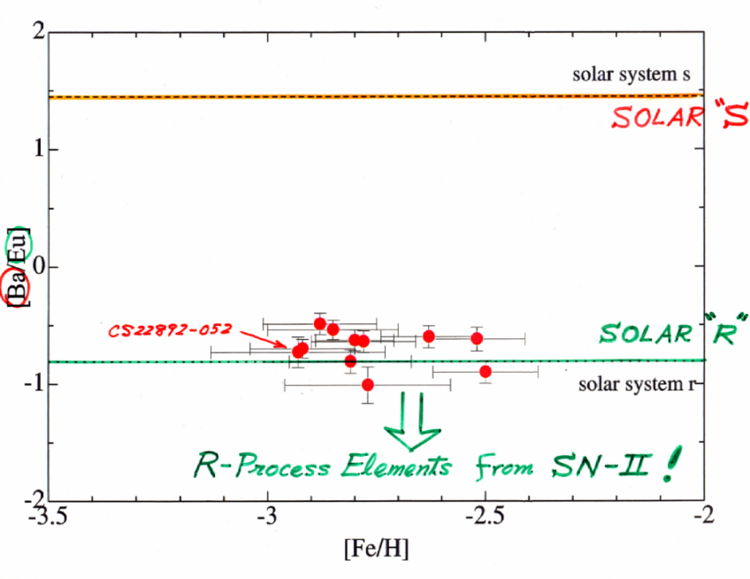
SUBARU Telescope HDS
Honda, Aoki, + Kajino et al. (SUBARU/HDS Collab.), 2004, ApJS 152, 113; 2004, ApJ 607, 474.
Metal-poor stars
Large abundance dispersion at [Fe/H]<-2.5
is an evidence for INDIVIDUAL SN episode!
Single SN episode(s) can exhibit the same r-process abundance pattern.
UIVERSALITY
[Ba/Fe]
0
0
solar - s
SN II SN I + II
[Ba/Eu]
+ binary NSM +AGB
solar - r
R-process elements from Type II SNe !
[Eu/Fe]
[Fe/H]
0
[Fe/H] = log(N_{Fe}/N_{H}) ― log(N_{Fe}/N_{H})
Lack due to
obs. limit.
10 ^{[Fe/H]} = time/10Gy
^{[Fe/H] = -3 ・・・ -2 ・・・ -1 ・・・} ⁰
10My 100My 1Gy 10Gy
Early Universe Today
[Fe/H]

Slide 5
Sneden, Cowan, Gallino, ARAA 46 (2008) 241.
Fe/H
Fe/H
t
10¹⁰y
HST-obs., Roederer et al., ApJ 747 (2012) L8.
log
∝
＝
－3.1
－3.0
－2.1
－2.9
－2.2
－3.0
Te
Six metal-poor
halo stars
Solar system
UNIVERSALITY !
Sr-Y-Zr Ba Eu Au Pb Th U
ELEMENTAL Abundance Pattern(Z)

Slide 6
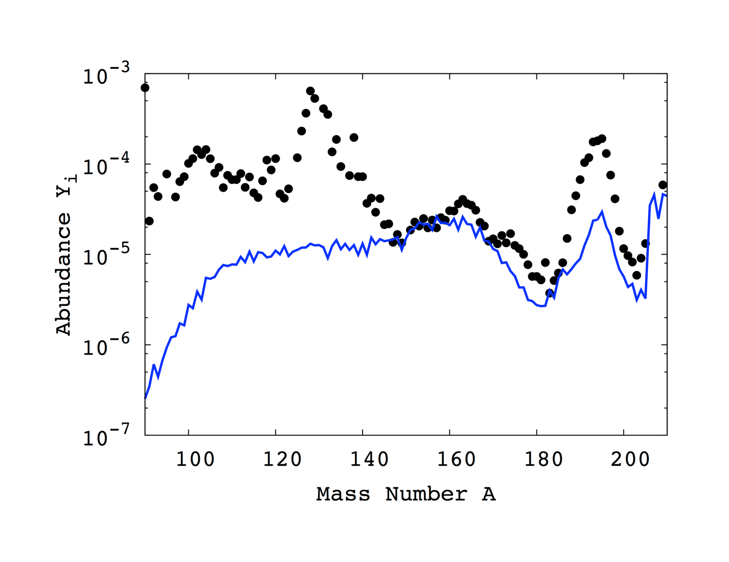
Contribution from Neutron Star Merger
Shibagaki, Kajino, Chiba, Mathews, Nishimura & Lorusso, ApJ (2015) submitted.
Asymmetric fission recycling from A～250 onto A=90-160 fragments
makes the 2nd peak smooth out, still keeping the REE hill and the 3rd peak.
2nd peak (A=130)
3rd peak (A=195)
REE Hill (A=165)
Neutron Star Merger
Solar r-process
elements

Slide 7
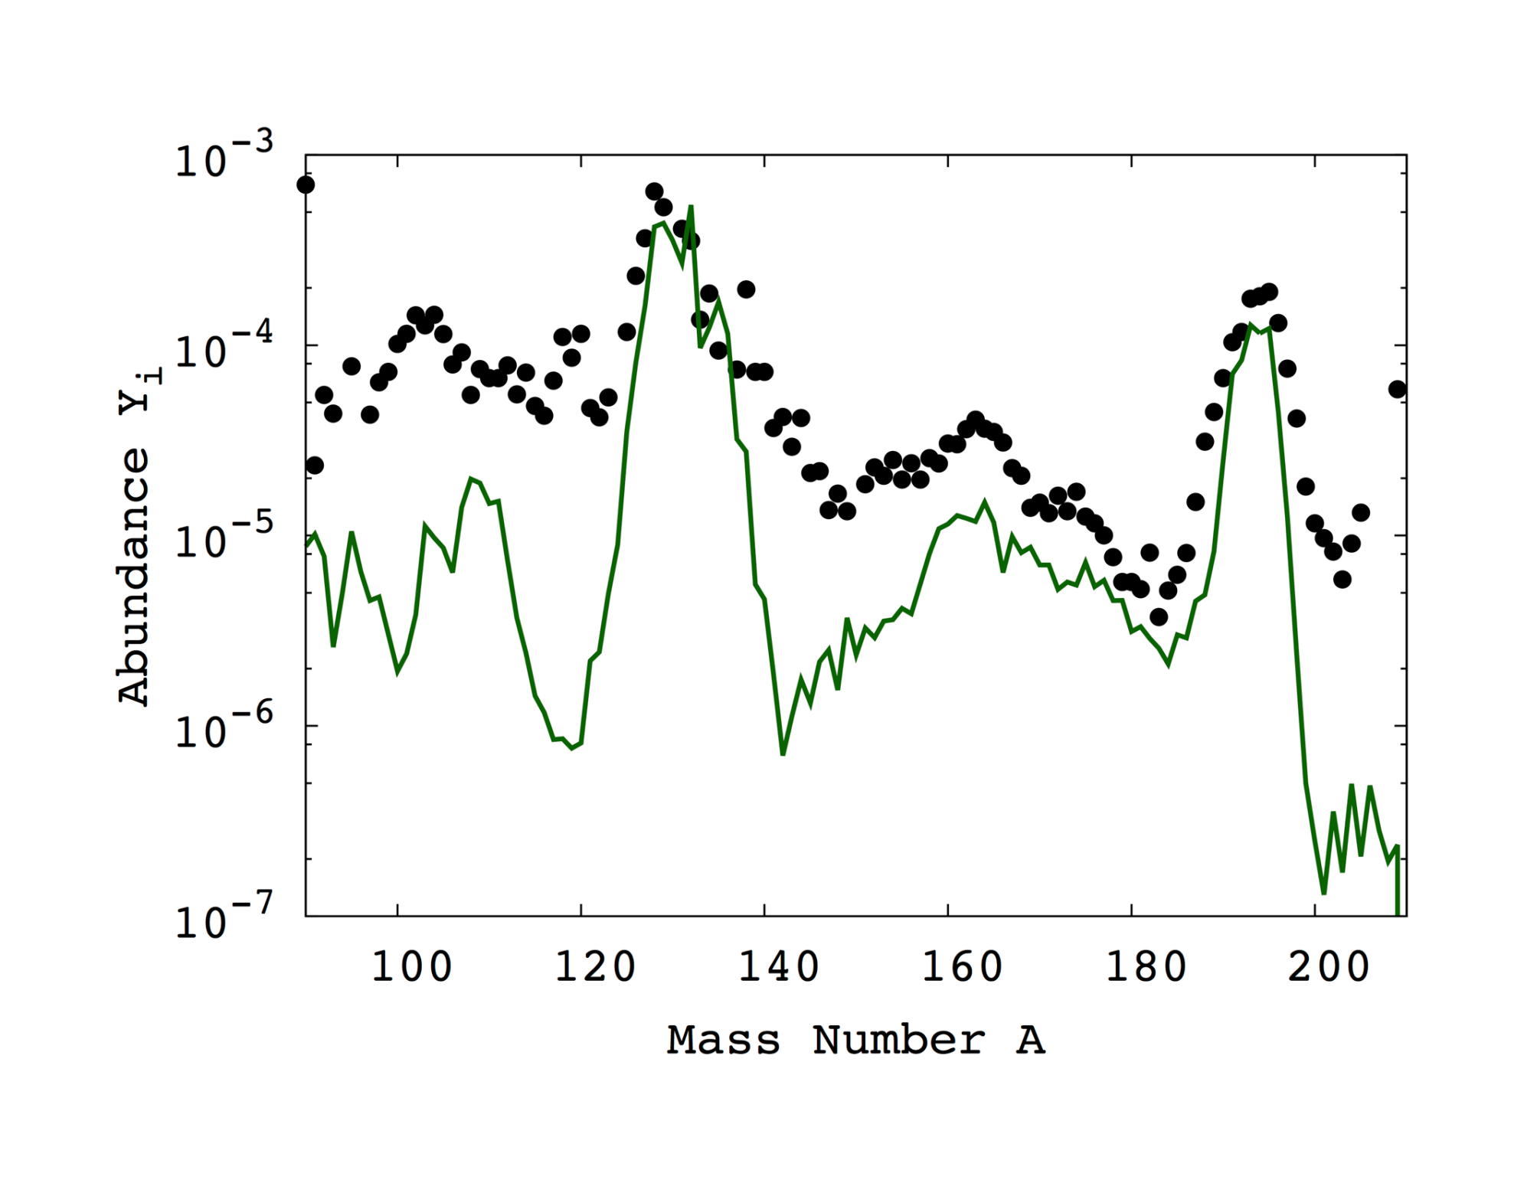
Magneto-Hydrodynamic Jet Supernovae
Nishimura, Kajino, Mathews, Nishimura, Suzuki (2012), PR C85, 048801.
2nd peak (A=130)
3rd peak (A=195)
REE Hill (A=165)
Magneto-Rot. Hydrodynamic
Supernova
ISOTOPIC Abundance Pattern(A)

Slide 8
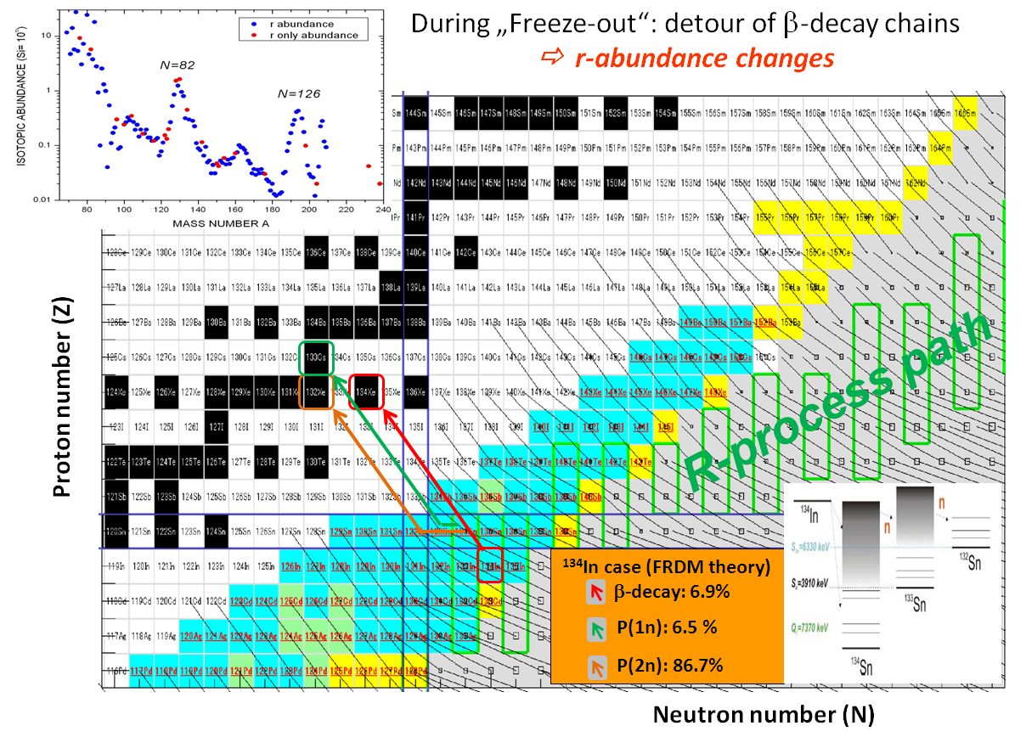
Universality is in
ELEMENTAL (Z) Abundance
¹²⁸Te
Z=50
R-process
path
¹²⁸Pd
N=82
Neutron number (N)

Slide 9
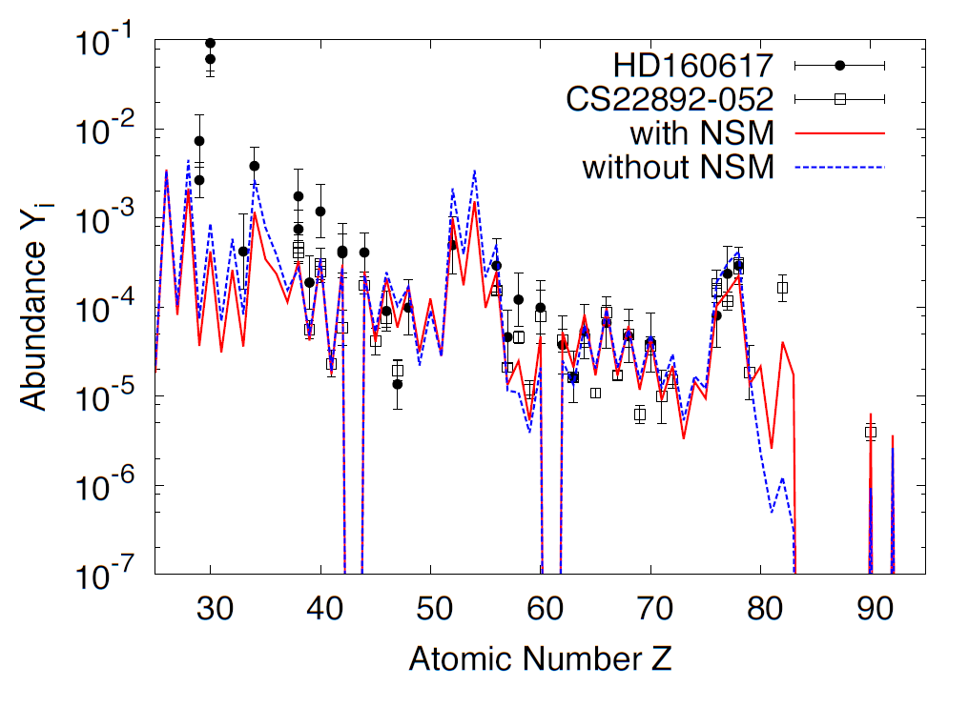
Only MHD-Jet SNe → Universality in EMP stars
Shibagaki, Kajino, Chiba, Mathews, Nishimura & Lorusso, PRC (2015).
^{125,126,128,130}Te
Without NSM
Observed “UNIVERSALITY” does not necessarily need
a contribution from binary NSMs in the early Galaxy !
ELEMENTAL Abundance Pattern(Z)

Slide 10

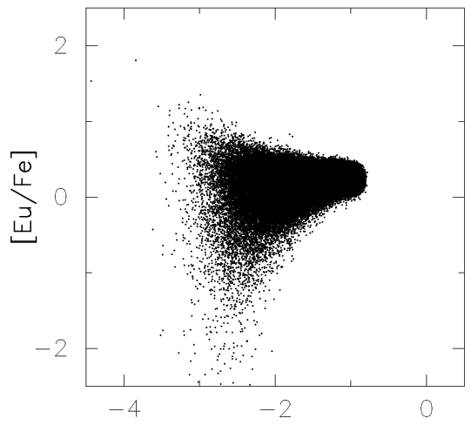
Galactic Chemo-Dynamical Evolution of Dwarf Galaxies
Hierarchical Galaxy Formation Scenario of Milky Way from Dwarf Spheroidals
N-Body/SPH Simulation: SNe + NSM (τ_{c}=100My), GAS MIXING in star forming region is included.
Argast, Samland, Thielemann,
Qian, A&A 416 (2004), 997.
τ_{c} = 100My
Yutaka Hirai,
Ishimaru, Saitoh, Fujii, Hidaka and Kajino,
ApJ (2015), submitted.
τ_{c} = 100My – 500My
Without GAS MIXING
With GAS MIXING
NSM contributes at later epoch !
SN(MHDJ)
contribution
[Fe/H] Galactic Time
[Fe/H] Galactic Time

Slide 11
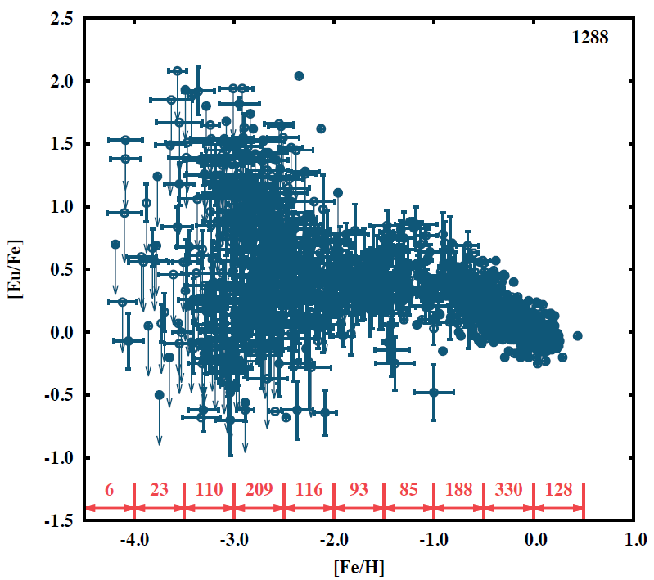
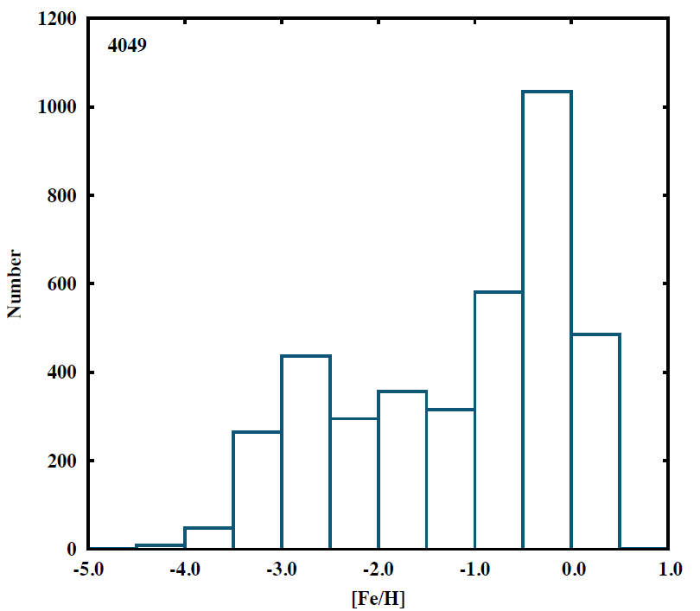
Milky Way halo Kajino, Shibagaki,
Hirai, Suda, Aoki,
& Mathews (2015)
SAGA data base
(Suda et al.)
[Eu/Fe]
- 4.0 - 3.0 - 2.0 - 1.0 0.0
[Fe/H]
SN (MHD Jet) contribution
in the early Galaxy
Binary Neutron-Star Mergers
Number of Stars
(arbitrary unit)
Disk (Pop. I)

Slide 12
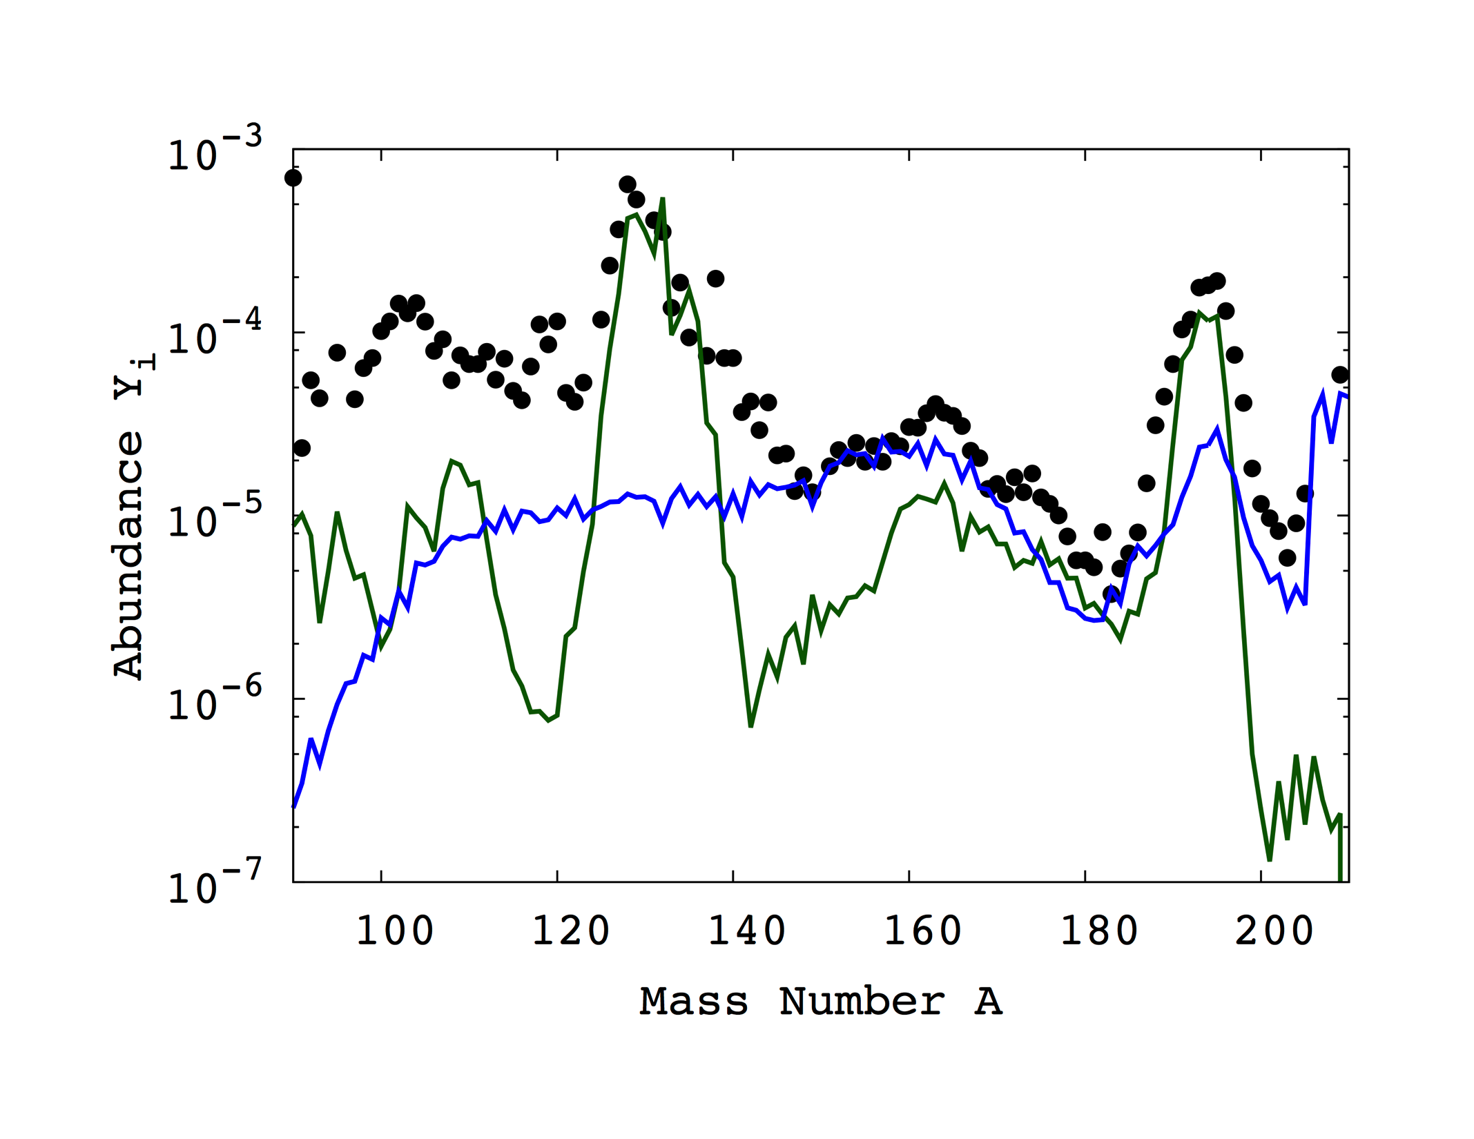
Solar System r-Process Abundance : TODAY
Shota Shibagaki, Kajino, Chiba, Mathews, Nishimura & Lorusso, ApJ (2015).
SN(ν-DW) + SN(MHDJ) + Binary NSM
ν-Driven Winds
Total SUM
80%(νSN weak-r)+15%(MHDJet)+5%(NSM)
Neutron Star Mergers
Magneto-Hydrodynam.
Jet Supernovae

Slide 13
Relative Contributions of
ν-SNe : MHD Jets : NSMs
from Galactic event rate observations !
Shibagaki, Kajino, Chiba, Mathews, Nishimura & Lorusso, ApJ(2015), subm.
Ejected Mass [Msun] x Event Rate [/Galaxy/Century]
Weak r = 7.4 x 10⁻⁴ x (1.9±1.1) ª
MHD Jet = 0.6 x 10⁻² x ((0.03±0.02) x (1.9±1.1)) ^{b}
NSM = (2±1) x 10⁻² x (1-28)x10⁻³ ^{c}
Observations a 1.9±1.1 Diehl, et al., Nature 439, 45 (2006).
b 0.03±0.02 Winteler, et al., ApJ 750, L22 (2012).
Obs. Estimate c (1-28) x 10⁻³ Kalogera, et al., ApJ 614, L137 (2004).

Slide 14
SUMMARY
on the Origin of R-Process ?
Only magneto-hydrodynamic jet supernovae (MHDJ SNe) can contribute to the r-process in the early Galaxy and explain the “universality” at EMP stars with [Fe/H]<-3.
Assuming binary neutron-star merger (NSM) r-process, Galactic chemo-dynamical evolution including gas mixing effects in star forming region partially accounts for the dispersion of the r-process elemental abundance pattern. However, it is limited to mergers for 100My < τ_{c} < 500My.
Both MHDJ SNe and binary NSMs definitely contribute to the solar-system r-process elements.

