Slide 1
The Star Formation Rate and Metallicity of the Host Galaxy of the Dark GRB 080325 at z=1.78 followed by the short gamma-ray bursts
Tetsuya Hashimoto (NAOJ)
Hashimoto et al. 2015, ApJ 806, 250
GRB workshop 2015 (31 Aug – 2 Sep) @RIKEN

Slide 2
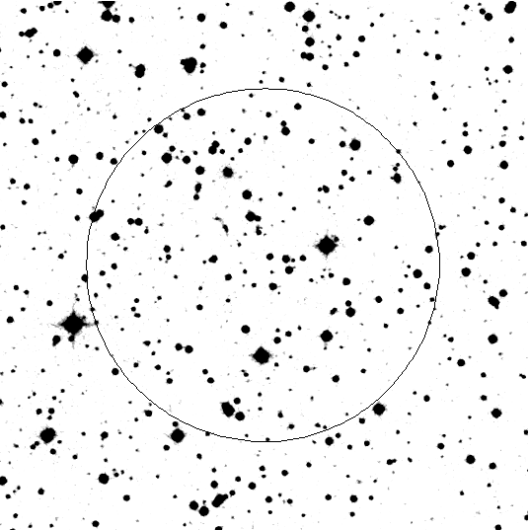
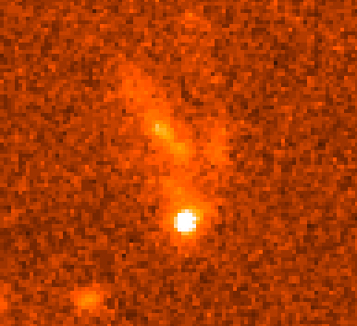
How to identify GRB host galaxy
Positional accuracy by Gamma-Ray detector
Bright optical afterglow is important to identify host galaxy
GRB host provides us …
dust, metallicity, SFR and stellar mass of host
Optical Afterglow
Host
OA
NASA (HST)

Slide 3
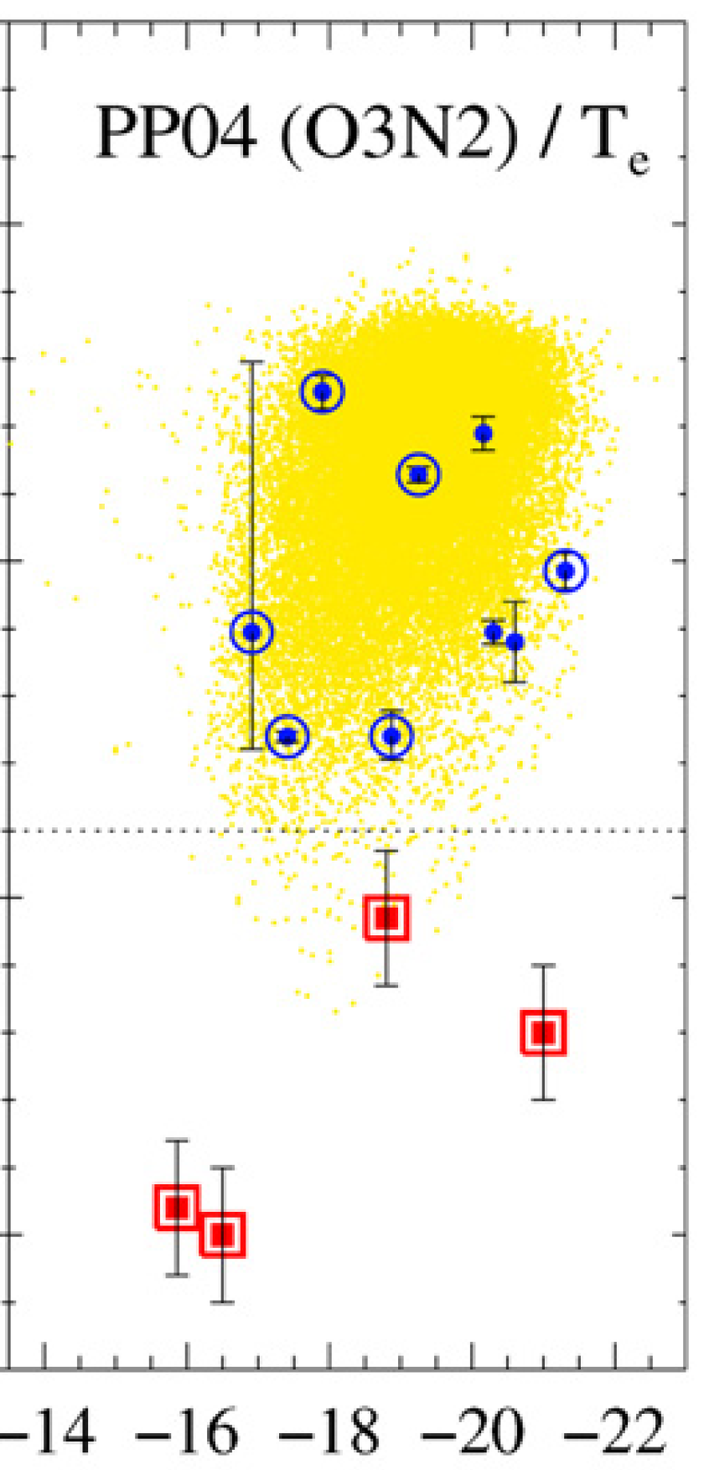
Metallicity of GRB host galaxies
Supernova (w/o GRB)
9.0
GRB+Supernova
GRBs occur in
SDSS
8.5
Low-metallicity environment
Metallicity
8.0
compared with SN hosts w/o GRBs and normal SF galaxies
7.5
Modjaz et al. 2008
Brightness of host galaxies

Slide 4
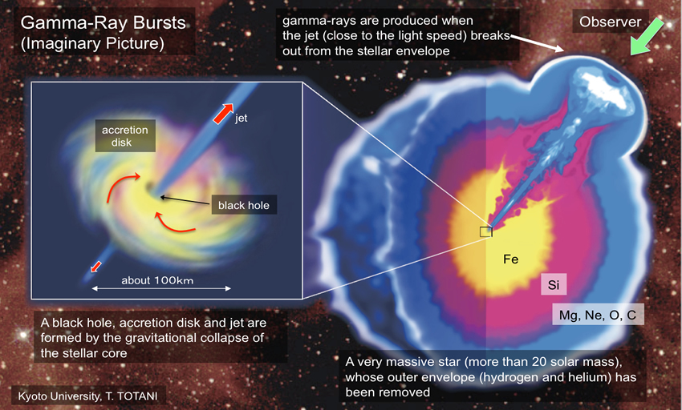
Collapsar models require
low-metal environment
Theoretical models involving the evolution of a single, rapidly rotating massive star require a
low-metallicity environment
e.g.,
Woosley & Heger 2006
Yoon et al. 2006
Imaginary picture of GRB (T. Totani)
–death of a massive star–
However, current GRB host samples are strongly biased to optically bright AG

Slide 5
“Dark” GRBs
shows unusually optical faint afterglow
makes it difficult to discover and identify their hosts
http://www.mpe.mpg.de/~jcg/grbgen.html
Jochen Greiner, 31-Aug-2015
Significant numbers of dark GRBs
Properties of Dark GRB hosts remains a mystery
Follow up observation with large optical/near-IR telescope is getting more important

Slide 6
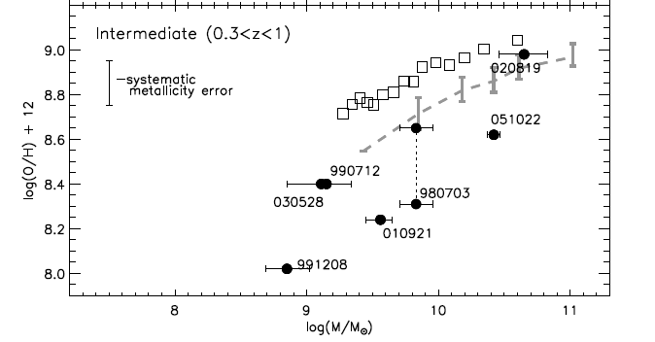
High-metal dark GRB hosts!?
Niino+ T. H. et al. 2012
100418A
(z=0.624)
(KK04)
(dark GRB)
DEEP2 Survey
(0.4 < z < 1.0)
Abraham et al. 2004
(dark GRB)
critical metallicity
Erb et al. 2006
(z ～ 2)
levesque et al. 2010

Slide 7
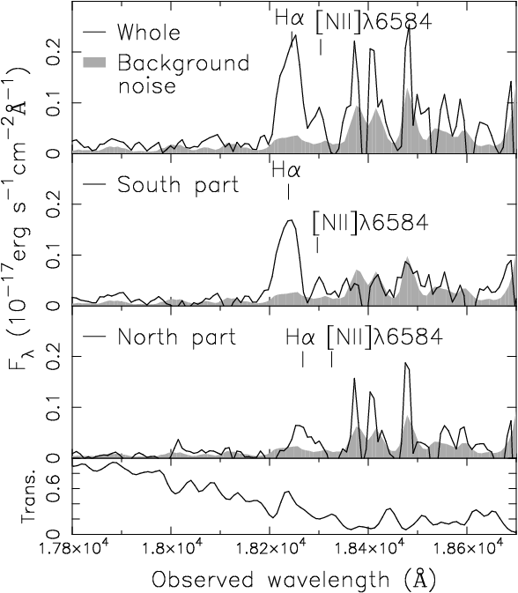
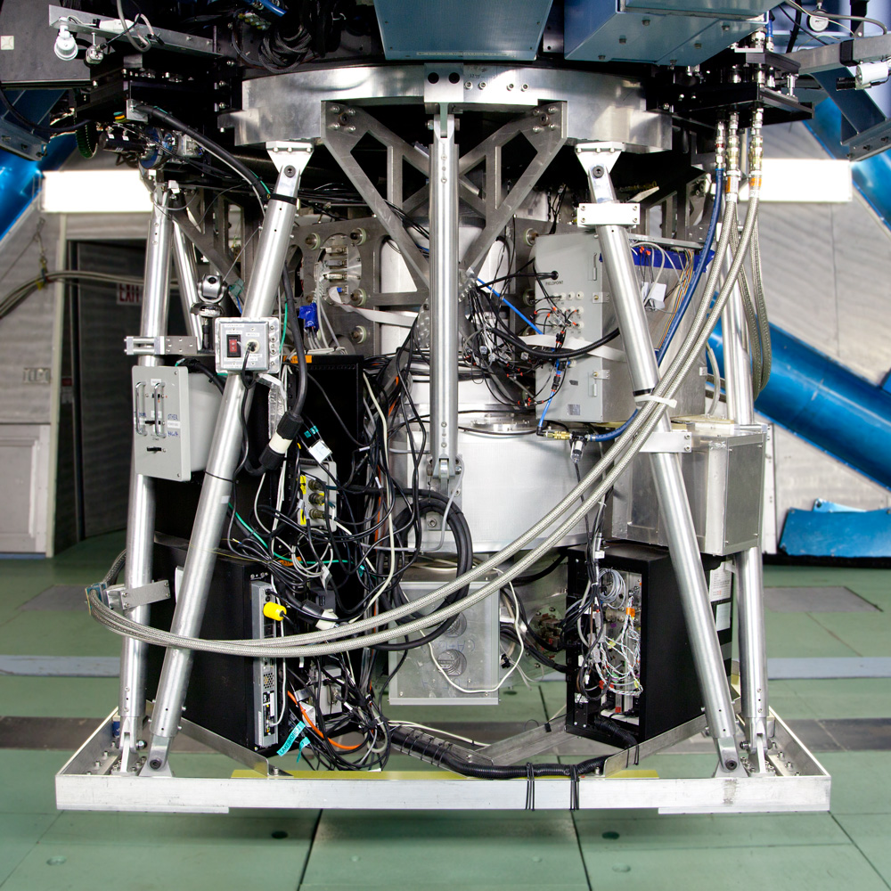
Near-IR Spec of Dark GRB 080325 host with Subaru/MOIRCS
Dark GRB 080325 host at z=1.78
S
N
HST image (1.2um)
Spec with Subaru/MOIRCS
TH+ 2015

Slide 8
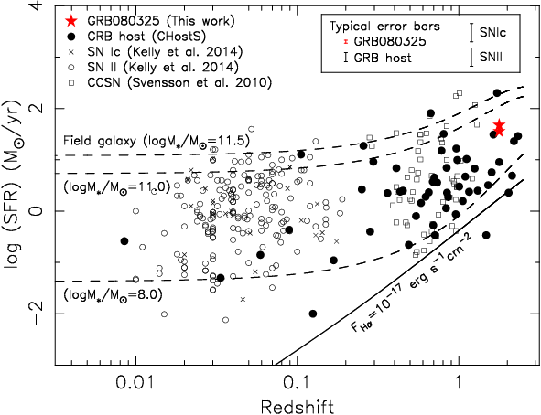
Star Formation Rate of host galaxies
The SFR of the host is typical among GRB host galaxies and SF galaxies
TH+ 2015

Slide 9
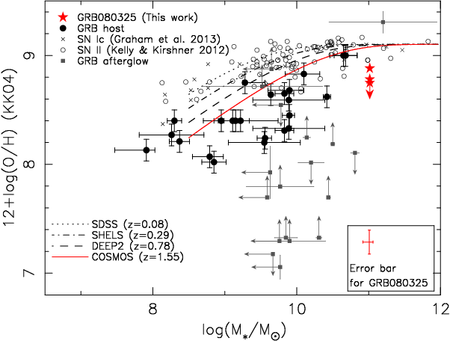
``Mass-metallicity relation’’ of host galaxies
The metallicity is fairly high among GRB hosts
The mass metallicity relation of normal SF galaxies evolves with redshift
TH+ 2015

Slide 10
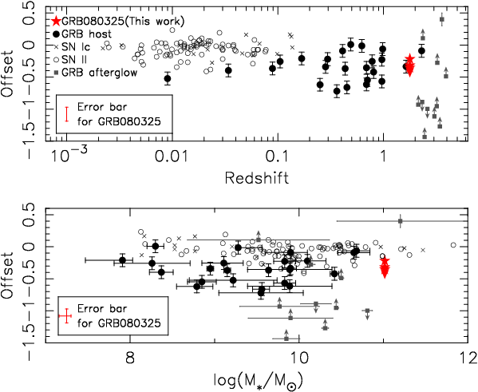
``Metallicity offset’’ from normal galaxies
The metallicity is high
But, still lower than
Normal SF galaxies
GRB hosts including dark bursts are uniformly biased toward low metallicity over a wide range of redshift and stellar mass
TH+ 2015

Slide 11
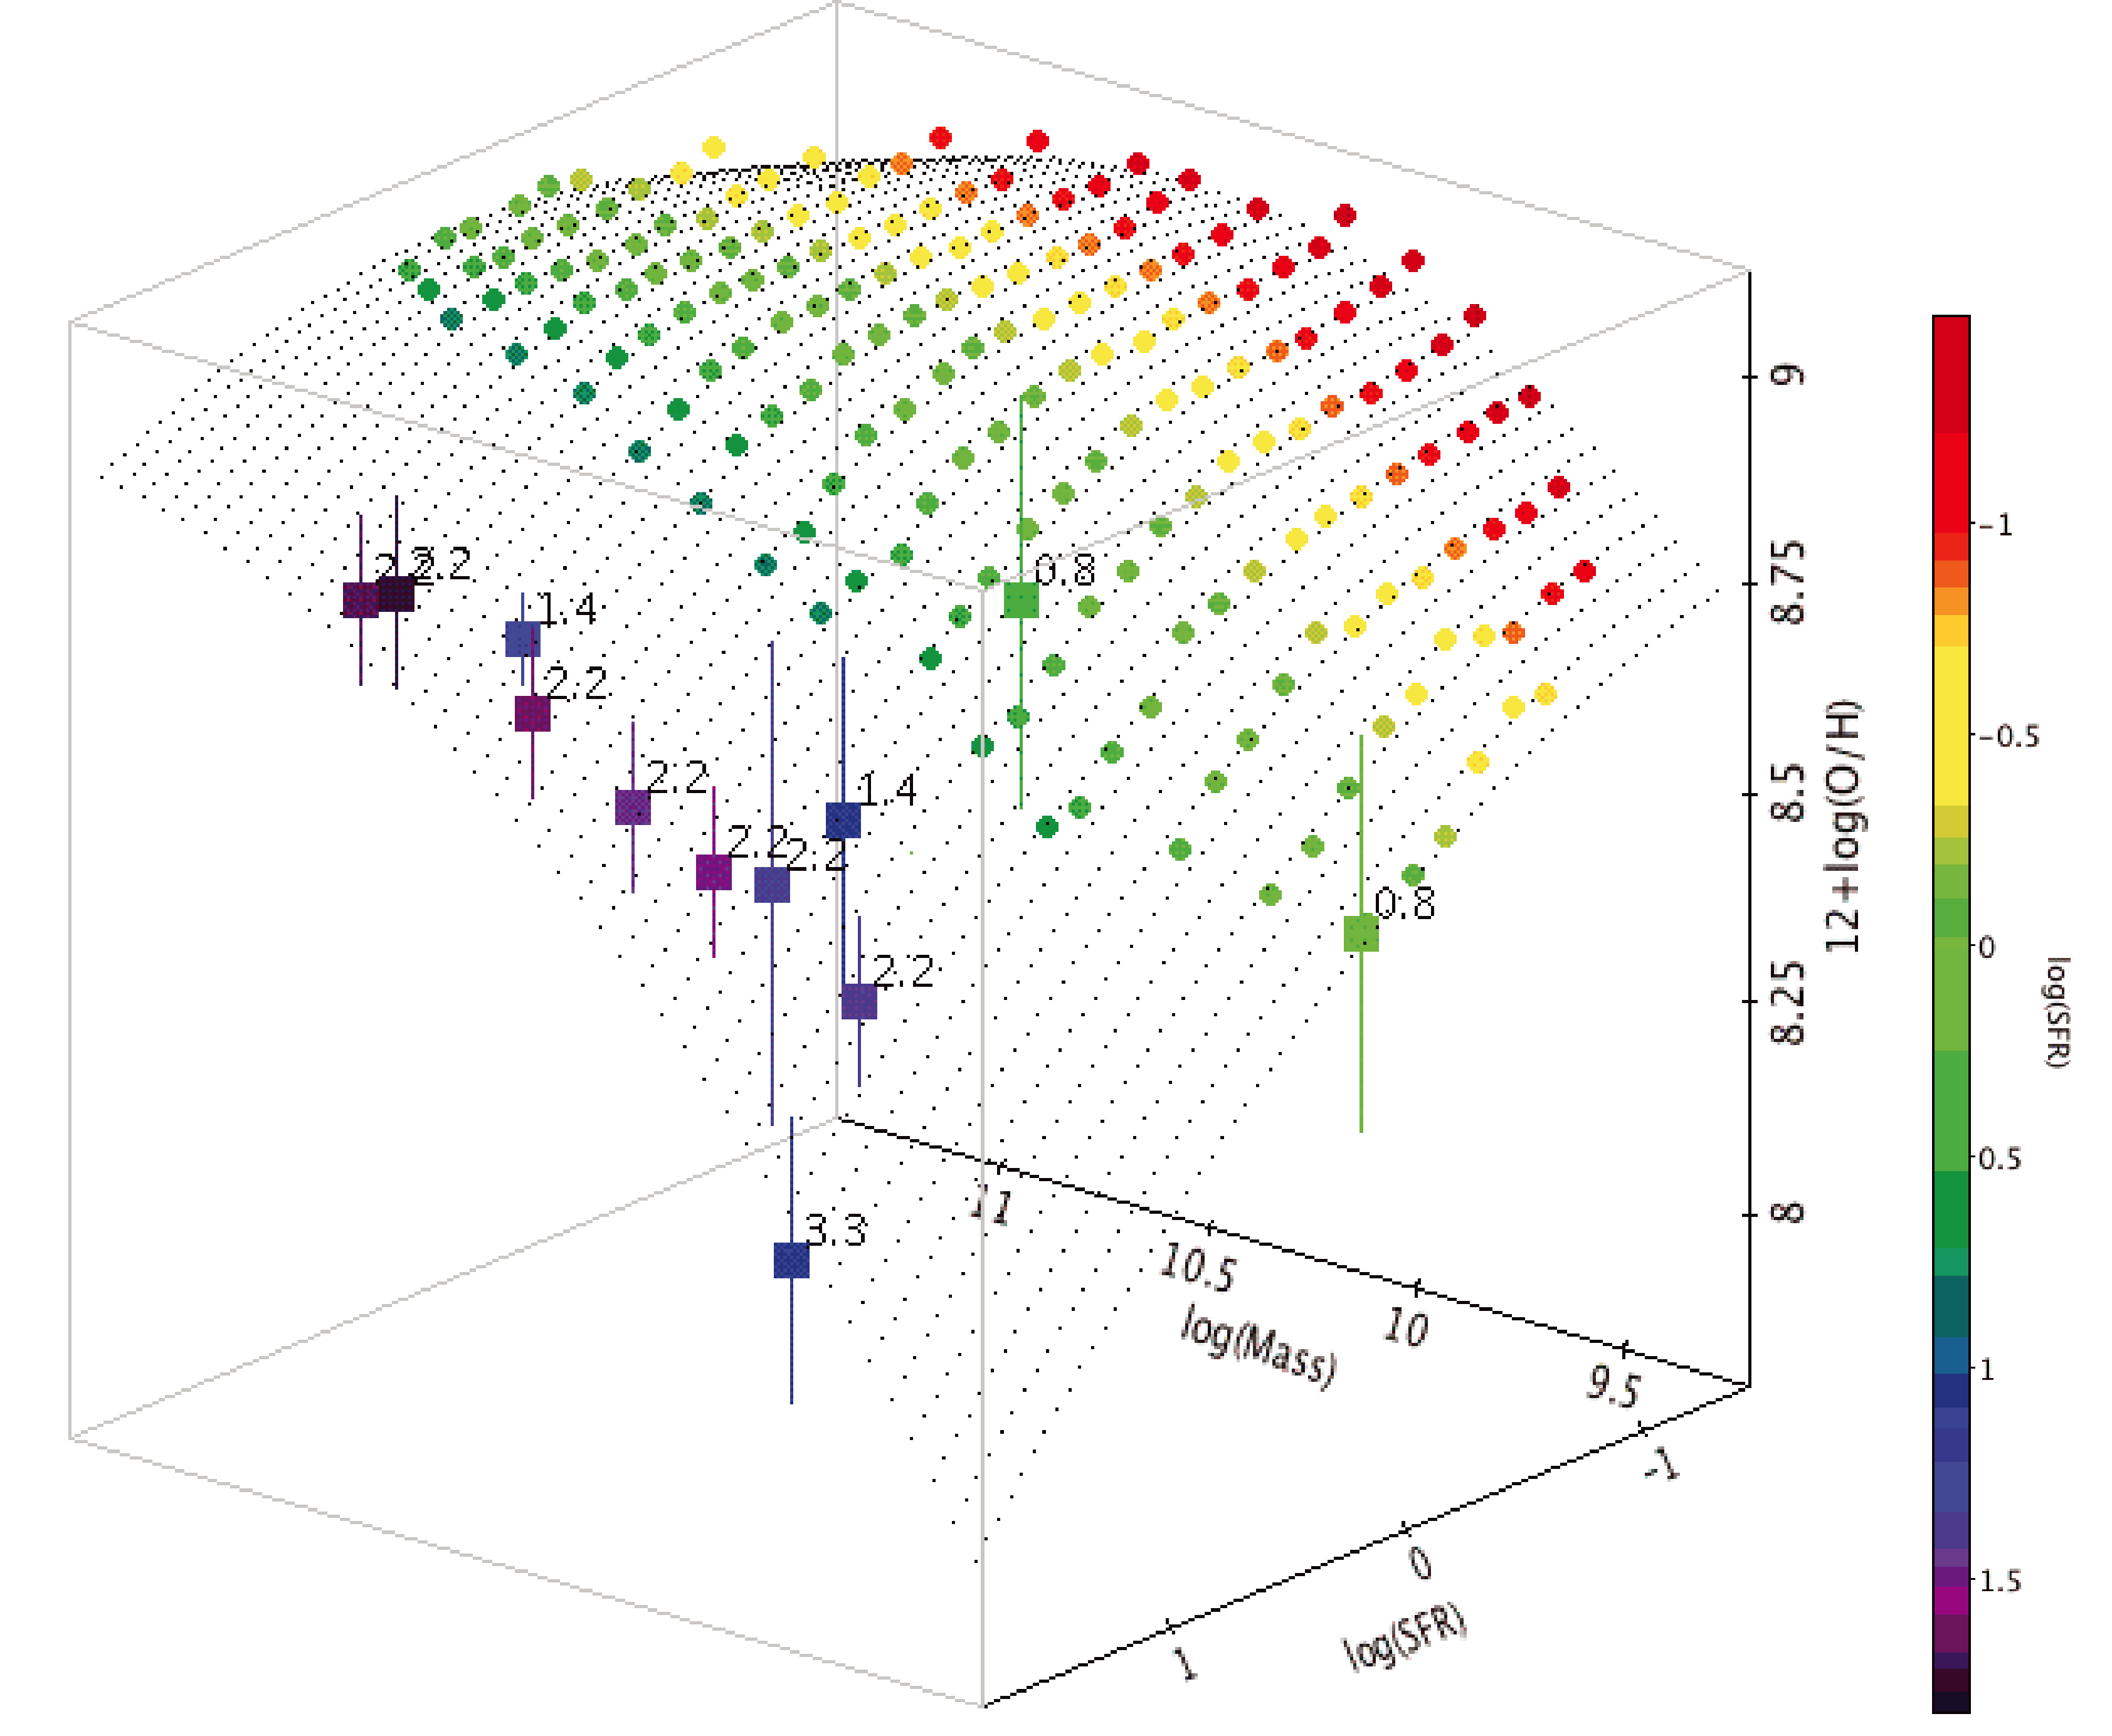
Low-metallicity nature is just mock?
Fundamental Plane of normal SF galaxies proposed by Mannucci et al. 2010
Same-mass galaxy with
Higher SFR
Lower metallicity
SFR selected GRB host
Low metallicity w/o any relation to GRB mechanism
Mannucci et al. 2010

Slide 12
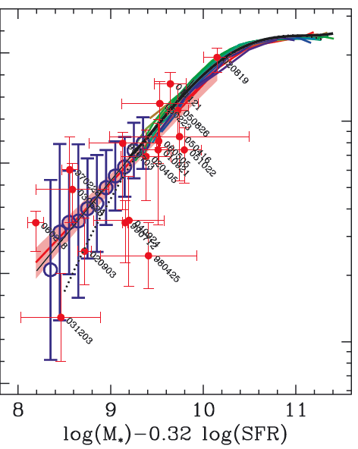
The projection of 3D curved surface of the fundamental plane
is consistent with the distribution of GRB host galaxies.
Mannucci et al suggest….
The apparent low metallicity is a consequence of the occurrence of a long GRB in low-mass, actively SF galaxies, known to dominate the current cosmic SFR.
080325
As for dark GRB 080325 host, the upper limit of the GRB site metallicity is ~0.5 dex lower than the fundamental plane.
Mannucci et al. 2011
Low-metal outlier of fundamental plane

Slide 13
Summary
We present near-IR spectroscopy of the host galaxy of the dark GRB 080325 using Subaru/MOIRCS
The SFR of the host is typical among GRB host galaxies and SF galaxies generally.
The metallicity is fairly high among GRB hosts, however, this is still lower than the metallicity of normal SF galaxies of the same mass at the same redshift.
The metallicity offset from normal SF galaxies is close to a typical value of other GRB hosts and indicates that GRB host galaxies are uniformly biased toward low metallicity over a wide range of redshifts and stellar masses.
The host is a metal-poor outlier of fundamental plane, thus, we conclude that the low metallicity is important to the mechanism that produced this GRB

