Slide 1
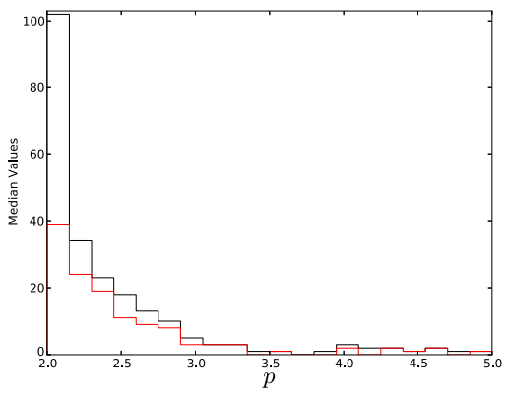
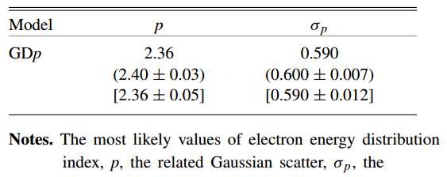
Efficient Shock Acceleration of Ions & Electrons in the Afterglow Phase of GRBs
Curran et al. (2010) (2010ApJ...716L.135C)
Ryan et al. (2015) (2015ApJ...806...15Z)
Don Warren
RIKEN – ABBL
GRB Workshop 2015
31 Aug 2015

Slide 2
Outline
Background
Nonlinear diffusive shock acceleration (DSA) in relativistic shocks
Nonlinear shock acceleration of electrons
Photon spectra

Slide 3
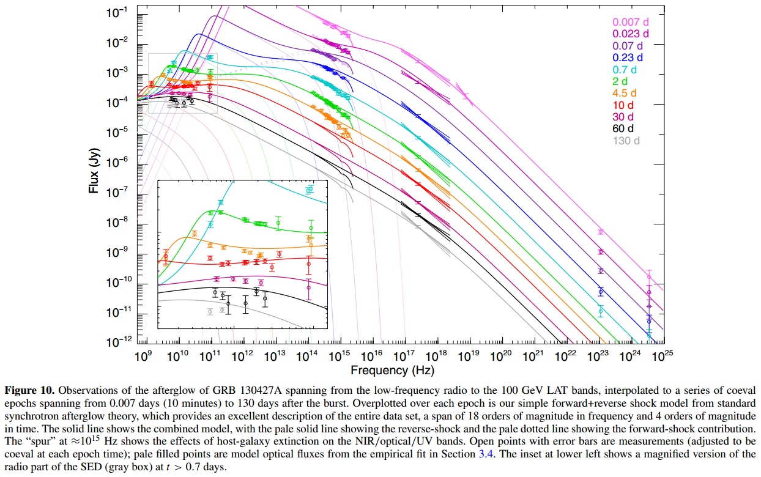
Background
Observations of GRB afterglows cover orders of magnitude in time and energy
Perley et al. (2014)
(2014ApJ...781...37P)

Slide 4
Background
Current afterglow studies assume extremely simple model for CR electrons accelerated by shock
Early times Late times
(mostly) Fine if shocks are test-particle and unaffected by B- field
N(E)
N(E)
E_{min}
E_{max}
E_{min}
E_{max}
Energy
Energy

Slide 5
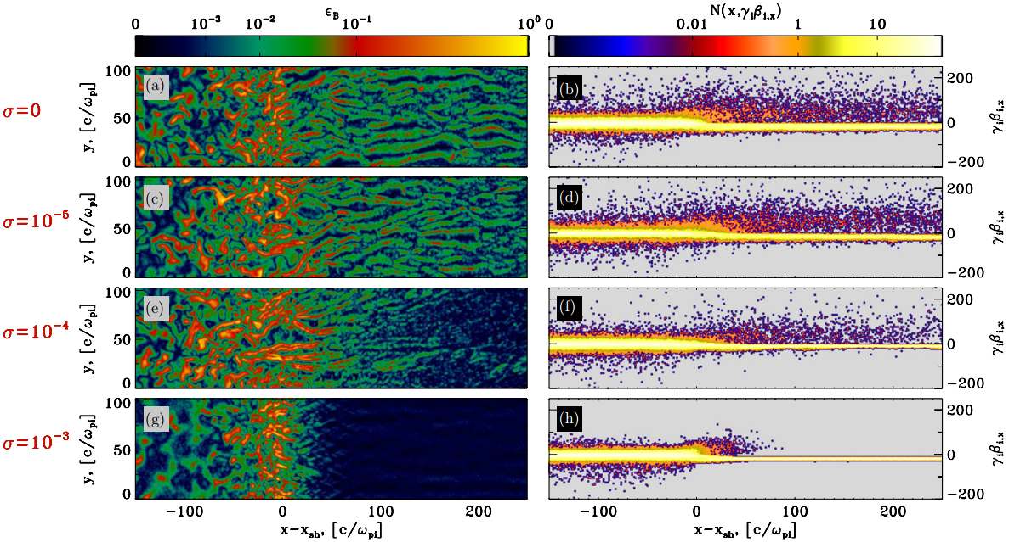
Background
Per PIC simulations, magnetic field may not be negligible, and accelerated particles may influence shock structure
Sironi et al. (2013) (2013ApJ...771...54S)
Notes:
Focus on top two rows. Explain what is being displayed. Point out strength of magnetic field (approaching or exceeding eps = 0.1) and number of particles upstream

Slide 6
Background
Strong B-field turbulence in vicinity of shock can scatter particles back into upstream region (← DSA)
Pressure from UpS particles affects
inflow of plasma, which affects shock,
which affects acceleration, which
affects pressure from UpS particles…
flow speed
shock
Spitkovsky (2008) (2008ApJ...682L...5S)
X
flow speed
subshock
X

Slide 7
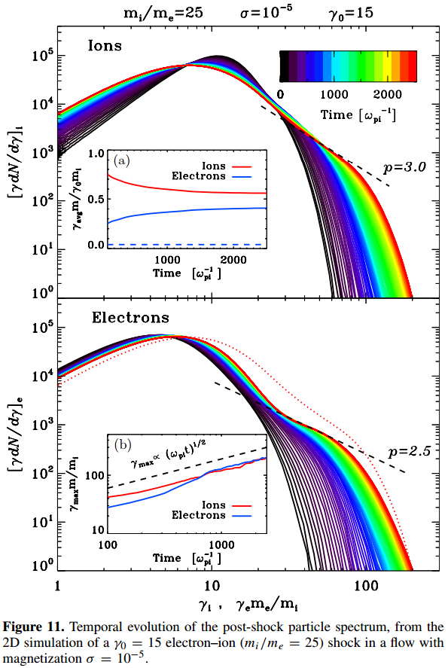
Background
Sironi et al. (2013) (2013ApJ...771...54S)
Interaction between shock, B-field
turbulence, and accelerated
particles important!
Leads to more complicated CR
spectrum than simply E^{-p}
PIC simulations impractical if
extended to necessary scales to
model GRB afterglows
Monte Carlo approach presented
here balances self-consistency &
computation time

Slide 8
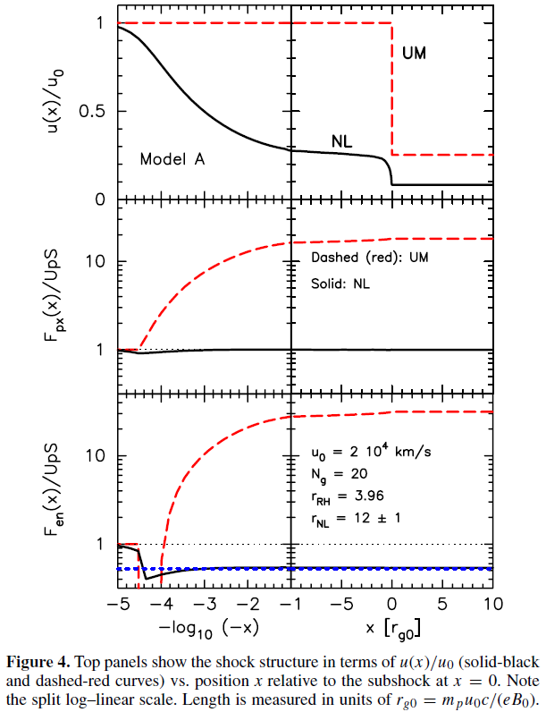
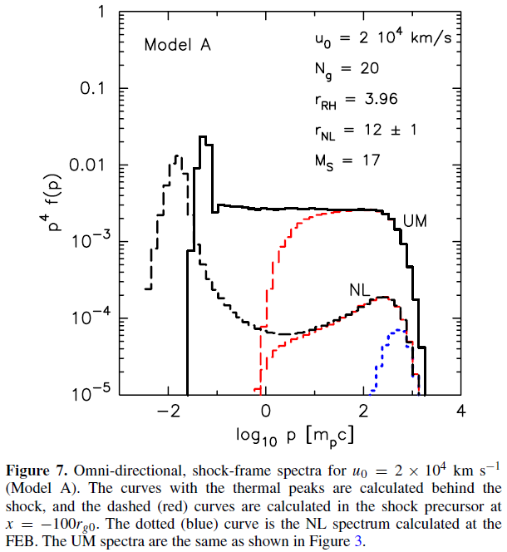
Nonlinear DSA in relativistic shocks
Ellison et al. (2013) (2013ApJ...776...46E)
Interaction between shock, B-field
turbulence, and accelerated
particles important!
Efficient DSA by unmodified shocks
does not conserve energy or
momentum flux
Ellison et al. (2013) (2013ApJ...776...46E)

Slide 9
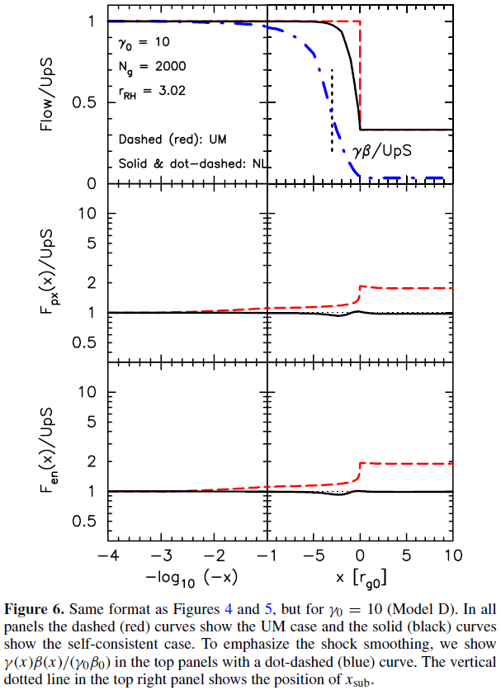
Nonlinear DSA in relativistic shocks
Ellison et al. (2013) (2013ApJ...776...46E)
Interaction between shock, B-field
turbulence, and accelerated
particles important!
Efficient DSA by unmodified shocks
does not conserve energy or
momentum flux
Even in relativistic shocks, must
have precursor & modified
velocity profile

Slide 10
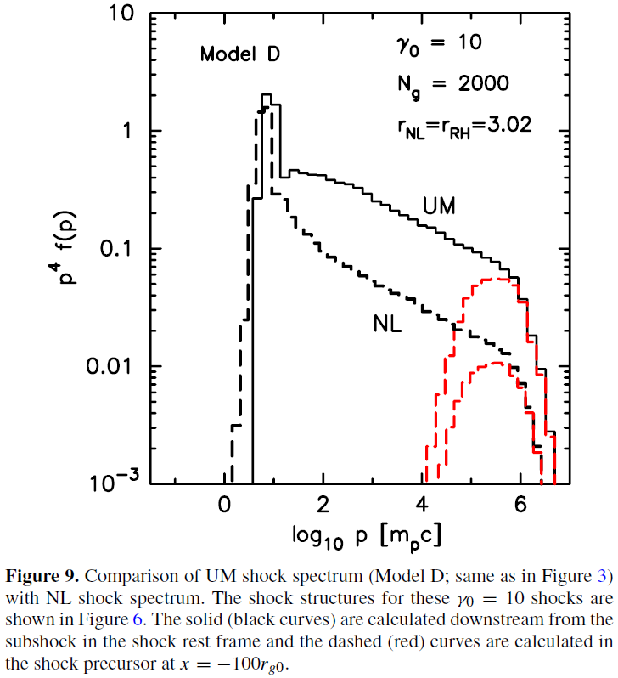
Nonlinear DSA in relativistic shocks
Ellison et al. (2013) (2013ApJ...776...46E)
Effects of NLDSA on spectrum of CR
protons:
Fewer CRs at any particular energy
Region of steep decay before
spectrum flattens to ≈p^{-4.23}
Approx. 30% of energy in CRs, so
acceleration still very efficient
Notes:
Point out agreement with PIC results out to gamma of ~100

Slide 11
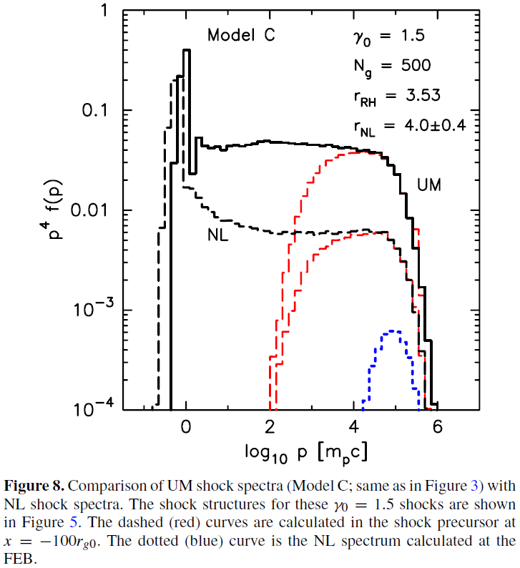
Nonlinear DSA in transrelativistic shocks
Ellison et al. (2013) (2013ApJ...776...46E)
Monte Carlo approach can probe
DSA in regimes PIC simulations have
difficulty with, e.g. mildly relativistic
shocks
Accel efficiency >50%
Spectrum of CRs shows hint of
concavity
Suggests smooth transition between
NLDSA at rel speeds and non-rel speeds

Slide 12
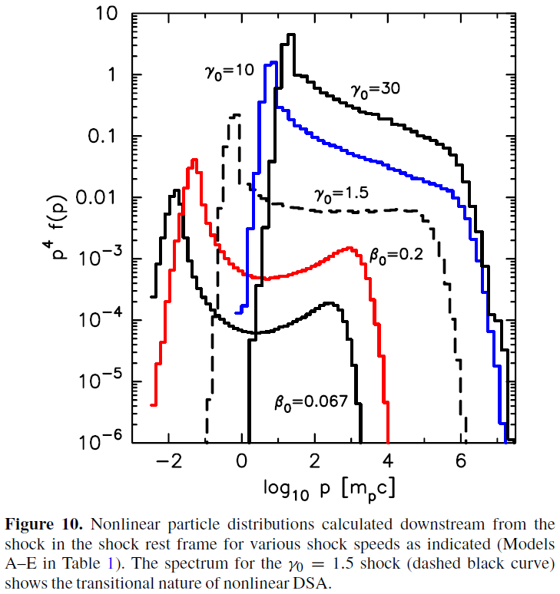
Nonlinear DSA in relativistic shocks
Ellison et al. (2013) (2013ApJ...776...46E)
As shock slows, CR spectrum
changes too
Single-index approach to CR
energy distribution may not
hold at any given instant
Very unlikely to hold across
extended observations of
GRB afterglows
But what about electrons?

Slide 13
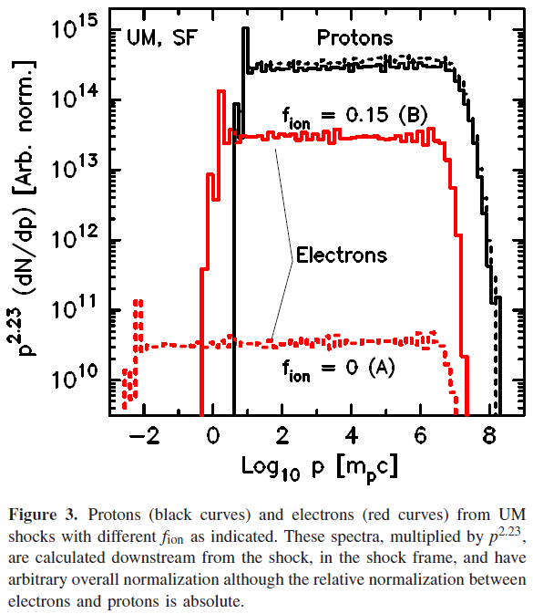
Electron DSA in relativistic shocks
Warren et al. (2015) (2015MNRAS.452..431W)
Electron acceleration much less
efficient than proton acceleration
Without energy transfer from ions,
GRB afterglow would be extremely
faint

Slide 14
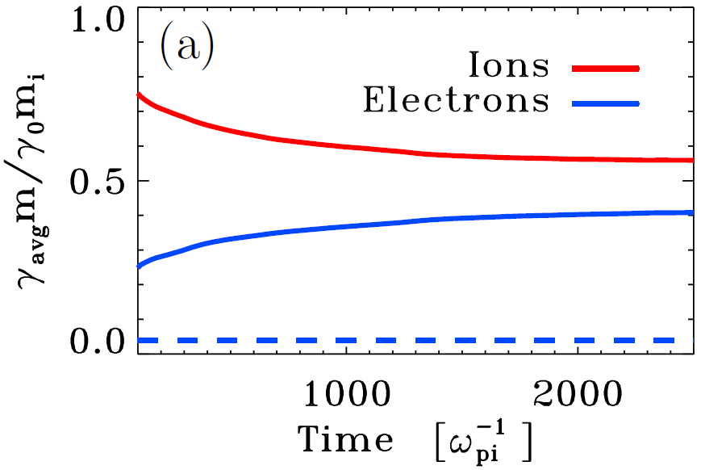
Electron DSA in relativistic shocks
Sironi et al. (2013) (2013ApJ...771...54S)
Electron acceleration much less
efficient than proton acceleration
Without energy transfer from ions,
GRB afterglow would be extremely
faint
PIC simulations (Sironi+ 2013,
Ardaneh+ 2015) show that this
transfer does occur
As much as 40% of bulk kinetic
energy deposited into electrons

Slide 15
Electron DSA in relativistic shocks
Warren et al. (2015) (2015MNRAS.452..431W)
Electron acceleration much less
efficient than proton acceleration
Without energy transfer from ions,
GRB afterglow would be extremely
faint
Even 15% transfer causes 1000x
increase in electron presence, but
minimal change to protons
Notes:
“Now, back to our results…”

Slide 16
Electron DSA in relativistic shocks
Ellison et al. (2013) (2013ApJ...776...46E)
For protons, not much difference
between unmodified DSA and
nonlinear DSA
Notes:
Point out that this is a repeat

Slide 17
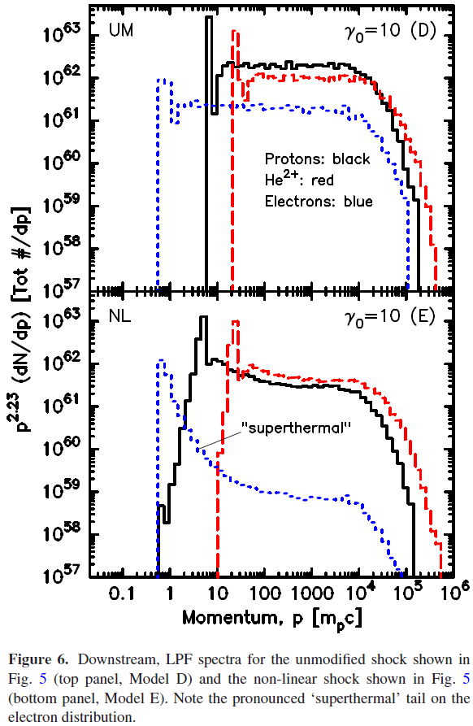
Electron DSA in relativistic shocks
Electron DSA in relativistic shocks
Warren et al. (2015) (2015MNRAS.452..431W)
For protons, not much difference
between unmodified DSA and
nonlinear DSA
For electrons, difference is stark
>100x fewer electron CRs at
highest energies
No clear power law in
NL electron spectrum
10% energy
transferred

Slide 18
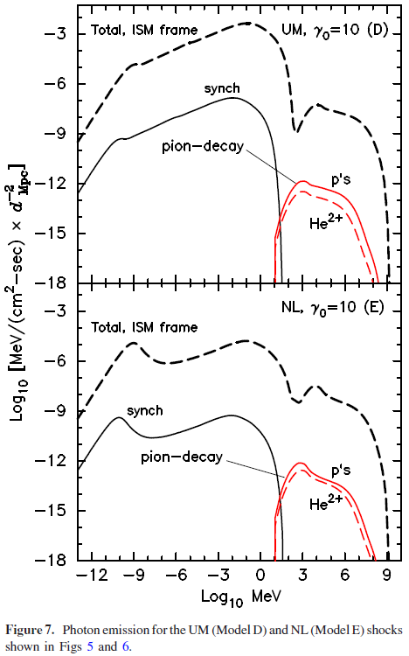
Electron DSA in relativistic shocks
Warren et al. (2015) (2015MNRAS.452..431W)
Difference in electron spectrum
visible in broadband photon spectrum
as well
Thermal peak in synchrotron (from
non-CR electrons) strongly enhanced
in nonlinear model
Early bump in radio/microwave may
reflect shape of thermal peak & offer
insight into microphysics of shock

Slide 19
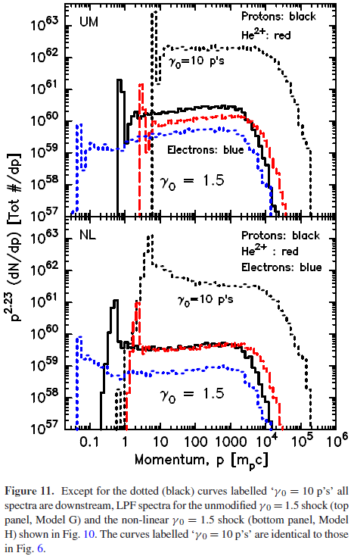
Electron DSA in relativistic shocks
Warren et al. (2015) (2015MNRAS.452..431W)
Electron DSA in trans-rel shocks
more uncertain
Thermal peak less pronounced; due
to shock profile at lower speeds
Weibel instability shuts off around
γ₀ ≈ 10, so less/no energy transfer?
Need PIC simulations to confirm
wave-particle interactions & guide
Monte Carlo model

Slide 20
Electron DSA in relativistic shocks
Warren et al. (2015) (2015MNRAS.452..431W)
Curran et al. (2010) (2010ApJ...716L.135C)
Ryan et al. (2015) (2015ApJ...806...15Z)

Slide 21
Conclusions
If CR acceleration by relativistic shocks efficient, must consider nonlinear interaction between shock & CRs
Shape of electron spectrum strongly affected by energy transfer & shock speed
Broadband spectrum may probe details of thermal electron population, injection into acceleration process
Single-value models of GRB afterglows highly likely to be deficient. Combining entire afterglow into one p, ε_{B}, ε_{e}, etc. misses a great deal of structure

Slide 22
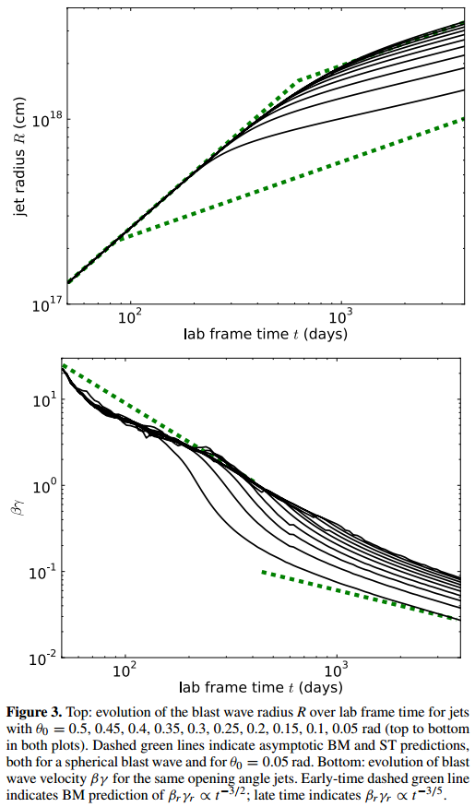
CR acceleration in GRB afterglows
Shock speed, size vary over orders of
magnitude as afterglow ages
Expect dramatically different shocks
& environments, which in turn affects
DSA
R (cm)
γβ
van Eerten et al. (2015) (2012ApJ...749...44V)

